Slide 1
Opening Sli.do
Please go to https://wall.sli.do/
Enter code: 1928455
Which of the following types of case finding are you currently doing in your practice?

Slide 2
Hypertension Case Finding
Tuesday 26th April 2023
13:00 – 14:00

Slide 3

Agenda: Hypertension case finding
Agenda Item | Speaker | Time
Context and background | Dr Neville Purssell, Co-Chair, NWL Cardiovascular Clinical Reference Group | 5 mins
Harness Case Study | Dr Subash Jayakumar, Clinical Director Harness South PCN, GP Partner The Stonebridge Practice | 15 mins
Neo Health Case Study | Dr Yasmin Razak, Clinical Director Neo Health PCN, GP Partner The Golborne Medical Centre | 15 mins
Panel Q&A | Above speakers are joined by Dr Neville Purssell for Q&A | 15 mins
Next Steps | Dr Neville Purssell to wrap up session The Big Case Find on World Hypertension Day – ICHP Feedback survey - ICHP | 10 mins
Housekeeping:
      Please use raise hand function on teams, to raise questions
      Questions? Enter into the chat, or, during our Q&A section at 13:35 use ‘raise hand’ function
      Please note we will be recording this meeting

Slide 4
NWL CVD and hypertension
Context & Background
Dr. Neville Purssell
Notes:
Add a slide for PCN guidance – DES 23/24 – this are things you will be working on

Slide 5
CVD and hypertension are local and national priorities
The NHS Long Term Plan identifies cardiovascular disease (CVD) as a clinical priority and the single biggest condition where lives can be saved by the NHS over the next 10 years
The plan includes a major ambition to prevent 150,000 strokes, heart attacks and dementia cases by improving the detection and treatment of the high-risk conditions of AF, hypertension (high BP) and high cholesterol
In line with this, the NWL CVD programme has outlined key ambitions for CVD in 2023/24
In hypertension, these ambitions are:
  Detect 80% of the expected population with hypertension (WSIC Dashboard to monitor recorded prevalence of Blood Pressure (BP) (prevalence gap of c.83,000 patients in NWL))
  Ensure 80% of patients with hypertension last blood pressure reading BP readings are to target (WSIC dashboard to monitor BP readings for 80yrs >140/90)
  [New interim target from NHSE operating guidance] Ensure 77% of patients with hypertension treated to target by March 2024

Slide 6
Improving BP optimization can save lives by preventing heart attacks and strokes

Slide 7
~30% of hypertension cases in NWL are undetected, at risk of complications
Approximately 30% of total HT cases in NWL are potentially undiagnosed, at risk of complication
Potential to gain 6-7 healthy life years from controlling BP in those with hypertension³
HT Cases
Population registered with GP and Diagnosed HT cased derived from WISC Database
Expected HT cases derived from expected prevalence in PHE 2017 model
Care Management to Reduce Disparities and Control Hypertension in Primary Care (2018)

Slide 8
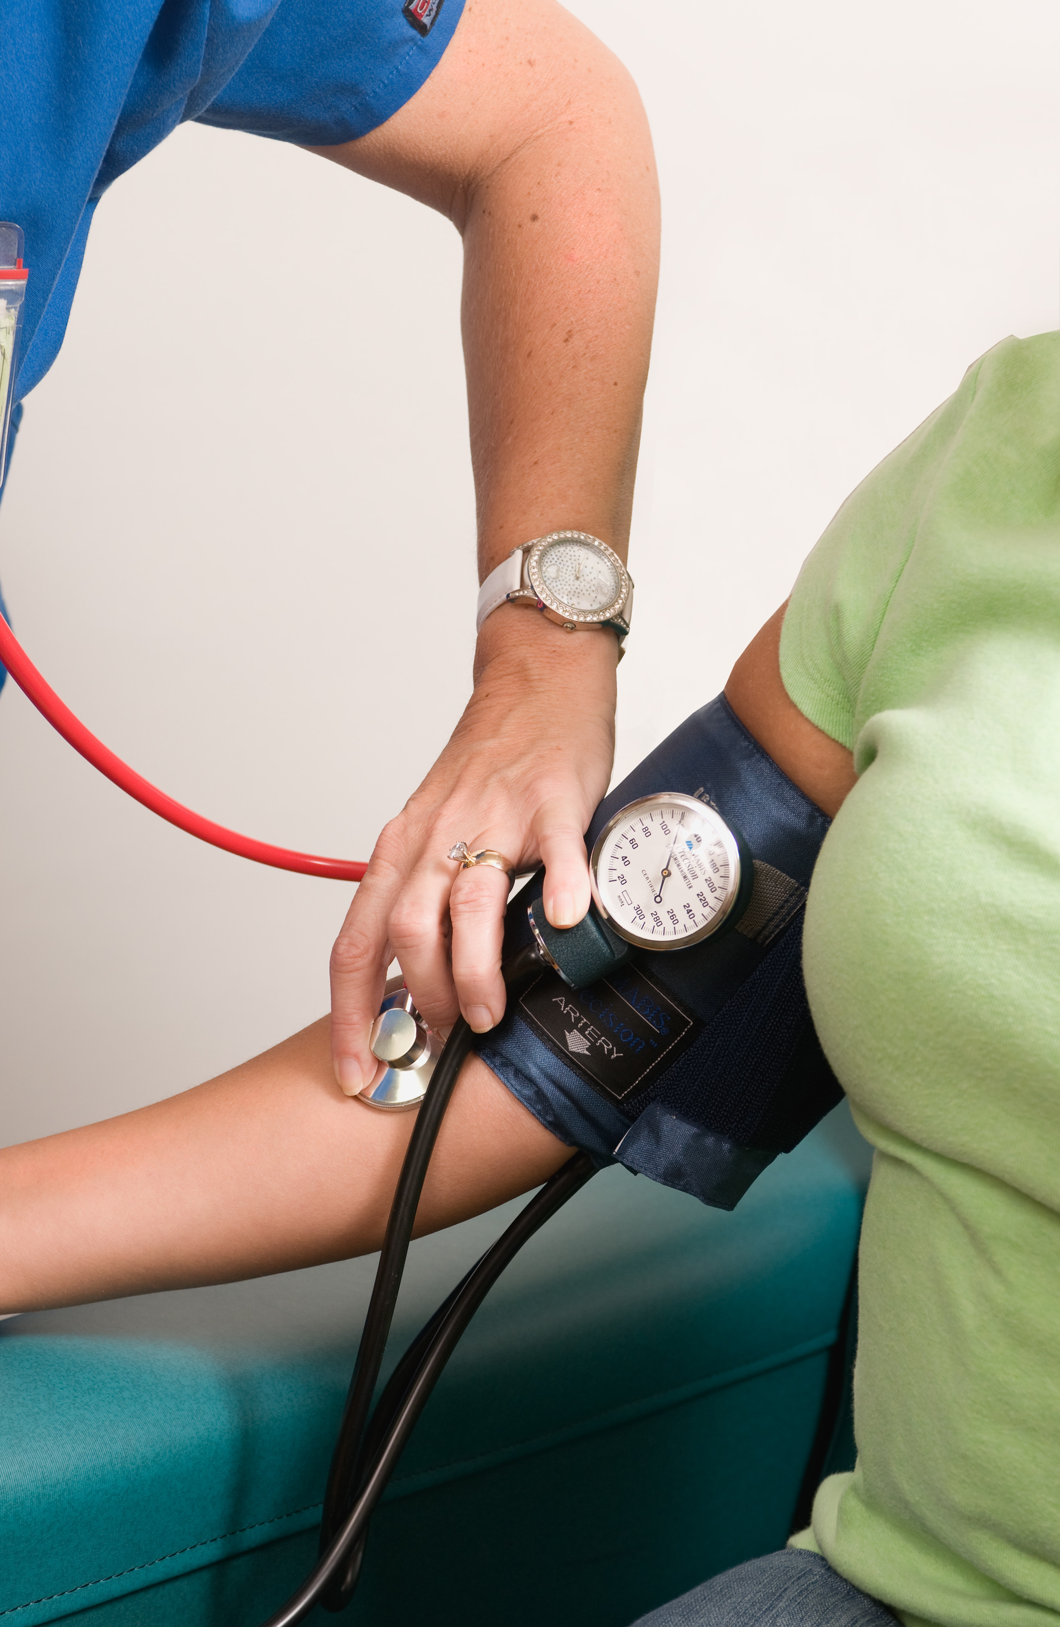
Why case finding matters
The term case finding is used in different ways:
To denote finding new cases of hypertension (previously undiagnosed), e.g. through hosting BP checks in the community
To denote finding existing patients with known raised blood pressures which are uncoded as hypertensives

Slide 9
23/24 Hypertension case finding primary care incentives
QOF Incentives
  BP002. The percentage of patients aged 45 or over who have a record of blood pressure in the preceding 5 years (Value: 15 QOF points; Thresholds: 50-90%)
  HYP001. The contractor establishes and maintains a register of patients with established hypertension (Value: 6 QOF points)
  HYP008. The percentage of patients aged 79 years or under with hypertension in whom the last blood pressure reading (measured in the preceding 12 months) is 140/90 mmHg or less (or equivalent home blood pressure reading) (Value: 14 QOF points; Thresholds: 40-77%)
  HYP009. The percentage of patients aged 80 years or over, with hypertension, in whom the last blood pressure reading (measured in the preceding 12 months) is 150/90 mmHg or less, (or equivalent home blood pressure reading) (Value: 5 QOF points; Thresholds: 40-80%)
  IIF
    No Specific Hypertension Indicators Listed
Notes:
Changes to the QoF Hypertension is the new inclusion of equivalent home blood pressure reading

Slide 10
23/24 Hypertension case finding primary care incentives
  PCN DES 23/24 lists that a PCN must
  Improve diagnosis of patients with hypertension, in line with NICE guideline NG136 by ensuring appropriate follow-up activity is undertaken to confirm or exclude a hypertension diagnosis where a blood pressure of ≥140/90mmHg in a GP practice, or ≥135/85 in a community setting, is recorded. This will include proactive review of historic patient records, to identify patients who have had a previous elevated blood pressure reading but have not had an appropriate diagnostic follow up; and
  Undertake activity to improve coverage of blood pressure checks, by:
    increasing opportunistic blood pressure testing where patients do not have a recently recorded reading;
    undertaking blood pressure testing at suitable outreach venues, agreeing the approach with local partners and targeting need as informed by local data on health inequalities and potentially at-risk groups
    working pro-actively with community pharmacies to improve access to blood pressure checks, in line with the Community Pharmacy Blood Pressure Check Service
Notes:
Changes to the QoF Hypertension is the new inclusion of equivalent home blood pressure reading

Slide 11
Harness Case Study
Dr Subash Jayakumar
Clinical Director Harness PCN
GP Partner The Stonebridge Practice
Suraj Shah, Radhika Sanghani & Nitesh Kerai
Senior PCN Clinical Pharmacists
Harness PCN

Slide 12
Background/Context
Hypertension: NHS cost £2.1bn annually with wide-ranging CVD / non-CVD complications; a significant asymptomatic and undiagnosed population
Primary Care: Multiple face-to-face appointments are needed to safely titrate patient's BP to achieve target; accounts for ~12% of all GP appointments
National Priority: QOF; IIF; CORE20PLUS5 (Reducing Health Inequalities)
Local Population: Harness (PCN North and PCN South, Brent, NWL): 18,151 patients QOF Hypertension Register 2022/23
Harness South: 2 of top 10 most deprived London zones: Harlesden & Stonebridge
Focus: Case Finding (Prevalence) and Optimisation (Target BP improvement)
1. Public Health England, Health matters: combating high blood pressure, (2017)
2. Public Health England: New opportunities to tackle high blood pressure in London (2015)
3. Data.London.gov.uk
Notes:
Points to discuss/what we wanted to achieve:
Hypertension cost to NHS, over 50% of all strokes are associated with high BP
Harness PCN (~150,000 patients across 20 practices) split into North and South, 10 in each
need for an evidence based solution to help improve patient care
reduce number of F2F appointments to increase capacity
implementing a population approach to streamline practice workflow in managing hypertension
PCN wide model to manage hypertension patients

Slide 13
What we did
March 2021: Harness PCNs agreed to pilot an evidence-based digital health platform, Hypertension Plus, design shaped by the TASMIN studies to manage hypertensive patients remotely
The OMRON digital health platform was used – a global leader in BP monitors
Practices: 10 practices initially involved in the rollout across the PCNs
Staff involved: GP’s; pharmacists; pharmacy technicians; nurses; HCA’s; social prescribing link workers; PCN administrative staff; practice administrators
Patients initially onboarded, risk stratified and managed via practice teams and Clinical Pharmacists
Notes:
Porf Richard McManus proved the clinical value of telemonitoring and self-titration for hypertensive patients via TASMIN which shaped the design of hypertension plus
Less input needed from GP’s
patients who are well managed do not trigger alerts and no further involvement is needed
Wanted to measure the impact of the model in terms of patients onboarded and number of patients moved from uncontrolled blood pressures to controlled
Appropriate training was provided to all staff on how to use the OMRON dashboard, patients were onboarded, treatment plans were created based on current treatment on EMIS (discuss allergies, ADRs, current co-morbidities such as CKD/diabetes). Alerts managed and actioned (traffic light system)
Skillset was mapped – higher risk patients managed first. Management was initially done at a practice level but moved towards a PCN approach.

Slide 14
ONBOARDED - Patients onboarded (Harness PCN Administrative team) and educated via app
CASE FINDING - Group 1 - Patients on Hypertension register. Group 2 - patients not on Hypertension register with elevated BP (clinic BP >140/90 or home BP >135/85) in the last two years (UCLP Risk Stratification searches)
MANAGEMENT – with optimisation remotely (PCN Clinical Pharmacists) utilising an online dashboard
RISK STRATIFICATION (Traffic light system) - Based on BP readings submitted during 7 day reading week
CONTACT - (AccuRx) SMS invitations sent to patients by member practices to register for OMRON Hypertension Plus app
COHORT – UCLP search used to identify "Digitally Engaged" patients, data from searches collated by via eMIS (Harness PCN Administrative team)
What we did: Case finding
Notes:
Case finding – Hypertensive patients controlled and uncontrolled onboarded and patients not on hypertension register with elevated BP in last two years
Digitally engaged – based on number of e-consultation submitted in last 12 months
Risk stratification – this was formulated based on BP readings submitted by patients during a reading week –2 readings a day for 4-10 days depending on readings, these were then identified and managed via alerts on the online dashboard.
Management – approval to next treatment step, generating of prescription etc.

Slide 15
Outcomes
Over the last 12 months:
  9% of all hypertensive patients from the signed-up surgeries were registered for Hypertension Plus, the current NWL target is 20%.
  58% of all patients enrolled are active on the platform, our aim is to increase engagement to >90%.
  -10.13 mmHg average systolic BP reduction in 16 months for patients enrolled on the platform*
  - 7.71 mmHg average diastolic BP reduction in 16 months for patients enrolled on the platform*
Patient Satisfaction - On a scale of 1-10 (1 being absolutely-not and 10 being definitely), we asked users if they would recommend Hypertension Plus to other patients with hypertension? n=25 gave an average score of 9.61 for recommending Hypertension Plus.
* - Taken from patients at the start
Notes:
Piloting new technology
Impact on staff

Slide 16
Challenges
Case finding
  Identifying "digitally engaged" patients, data extracted based on patient's use of practice technology such as online consultations, AccuRx and triaging platforms
  On boarding of clinically appropriate patients, for example not appropriate for complex HF patients
App Use and Digital Platform
  Intergration into EMIS
  Updating of drug formulary in line with NICE /BNF guidelines
Patient
  Challenges with patient demographics: language, education, lack of access to technology and BP machines
  App usability and navigation
  On-boarding, ongoing training and support for the use of the app
  Agreeing and approval of treatment plans
Practice/PCN
  Training and familiarity of existing staff and new staff joiners
  Accountability and management of alerts
  Workload prioritisation and "target overload"
Notes:
Case finding – difficult to identify this cohort in an area where there is high deprivation in the South and patients do not like using e-consults etc.
App – integrating into EMIS not seamless, you still have to tick intolerances and co-morbidities like HF, frailty, established CVD, issues with drug formulary on the platform – drugs like Losartan/HCZ missing from platform. Patients come with multiple conditions or develop other conditions with hypertension
Service user/HCP – training of staff, onboarding of staff onto platform, managing of alerts and who was accountable for this, issues when locum staff unfamiliar with the platform would make changes, having to update platform once changes are made on EMIS, engaging/training users who were not digitally engaged
Patient – confusion with downloading app, training on how to use the app, agreeing and approving treatment plans, engagement with submitting BP readings, challenges with patient demographics where not all have access to internet services and smartphones.
Biggest challenges – patients not having access to BP machines – some happy to buy, but in south high deprivation some practices loaning machines out.
Practice/PCN
Alert management – lots of alerts popping up, reading week missed, BP out of limits (high/low), blood test/urine test review, patient has not confirmed next medication step
Work prioritisation, risk prioritisation of patients, target focused overload
Overcame these by
App – fedback to Omron and worked with the developers, created a log for issues, process map for new starters to follow, integration into EMIS supported by IT
Service user – time to attend training, discussion with Omron on provision of training, on demand training videos, dedicated leads at each practice, appropriately assigned roles to manage alerts and risk stratify patients,
Patient – user friendly app, customer service support team for patients, dedicated staff member at practice for queries
Biggest challenges – BP machines loaned out to patients either via practice or via BP@HOME, understanding use of cuff, smaller cuffs often provided
Management of alerts – close communication and feedback to OMRON team – able to implement filters to help clinicians risk prioritise work to be actioned

Slide 17
Practical tips
Capacity assessment – is there sufficient workforce at practice/PCN level to implement a roll out and maintain this?
Pilot your initial roll out with a small cohort of patients and practices
Ensure all staff members (clinical and non-clinical) are aware of their respective roles and responsibilities and utilise bespoke training sessions
Utilise Social Prescribers to support the non-engaged patients
Utilise the Hypertension Plus query log to feedback teething issues
Implement a workflow process and ensure all staff read the SOP’s
Promote the platform via your practice website, AccuRx SMS and target engagement at your Patient Participation Groups
Nominate a lead at a Practice/PCN level and ensure regular meetings to discuss important cases/collaborate/discuss solutions to any issues identified
Review data periodically with the Hypertension Plus team
Notes:
Keep it as simple as possible
Roll out to patients for monitoring only first, currently managing patients this way
Ensure staff aware of H+ app functionality – lots of duplication and miscommunication based on patients writing down readings and submitting to practice but then not being registered via app. Cases where on H+ app patients showing as recommendation for next step, however already done via eMIS just not updated on app.
Utilise social prescribers – to support non-engaged patients – some patients referred to computer courses

Slide 18

NeoHealth Case Study
Dr Yasmin Razak
Clinical Lead NeoHealth PCN, GP Trainer Imperial, RIPEN Training Hub Lead, West London
GP Partner West10 GPs - Golborne
Notes:
My background in system leadership, technology & longitudinal LTC management with secondary care and community, having worked in Diabetes, COPD & Asthma, and GP Trainer / Training Hub lead. As CD, set up a distributed leadership model to develop the PCN, with my main area post covid recovery being eHUB, and clinical lead area Hypertension. Why I have been asked to speak today : outcomes

Slide 19
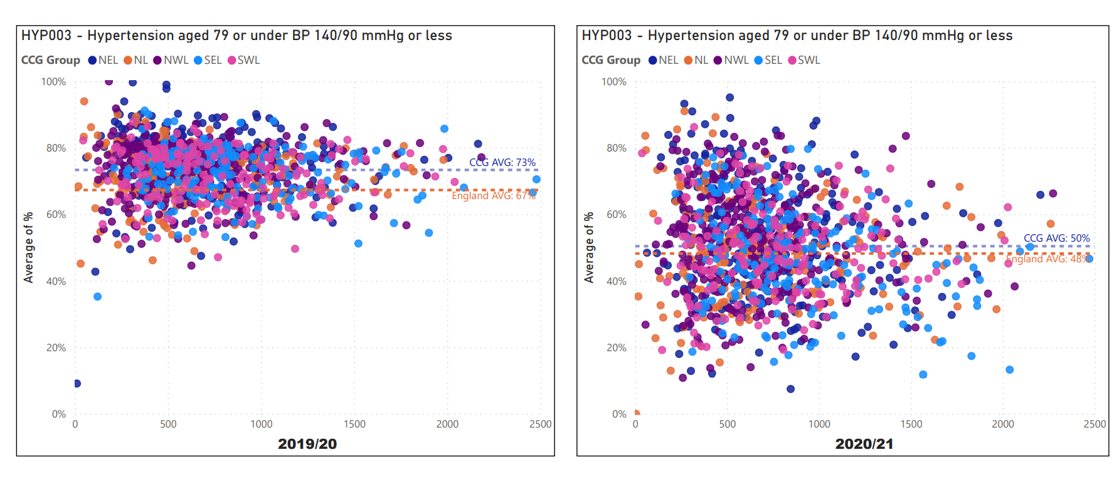
Background
Q: Patients forgetting to take BP meds - is there anything that we can do?
A: Adherence may be better during this time. Ensuring they are ordering and giving online access important. Remote monitoring of blood pressures very helpful
Worked with Dr Neil Chapman on updated hypertension guidelines
“Hypertension in Lockdown”
2DO2DAY – online access for patients starting with hypertension
WSIC Data set – high prevalence of Hypertension within PCN (deprivation related) plus need to case find (core 20 plus 5)
Noticing increasing number of CVAs
Notes:
Hold on ABPM, hold on initiating ACEs. Core 20 plus 5

Slide 20
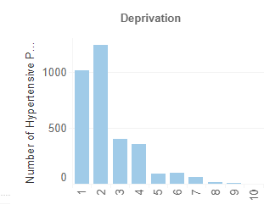
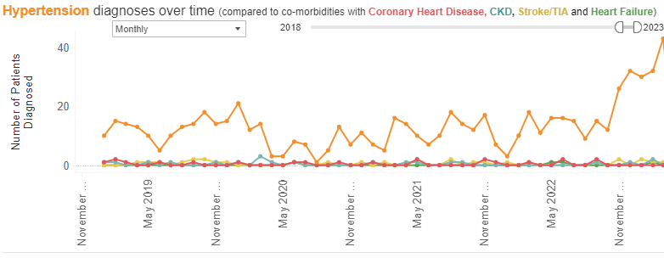
Outcomes
More patients getting their BP checked
Highest increase in point prevalence for Hypertension in Borough
Very high clinical outcomes with optimised BPs to match
Notes:
Highest deprivation but highest patient satifsation due to engagement activities.

Slide 21
Neohealth PCN Plan: Better Blood Pressure
Identify recall list – UCLP searches, Diabetic off target, Amlodipine without Dx
Get Accurate BPs – BP@Home, Omron, Accurx, Pharmacy & Walk-in.
Get these to Target – workflow & extra staffing to Monitor
Expert prompt MDT for decisions for tricky cases within eHub, incl ABPMs
Community Outreach to case find and address under-served parts of our population
Data & IT
Notes:
Much reduced opportunistic testing. Target – improve on pre-pandemic baseline and increase prevalence. Underpinned by IT.

Slide 22
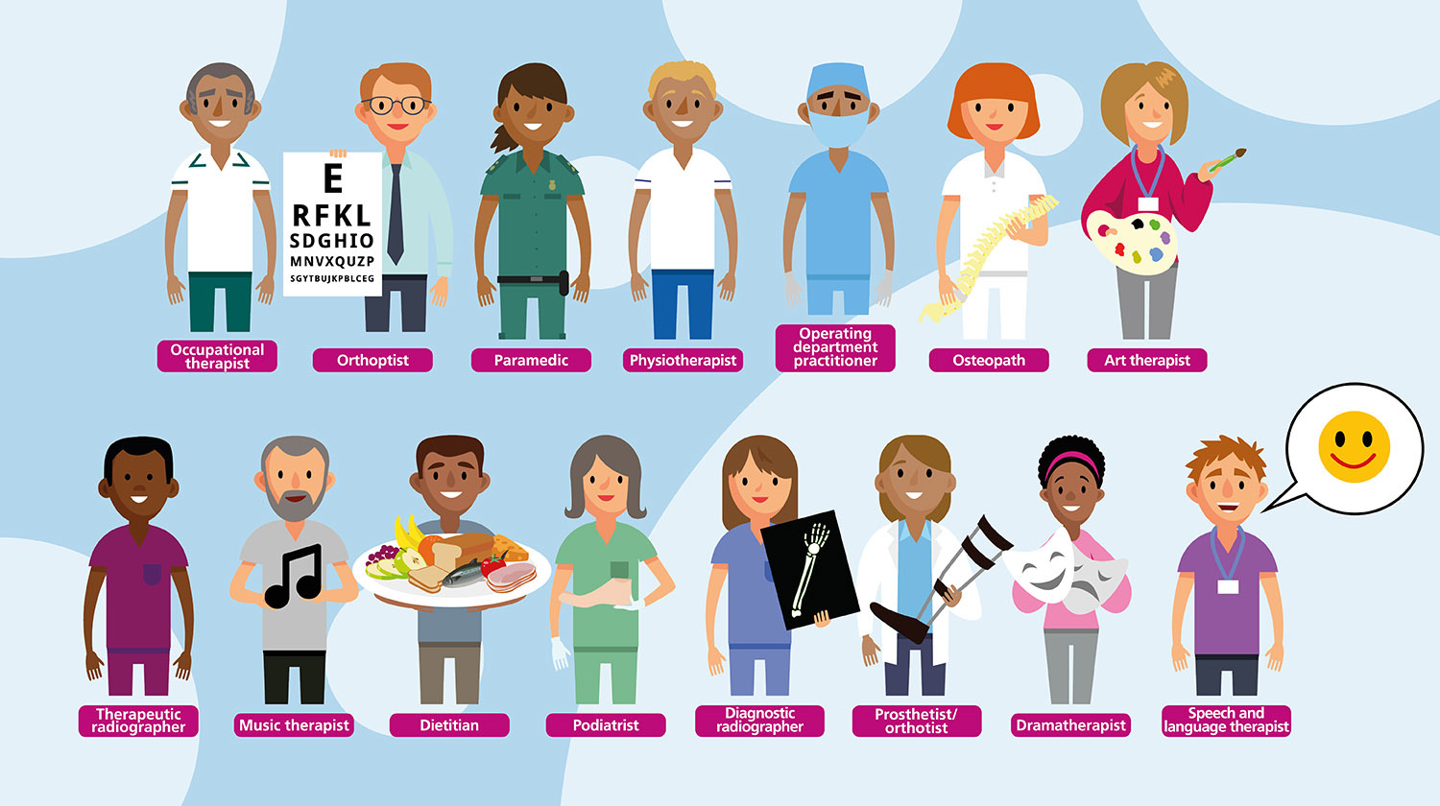


Slide 23
PCN Level MDT Team – Weekly Wardround
Neil Chapman – Consultant Expert
GP Clinical Lead – run MDT & integrate with PCN
Clinical Pharmacists – routine & complex prescribing
Cardiology PA – good at motivation, follow up and education
Care Co-ordinator – key to obtaining BPs and booking patients, plug in with coaches & HCAs
IT support and FY2
Integrated, trained & supervised, sharing IT, clear leads, regular meetings, learning notes library
Notes:
Hanae, Arhtur, Mo, Paul Carnduff, Xavier, Emma Smith, CC Hannah Kamilla. Lee Student, Beth

Slide 24

UCLP Searches - High Blood Pressure Stratification and Management
PRIORITY ONE:
Clinic BP ≥ 180/120mmHg
PRIORITY TWO:
Clinic BP ≥ 160/100mmHg (2a)
Clinic BP ≥ 140/90mmHg if BAME & relevant co-morbidity/risk factor* (2b)
No BP reading in 18 months (2c)
PRIORITY THREE:
Clinic BP ≥ 140/90mmHg
PRIORITY FOUR:
Under 80 years
Clinic BP < 140/90mmHg
80 years and over
Clinic BP < 150/90mmHg
Ask patient for up-to-date home BP if available: adjust priority group if needed (as above)
Review by Prescribing Clinician
Review by HCA or other staff role
Monitor
Investigations, as needed: Renal, lipids, ACR, ECG
If no pre-existing CVD - assess QRisk score and consider lipid lowering therapy if >10% and not on statin
Review medication:
Identify and address adherence issues – refer to practice pharmacist if additional support required
Optimise medications, in line with NICE guidance (see slide 8)
Seek specialist advise
If BP uncontrolled on four antihypertensives and no adherence issues identified
Multiple drug intolerances
Hypertension in young person requiring investigation of secondary causes
Advise
When to check BP and submit readings (e.g, monthly until controlled, then every 3 months)
When to seek help based on BP readings
Book follow up and code
Self management and behaviour change support
Check BP taking technique
Share resources to help understanding of high blood pressure, CVD risk and treatment
CVD prevention brief interventions – diet / exercise / smoking / weight / alcohol
Signpost tools and resources
Medication:
Check if any issues / concerns regarding medicines – refer to practice pharmacist for meds review / adherence support, if needed
Confirm supply / delivery
Advise
When to submit BP readings (e.g. every 3 months)
When to seek help based on BP readings
Referral
Refer to GP if any red flags identified
If QRIsk > 10% and no statin – refer to prescribing clinician
Recall and code
Review by HCA or other staff role
Support for self management and behaviour change
Check BP taking technique
Check if existing CVD or QRisk >10% and not on statin (refer to prescribing clinician)
Share resources to help understanding of high blood pressure, CVD risk and treatment
CVD prevention brief interventions – diet / exercise / smoking / weight / alcohol
Signpost tools and resources
Notes:
Batch Report with clear actions

Slide 25
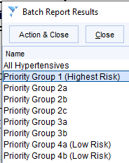
Workflow it!
Notes:
WORKFLOW

Slide 26
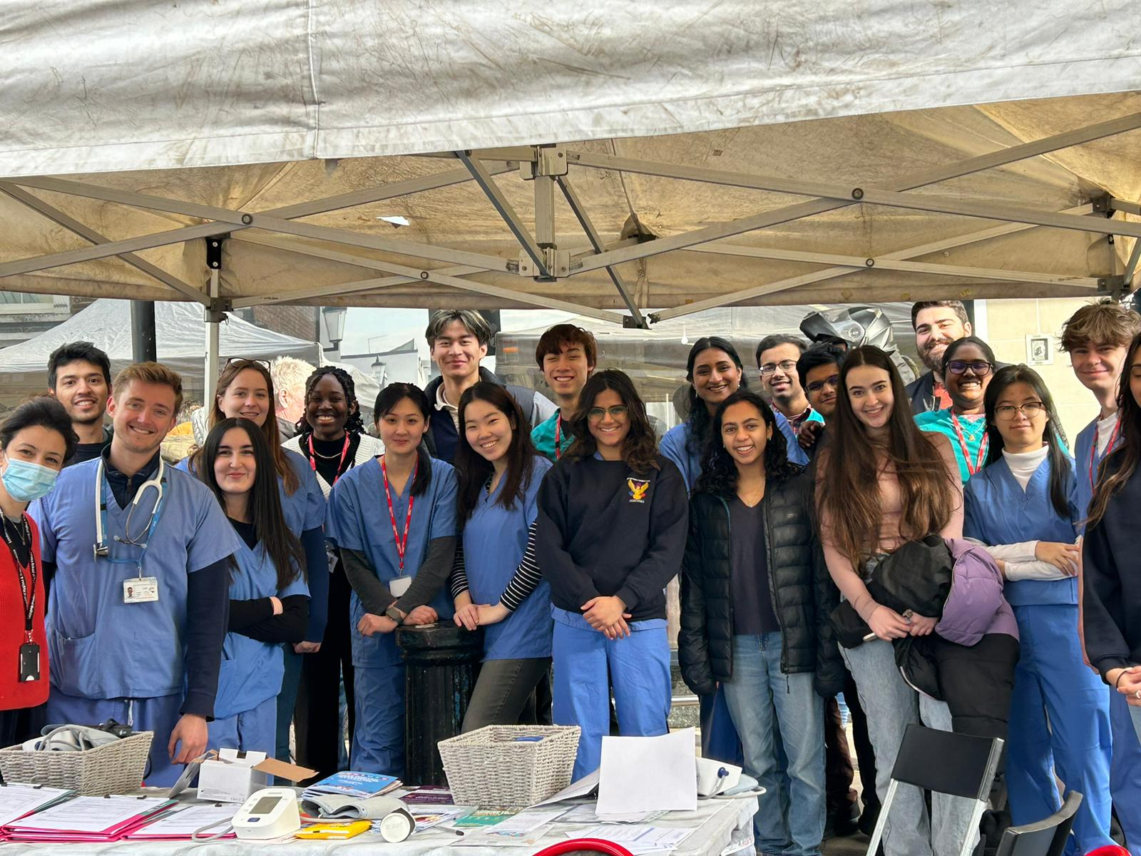
Harnessing Community & Collaborative Energy!
Community Champions & Health Workers
One You Health Coaches
PCN Social Prescribers
Imperial Medical Students
GP Registrars
High Street Community Pharmacists
ICHP
Public Health doctors
Mental health counsellors

Slide 27
Video – BP @ PortoBello
37.7% of those screened had a raised BP (> 140/90)
60% stage I, 37.8% stage 2, 0.2% stage 3
1/3 were pre-existing diagnoses off target
Notes:
New high bp
Known high bp off target

Slide 28
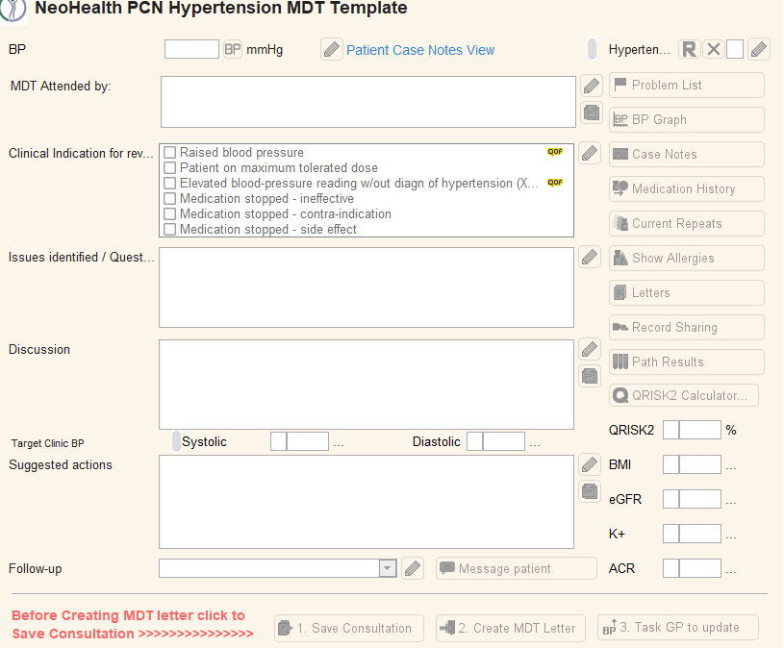
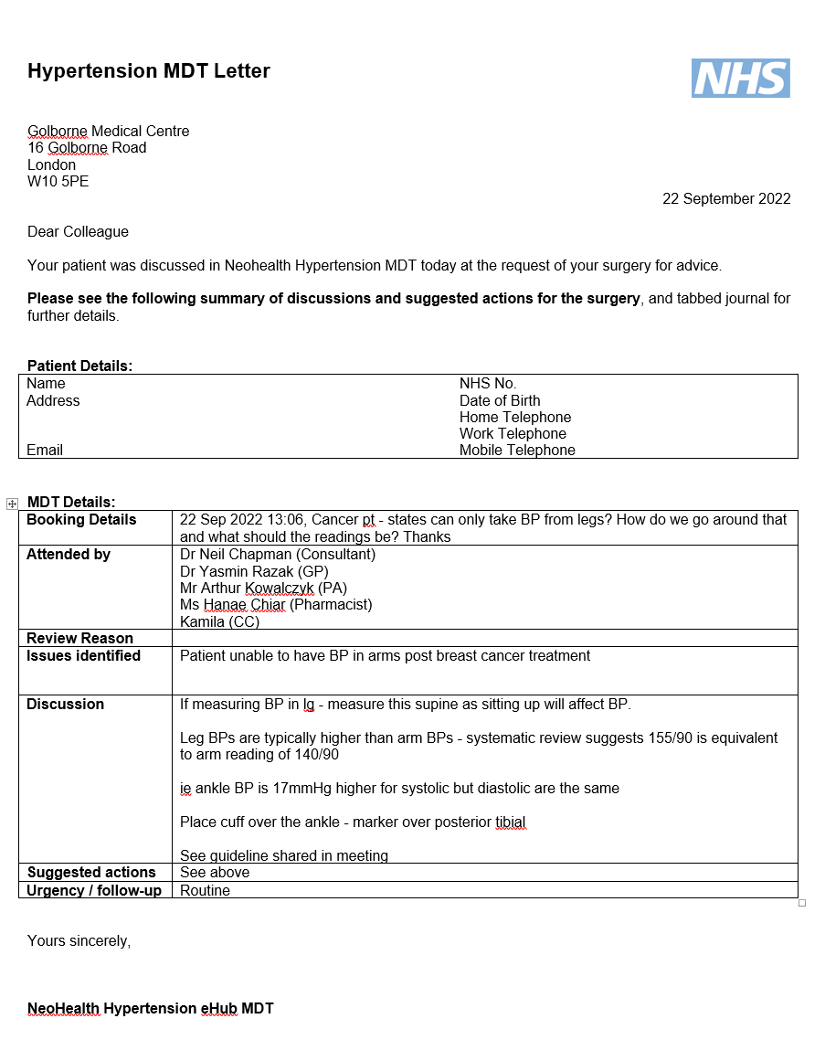
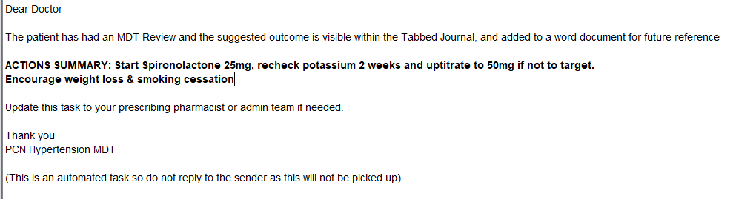

Slide 29
MDT content
Clinical Supervision for PA / Pharmacist
Correct diagnoses
Up / Down titrating eg 3 agents no improvement
Meds rationalisation
Drugs with extra therapeutic benefit e.g. RAAS blockade
Quick specialist opinion (avoiding referral)
Upskilling of primary care clinical staff
Notes:
HEALTH ANXIETY DRIVEN PRESENTATIONS

Slide 30
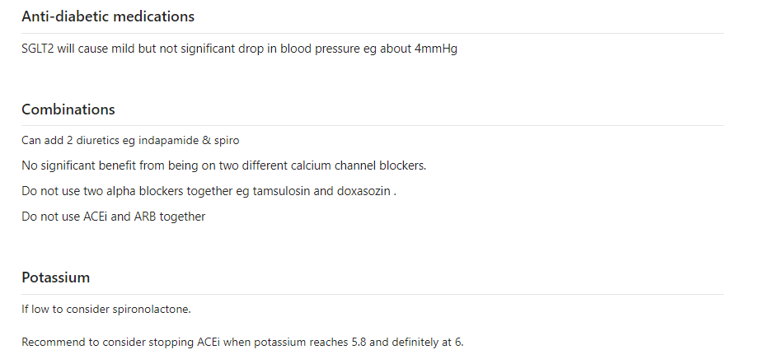
Learning Notes

Slide 31
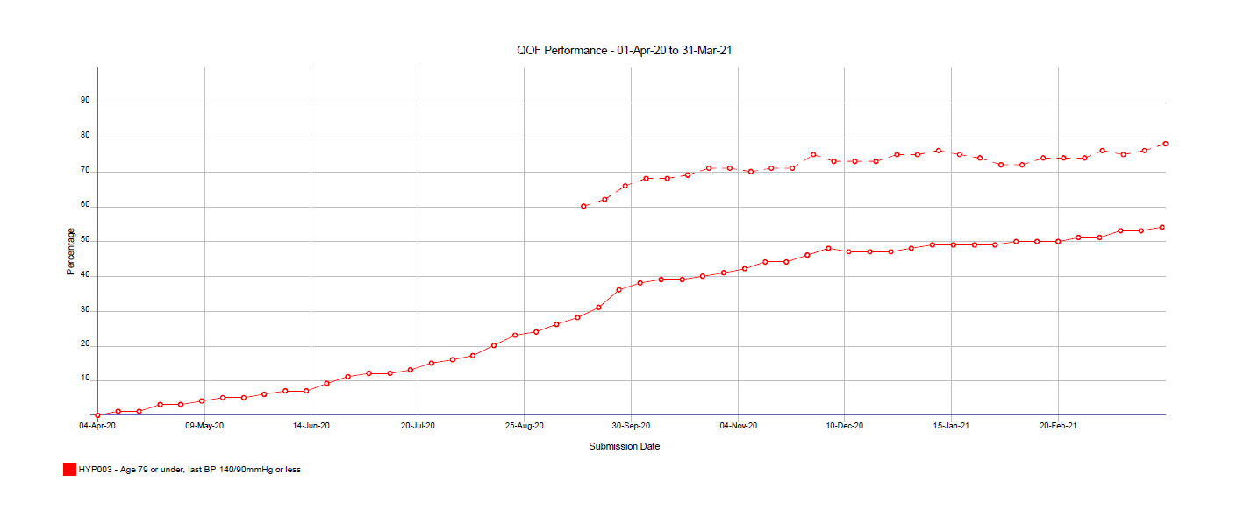
QOF Performance 20/21

Slide 32
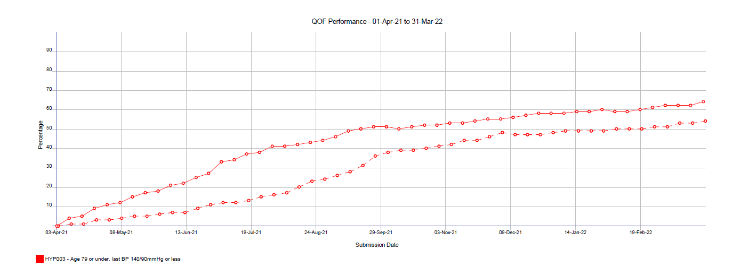
QOF Performance 22/22

Slide 33
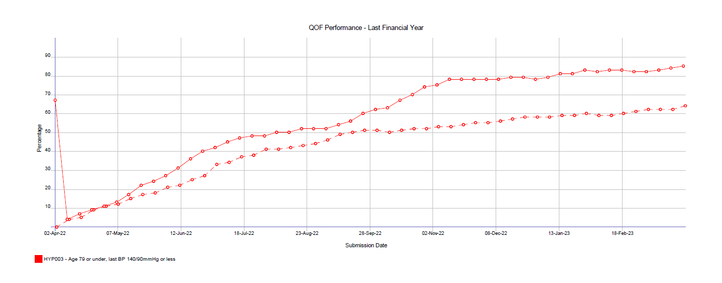
QOF Performance 22/23

Slide 34
Outcomes
Primary Care Network
  Highest increase in prevalence in borough, hitting target earlier (2937 to 3386)
  Achieved all required CVD IIF markers, including follow up of raised BPs
  2 surgeries clinical target outcomes extremely high (1st & 3rd in borough), all surgeries showed recovery and improved on baseline
  Hypertension trained Primary Care Clinicians
  eHub infrastructure set up for ongoing PCN collaboration
Locality
  Relationships with community pharmacy
  Energised community & sharing of assets.
Practice Level - Highest recall of established high BP patients achieved across NWL, highest outcomes in borough
Potential to reduce OPD referrals

Slide 35
Challenges
 | System | Older Population | Inter practice variation
Challenge | Time, effort, organisation, act on results. IIF complicated Staffing | ⬆ fraility & housebound and reduced cognition, also travel for longer periods abroad. Technology not as helpful | BP coding & understanding that 140/90 is high (140-155 often accepted). Different processes & no mandate to redesign
How to overcome | Pan PCN approach. Clinical Leadership MDT Resource needed. IT to ease ICB Support. | Social care Loan monitors Identify key carers Memory reviews | Shared protocols & staff. Learning from best practice & sharing where can do better. Remove ghosts. Community Pharmacy in surgeries. Sharing Success. £KPIs
Notes:
Having NWL ICHP support was helpful

Slide 36
Practical tips
What would be the keys for success if other practices/PCNs are interested in doing this
Resource with a budget (ARRS)
Alignment with contractual targets eg diabetes / IIF
Share learning – learning notes, meetings
Clinical leadership & expertise
Clever use of IT (Brigid)
Bigger Picture

Slide 37
More information do get in touch!
@NeohealthPCN neohealth.pcn@nhs.net

Slide 38
Panel Q&A
Led by Dr. Neville Purssell

Slide 39
Next Steps
Dr. Neville Purssell &
Imperial College Health Partners

Slide 40

Marking World Hypertension Day
This May, we propose we come together as a NWL Primary Care system and focus on detection by:
1. Performing as many Blood Pressure checks as part of routine GP appointments as clinically appropriate
2. Offering Blood Pressure checks when people come into your Pharmacies
3. Encouraging Blood Pressure checks in your waiting rooms
Question: What do you need from us to support you to do this?
Notes:
For us to be successful in treating and managing CVD in our NWL population, as we have heard today we must first focus on detection.
We seek to use World Hypertension day (17 May) as an opportunity for us to all come together as a NWL sector, in the month of May, and find as many cases of hypertension amongst our population as possible: we are calling this collective effort, The Big NWL Case Find: Hypertension.
The ask of our Primary Care colleagues is from 02 May, to:
Conducting additional BP checks to as many patients attending routine appointments as clinically appropriate (over 35s, BMI >30, co-morbidities, maternity)
Use the WSIC data to compare your practice with peers, understand the potential gaps in prevalence within your communities, and searches on the IT system to identify uncoded patients with hypertension
(Where appropriate/able) Deliver additional BP check clinics at some point in May, either in surgery or in the community. ICHP will fund for 8 PCNS (one per Borough) to deliver this, and will be working with Borough leads to identify who needs to receive this support, prioritising based on the health inequality/deprivation perspective.
You will receive an email following this session that will tell you how to get involved, and where you can find more information and some promotional assets you may with to share with staff. But our question to you, is there anything else we could be doing to support for this to happen?
I believe coming together in this focussed way over the course of the month of May could be a potentially really powerful for us all to have a massive impact on the CVD health of our local population, reducing strokes and heart attacks, so please do support us and get involved with this initiative in May.

Slide 41
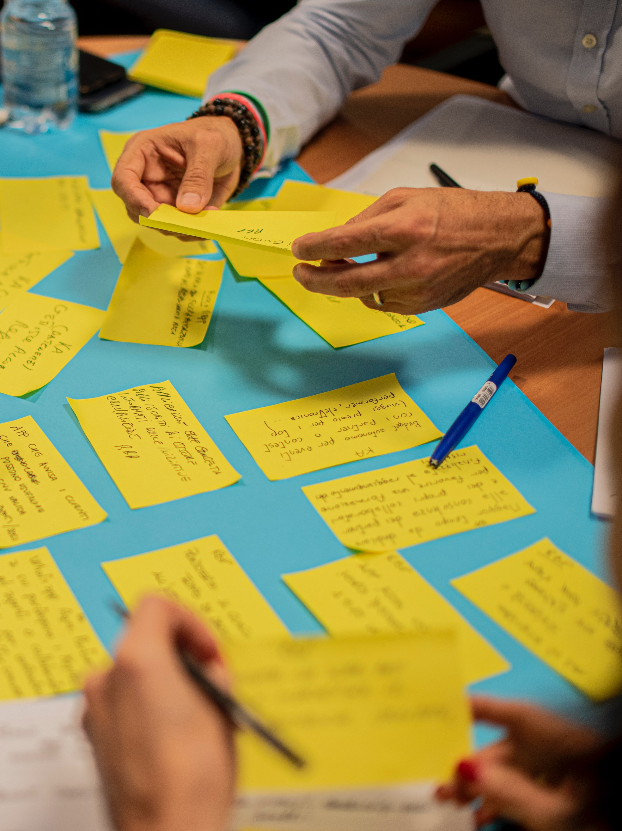
To get involved in ICHP’s CVD education series
Give us feedback on what topics you think we should cover in this format by answering our survey (link in the chat!)
For further information and/or to get involved with the ICHP CVD education series please contact
Larry.koyama@imperialcollegehealthpartners.com or catherine.caldwell@imperialcollegehealthpartners.com

