Slide 1
Call for innovation
ICHP and the NW London system is currently looking for innovations that have the potential to positively disrupt our patients’ journey.
Please read the patient story on the next page and provide some information about how your innovation could help our patient spend more days at home with her family

Slide 2
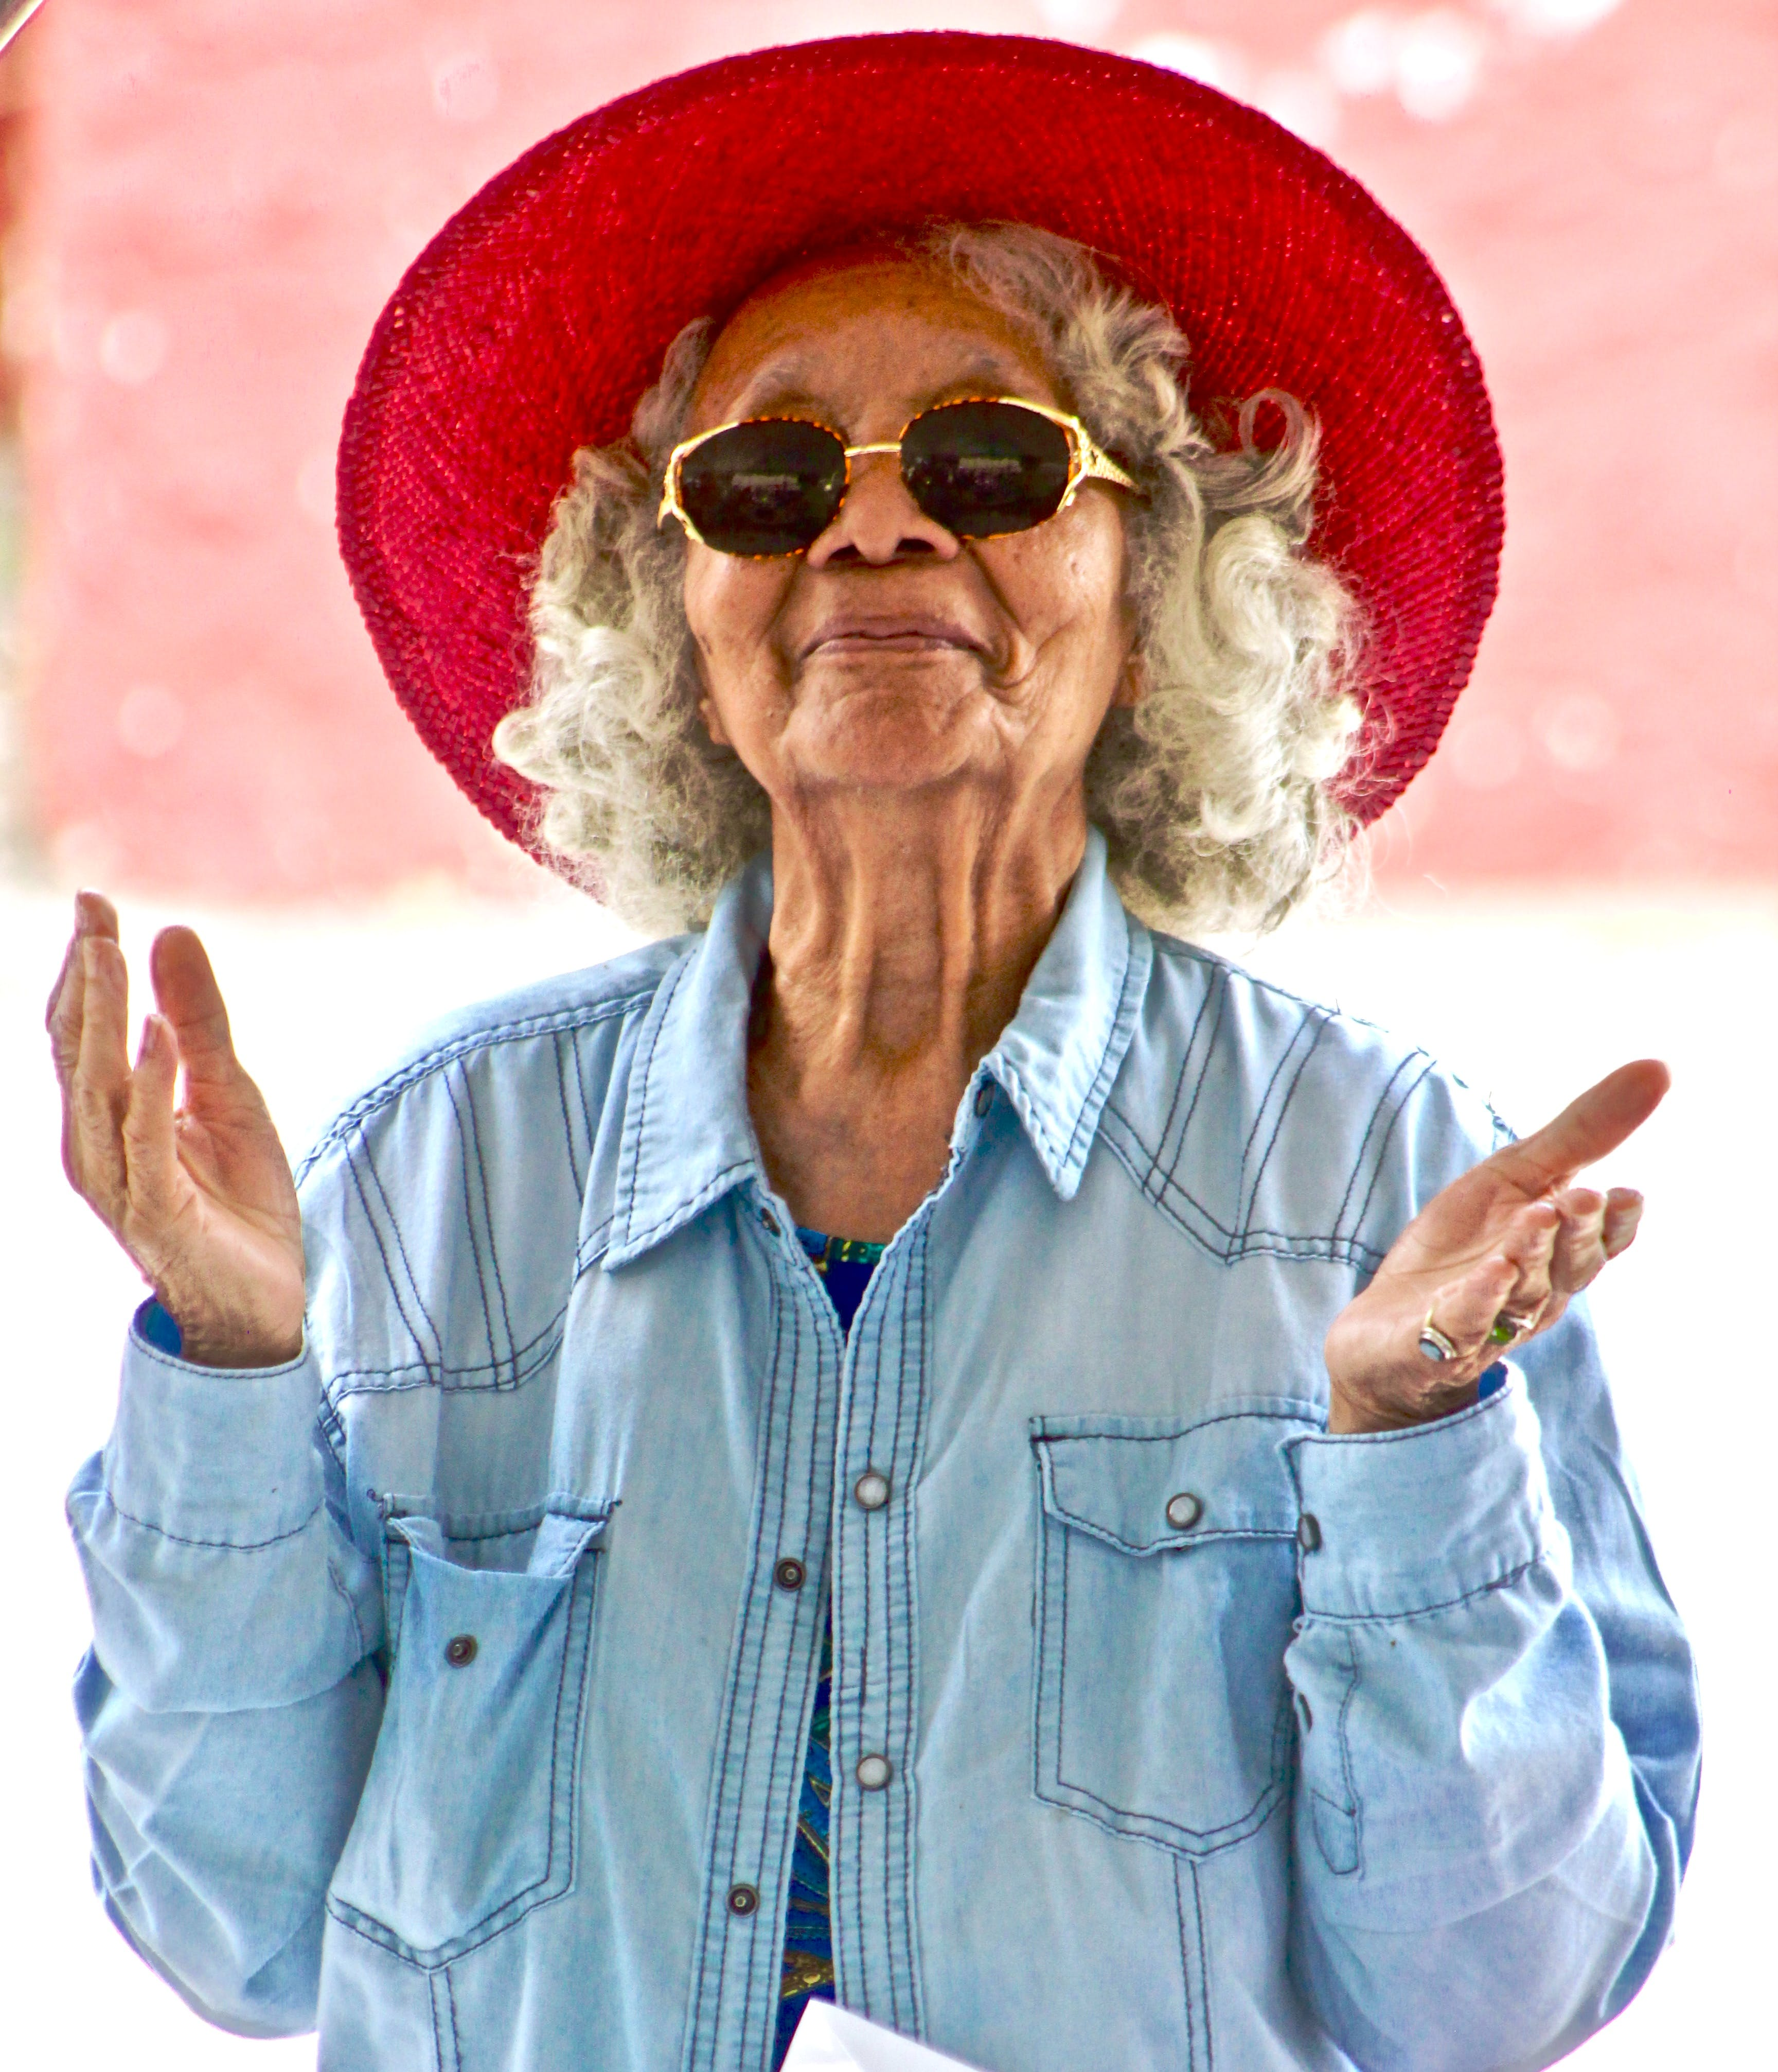
Meet Joshna
Joshna is an 84-year-old retired teacher living with her 85-year-old husband Amish in the family home they bought when they had their first child. Since retiring 20 years ago, Joshna had been active, going to the local market on Saturdays and playing bowls with her husband and friends every Sunday.
Joshna’s journey started when she began to find everyday tasks more difficult, and her walking was becoming slower. She had already had one fall but had not requested or received any support to prevent further falls.
On a Friday evening, while using the bathroom, Joshna felt dizzy and fell. Amish, Joshna’s husband, came to help her but couldn’t manage to get her back on her feet, and Joshna said her right hip hurt. He called 999 and when the paramedics arrived, they advised the couple that Joshna would need to go to A&E, even though she wasn’t keen and preferred to stay at home.
At 6.30pm that Friday evening, Joshna was in the hospital’s emergency department. Around 8pm, the on-call A&E consultant arranged for her to get a hip x-ray, which didn’t show any fracture. However, her blood and urine tests suggested she was mildly dehydrated and might have a urinary tract infection.
Joshna spent nearly six hours in the emergency department, then moved on to the acute medical unit where she was put on a drip and given antibiotics to treat her infection along with her usual medications.

Slide 3
Joshna’s journey continued
On Saturday morning, Joshna was seen by the on-call doctor for a medical review but before anyone had a chance to fully assess her mobility, needs and preferences, she was moved to the first available bed on a general medical ward. She spent the rest of the weekend worrying and waiting for further updates on what might happen to her. There was no routine physiotherapy or occupational therapy over the weekend, so she couldn’t be referred to the home rehabilitation team until Monday. Amish had been able to visit but there had been very little information over the weekend as to what would happen with Joshna, which left them both feeling vulnerable and not having any control of their situation.
By Monday morning, Joshna had been either on a trolley or in bed with the cot sides up for three days and nights, because she was deemed to be at high risk of falls, and a catheter had been inserted to monitor fluid output. By then, her muscles had started to get weaker, particularly in her legs. She was seen that morning by the physiotherapist who got her out of bed with the aid of a walking frame.
On Monday morning the ward doctors and occupational therapists decided to gather more information on Joshna’s medical history, usual abilities and needs. They asked for her GP records to be emailed in securely via NHSmail and talked to Amish who told them that Joshna had been getting more unsteady recently and that he often had to help her climb the stairs. She had suffered another fall and he also explained her memory wasn’t as good as it used to be. The ward team discovered that her blood pressure was dropping very low when she stood up; indicating that she had ‘postural hypotension’ which often leads to falls and faints in older people. They decided to stop a couple of her heart medications to see if it could help solve this problem. Then Joshna’s bed on the acute medical ward was needed for an acutely ill patient, so she was moved to an available bed on a surgical ward.
On Wednesday, five days after her admission, Joshna was able to stand with assistance and walk short distances. The physiotherapists came to see her and made a plan to refer her for ongoing rehabilitation in the local community hospital, as the next step on her journey to getting back home. The referral involved filling out and securely emailing several forms to their referral ‘hub’ but there were no beds available in the community hospital, so she had to stay in the acute hospital.

Slide 4
Joshna’s journey continued
By the following Monday – day 10 of her admission – the surgical ward needed more beds so she was moved to a ‘winter escalation’ ward. After all these moves, Joshna had become increasingly confused and agitated. She sustained another fall, and was found lying on the floor by the nurses. She sprained her wrist which made it difficult to hold her walking frame, and now required two nurses to move her out of bed.
Joshna spent more and more time in bed with the cot sides up to protect her from another fall. By day 12 of her admission, the community hospital phoned back saying that she had ‘no potential for rehabilitation’ and should have a care package instead. She was therefore referred to social services with the aim of sending her home on Friday, over two weeks after her admission to hospital. However, the care package could not be put in place until the following Tuesday when she went home to receive a three-times-a-day care package. She still hadn’t received a formal diagnosis for the underlying causes of her progressive memory issues and falls, or a plan made to further investigate these issues in the community.
Three weeks after leaving the hospital, Joshna suffered another serious fall and had another stay in hospital; similar in many ways to her first acute experience. Four weeks after Joshna returned home (from her second hospital admission), her memory was getting worse. Amish was more and more anxious, worried and exhausted, and as a result Joshna was admitted for respite to a local care home. As she was now living with severe frailty and required daily personal care, Joshna stayed in the care home for just over a month. Amish was left on his own in their family home, visiting Joshna as often as he was able. The care home support came to an end when Joshna (who was now deteriorating quickly) had another serious fall. She was again taken to hospital and after one week of hospital care Joshna was admitted to intensive care with severe hospital acquired pneumonia where she died 10 days later.

Slide 5
Your Innovation
Problem Which part of Joshna’s journey can your innovation positively disrupt?
Overview How does your innovation support the Joshna to spend more days at home?
Impact What is the actual or projected impact on; Joshna and her family NHS staff NHS resources

