Slide 1
Lipid Management
Effective management, and how to fulfil QoF
Wednesday 19th July 2023
13:00 – 14:00

Slide 2

Agenda: Lipid Management and FH: Effective case-finding, management, and how to fulfil the PCN DES
Agenda Item | Speaker | Time
Welcome & Update on lipid management plans in NWL | Dr Neville Purssell, Co-Chair, NWL Cardiovascular Clinical Reference Group | 5mins
Novel therapies and Clinical Pathways in Lipidology | Dr Jai Cegla, Consultant in Metabolic Medicine, ICHT & NHS England clinical advisor | 30 mins
Q&A | Lead by Dr Jai Cegla | 15 mins
Next Steps | Dr Neville Purssell | 5 mins
Housekeeping:
      Please remain on mute and with camera off unless speaking
      Questions? Enter into the chat, or, during our Q&A section at 13:35 use ‘raise hand’ function
      Please note we will be recording this meeting

Slide 3
Improving Lipid Management in NWL
Dr. Neville Purssell

Slide 4
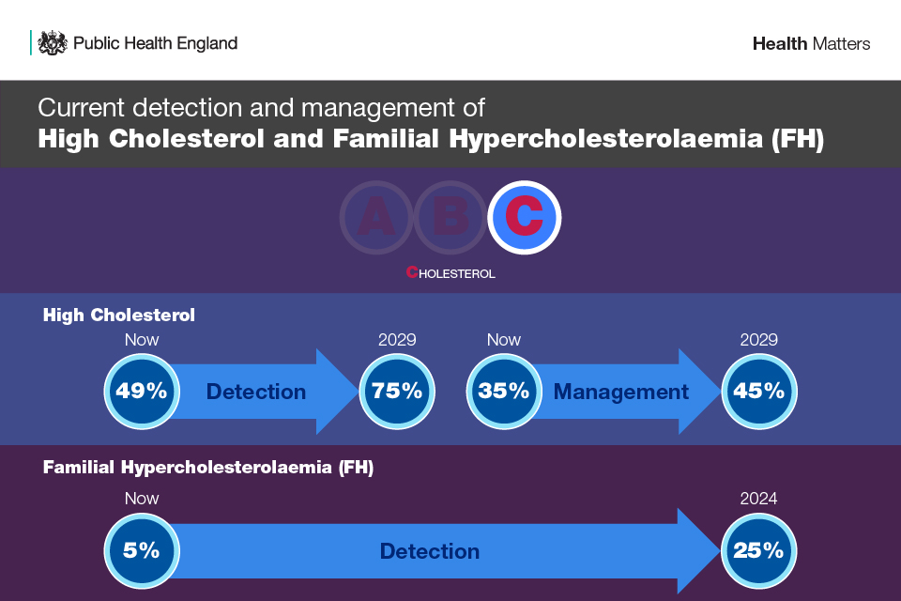

Slide 5
NWL CVD Plan
Ensure eligible patients are offered and take up cardiac risk checks (primary prevention)
Offer statin treatment to patients with a QRISK3 score ≥ 10%, where clinically appropriate, and in line with NICE guideline CG181.
Ensure patients who have a history of CVD are on optimal lipid lowering therapy (secondary prevention) and treated to non-HDL cholesterol <2.5mmol/l or LDL cholesterol < 1.8mmol/l in the preceding 12 months
Improve detection of Familial Hypercholesterolaemia

Slide 6
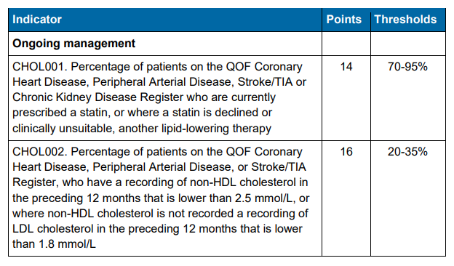
QOF - Cholesterol control and Lipid Management

Slide 7
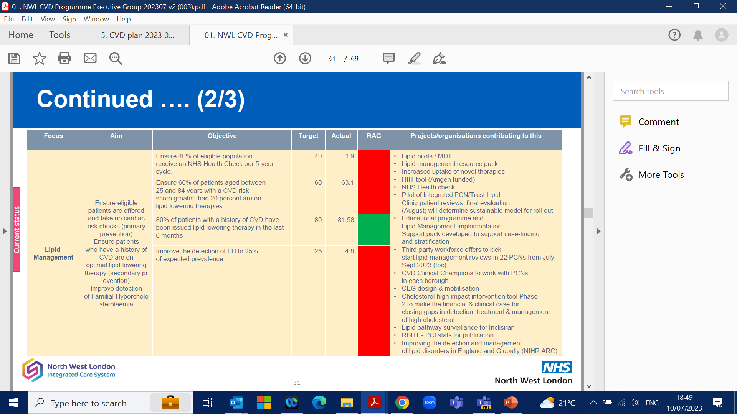
How is NWL performing?
 | Aim | Objective | Target | Actual
Lipid Management | Ensure eligible patients are offered and take up cardiac risk checks (primary prevention) Ensure patients who have a history of CVD are on optimal lipid lowering therapy (secondary prevention) Improve detection of Familial Hypercholesterolaemia | Ensure 40% of eligible population receive an NHS Health Check per 5-year cycle. | 2%* | 3.2%*
 |  | Ensure 60% of patients aged between 25 and 84 years with a CVD risk score greater than 20 percent are on lipid lowering therapies | 60% | 63.1%
 |  | 80% of patients with a history of CVD have been issued lipid lowering therapy in the last 6 months | 80% | 81.58%
 |  | Improve the detection of FH to 25% of expected prevalence | 25% | 4.8%
*Target and actual are expressed as quarterly increases. Target of 40% over 5 years equates to a 2% increase per quarter.

Slide 8
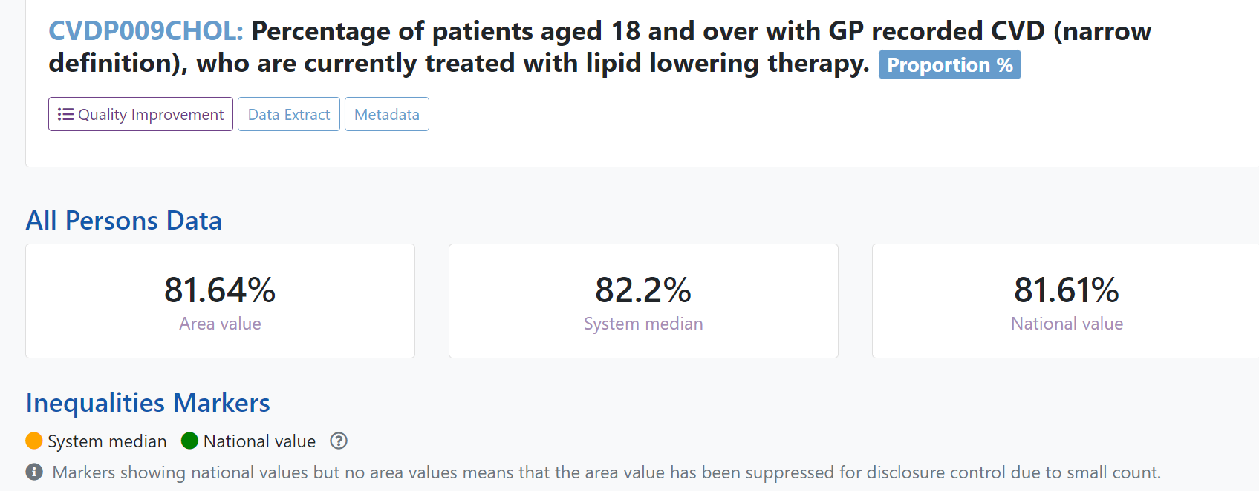
How is NWL performing?

Slide 9
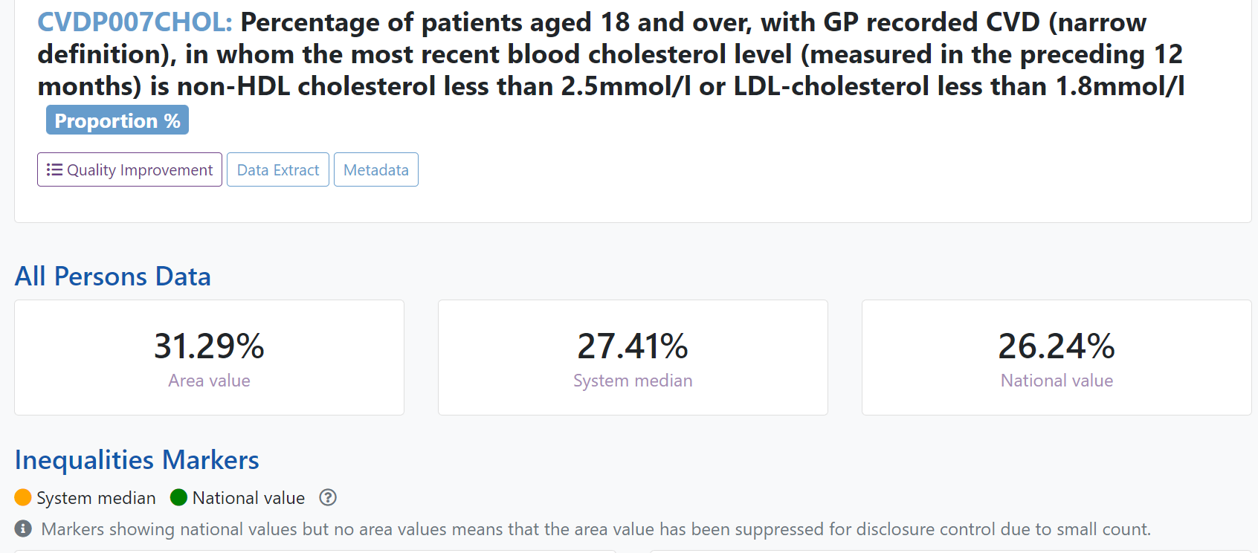
How is NWL performing?

Slide 10
Lipid Management Pilots – value of MDTs
Which education and upskilling elements were most useful and effective for you?
Key findings
When asked about most useful education elements of the pilot, almost all respondents highlighted MDTs
Clinicians described value of experiential learning
There is room to improve in promoting awareness and utilisation of existing resources. Only half or less of respondents accessed live webinars, Heart UK materials, and the NWL Lipid Management Implementation Support Pack, though these have been noted as valuable by pilot participants and other clinicians anecdotally.
“The MDT discussions were very useful. Case based learning and implementation of guidance is vital, as well as networking with colleagues (even virtually!)” – GP
“MDTs were fantastic, I learnt a lot from them” – PCN Pharmacist
“The Lipid MDTs which we built into our existing Diabetes MDT structure was very helpful and liked by the PCN.” – GP
“Webinar that included Dr Cegla and Prof Ray.” – PCN Pharmacist
To consider going forward
MDTs included as core learning element for further primary care rollout
Further explore (with clinicians and other areas) best practice for providing other resources & disseminating awareness, including value of live sessions vs recordings
“The lipid MDT is an amazing way to upskill clinicians. Very efficient and impactful, I saw a large improvement in the confidence of the pharmacists most involved in the MDT meetings.” – PCN Pharmacist

Slide 11
Lipid Management MDT Process across all NWL PCNs
HCP reviews patient, consults GP, and recommends lipid-lowering therapy
*If patient has suspected FH, complex needs or therapies for specialist initiation only
*GP deems appropriate for MDT discussion
GP/Pharmacist/CVD Nurse Specialist Prescriber initiates lipid lowering therapy and schedules follow up
*GP/Pharmacist/CVD Nurse Specialist Prescriber uses Rego process to seek Advice & Guidance from Trust endocrinology/cardiology
MDT discussion
If deemed necessary after seeking specialist opinion
Where appropriate patient discharged back into Primary Care for on-going management.
GP/Pharmacist Prescriber
refers patient into
Trust Lipid Clinic

Slide 12

NWL experience with inclisiran
Patients benefiting from Inclisiran
Primary Care - 654 doses ordered in primary care
Secondary Care - 677 doses ordered in secondary care
Total of 1331 doses as of 12th June 2023
Driven through;
Lipid Management Implementation Support Pack
Comms & webinars
Inclisiran FAQ
Support to PCNs from ICHP and Trust Lipid Clinics (MDT)

Slide 13
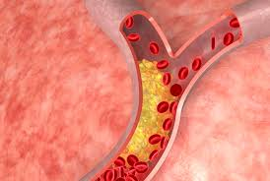
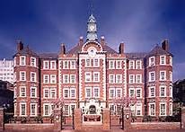
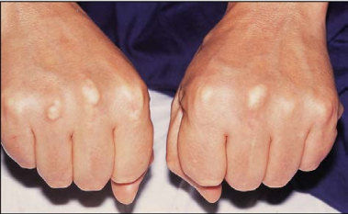
Novel therapies and Clinical Pathways in Lipidology
Jaimini Cegla FRCP FRCPath PhD, Consultant in Metabolic Medicine
Hammersmith Hospital Lipid Clinic, Imperial College Healthcare NHS Trust
19th July 2023

Slide 14
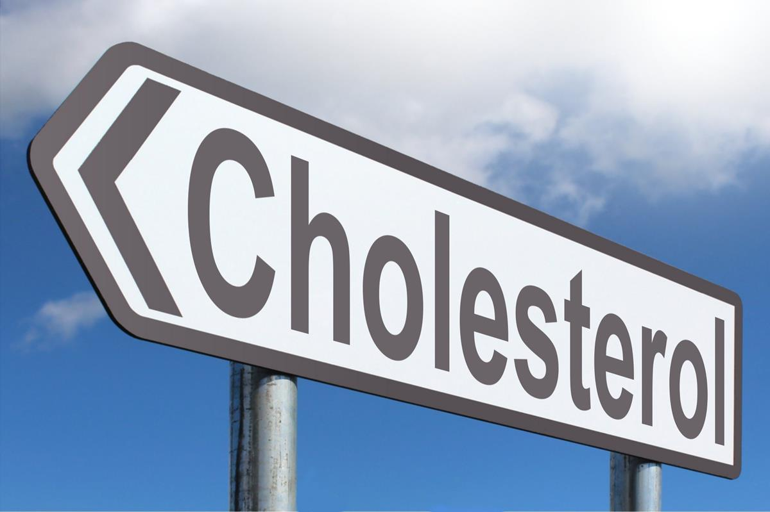
Content
CV Risk and lipid lowering
Lipid lowering therapies
Pathways for lipid management

Slide 15

Case 1
59 year old male
Barrister
Asymptomatic
No Family History of CVD
Total cholesterol 7.2 mmol/L
HDL-c 1.4 mmol/L
LDL-c 4.1 mmol/l
TG 1.4 mmol/l
Non-HDL-c 5.8 mmol/l

Slide 16
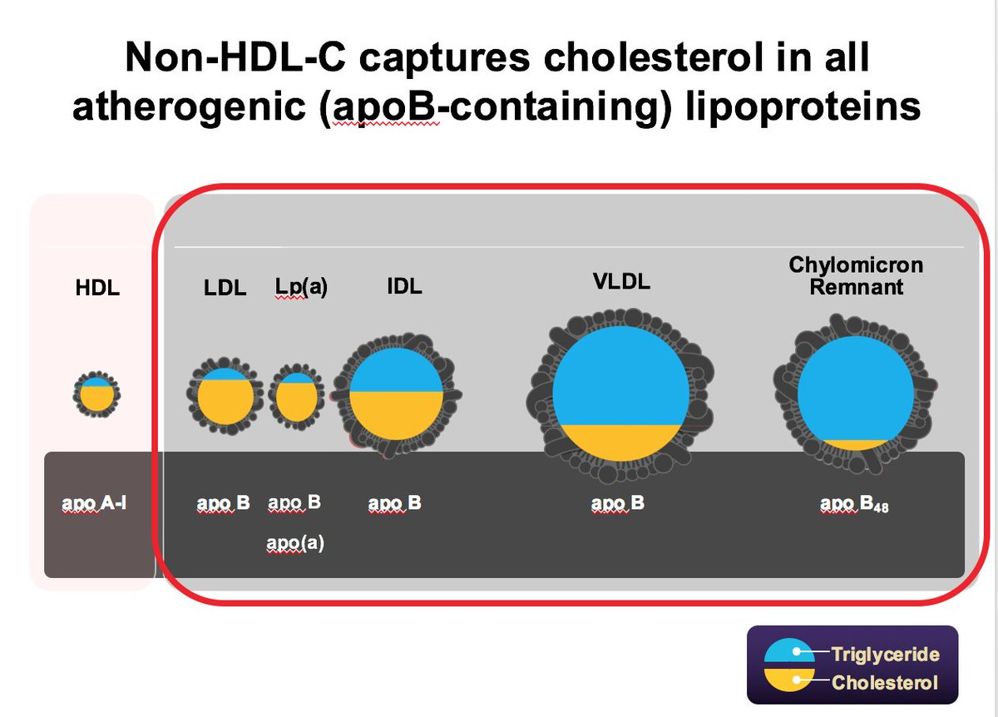
Cholesterol Sub-Types
Non-HDL-C = Total cholesterol – HDL-C

Slide 17
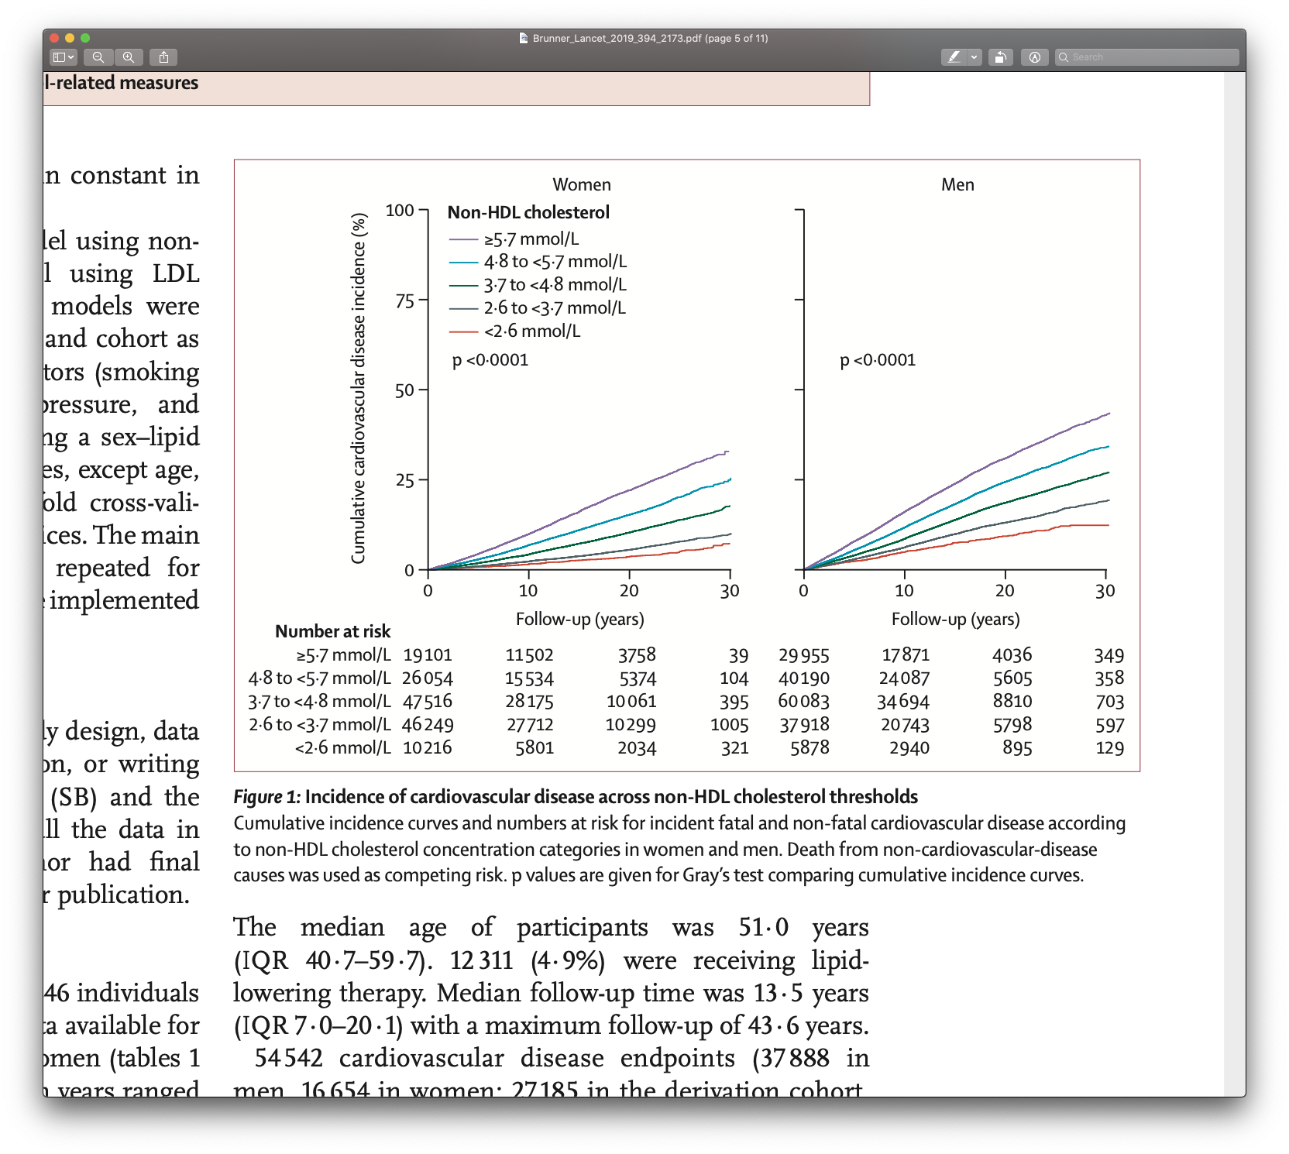
CVD and non-HDL cholesterol
Brunner F et al., Lancet (2019) 394:2173-82

Slide 18
Case 1
59 year old male
Barrister
Asymptomatic
No Family History of CVD
Total cholesterol 7.2 mmol/L
HDL-c 1.4 mmol/L
LDL-c 4.1 mmol/l
TG 1.4 mmol/l
Non-HDL-c 5.8 mmol/l
Does he need a statin?

Slide 19
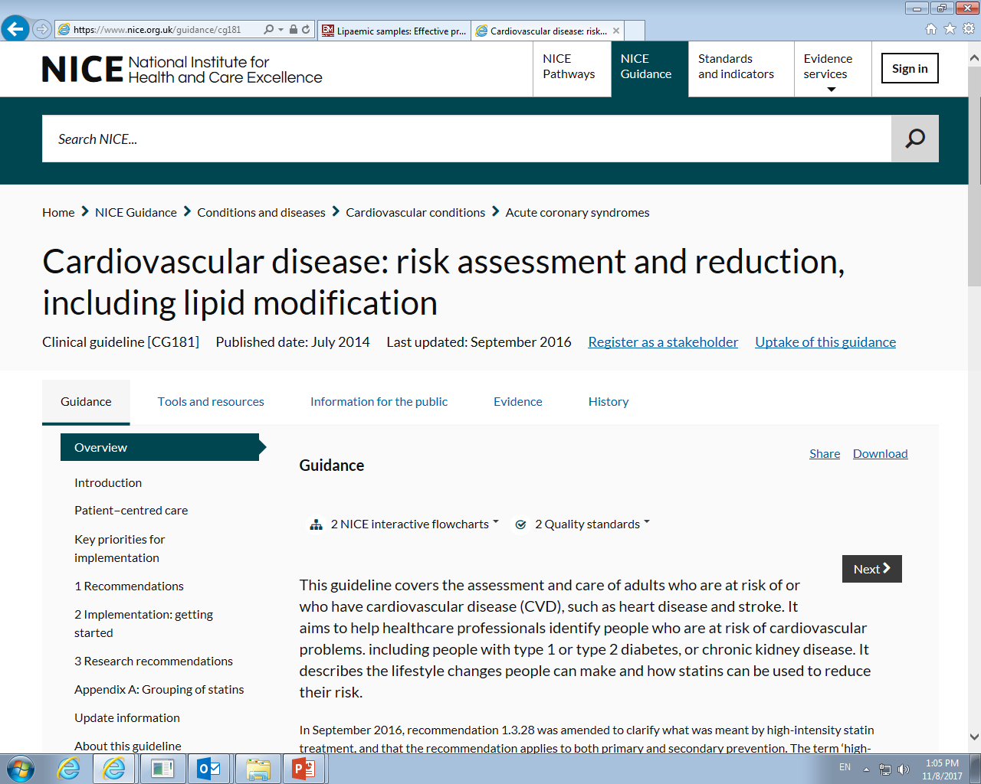
Guidance
Offer lipid modification therapy to people aged 25 to 84 years (including those with type 2 diabetes) if their estimated 10-year risk of developing cardiovascular disease (CVD) using the QRISK3 assessment tool is 10% or more and lifestyle modification is ineffective or inappropriate.
http://www.jbs3risk.com/pages/risk_calculator.htm
Obviously:
Exclude secondary causes of hypercholesterolaemia
(drugs, hypothyroidism, nephrotic syndrome, anorexia etc)
Do not use a risk assessment tool in people with:
Secondary prevention
type 1 diabetes
eGFR less than 60 and/or albuminuria
familial hypercholesterolaemia
Underestimates risk in people:
treated for HIV
with serious mental health problems
taking medicines that can cause dyslipidaemia
(eg antipsychotics, steroids or immunosuppressant)
with autoimmune disorders such as SLE

Slide 20
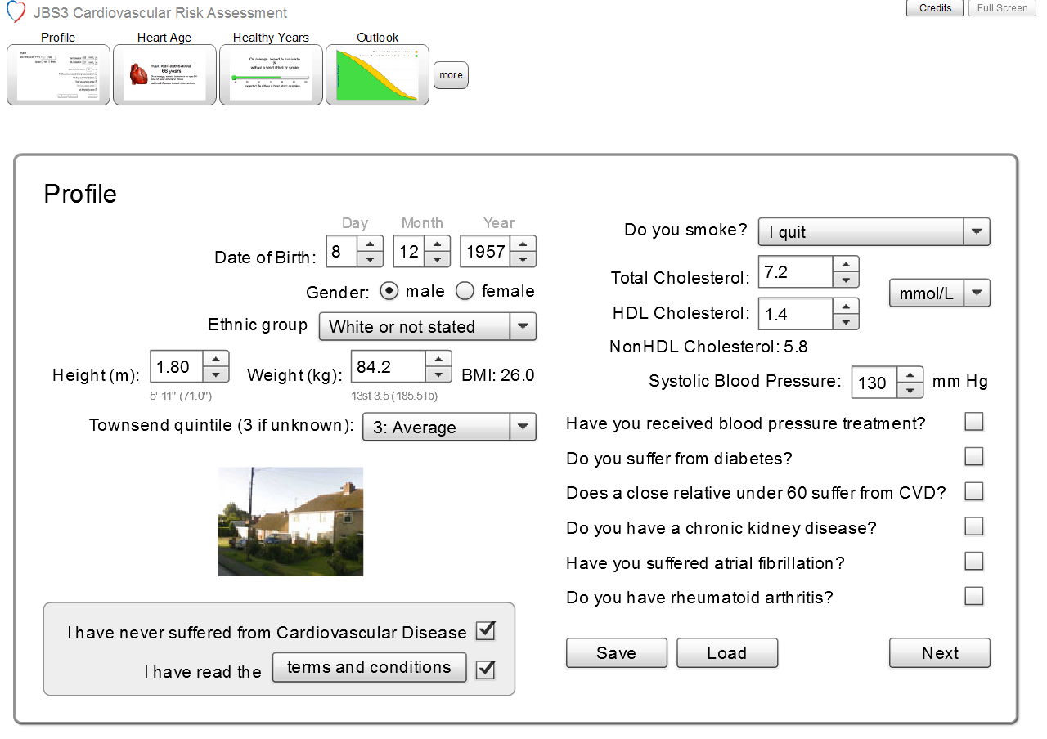

Slide 21
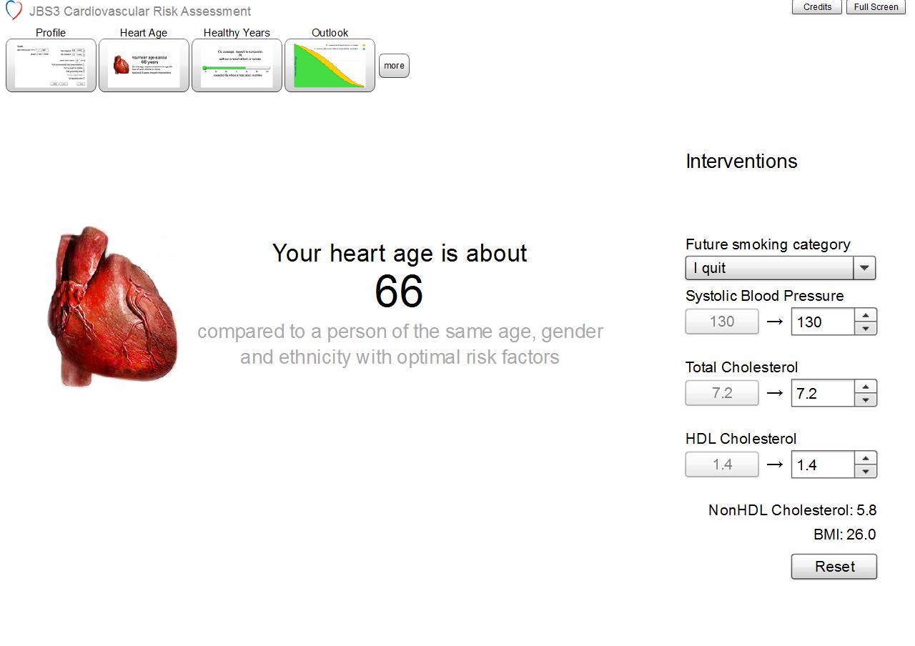

Slide 22
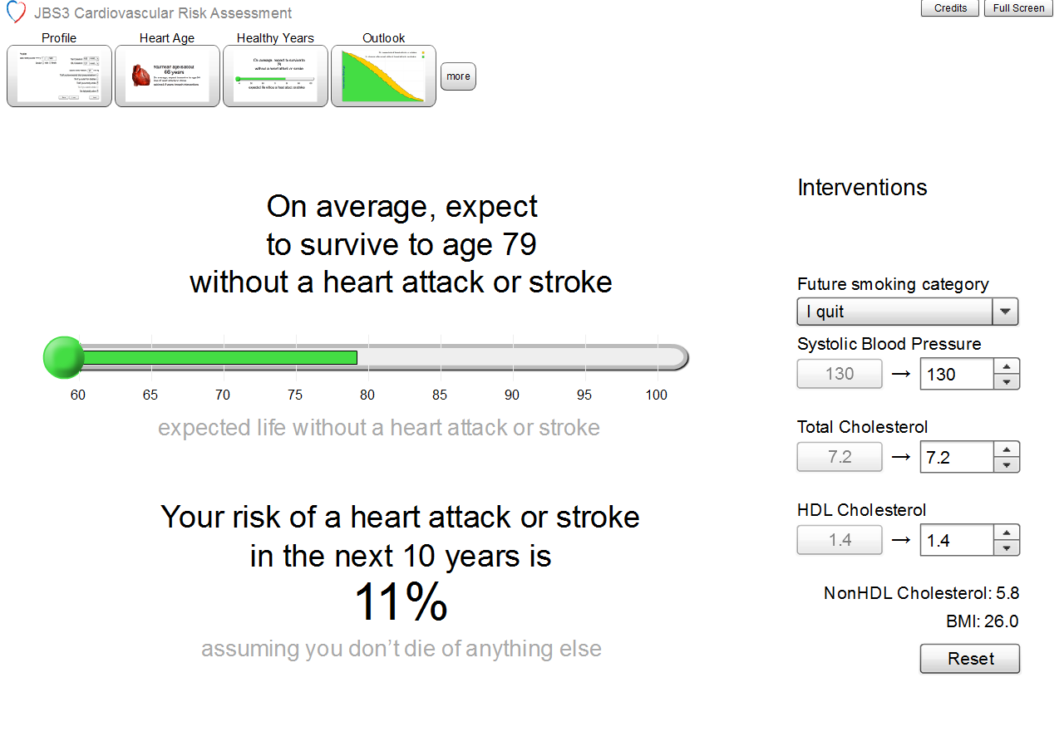

Slide 23
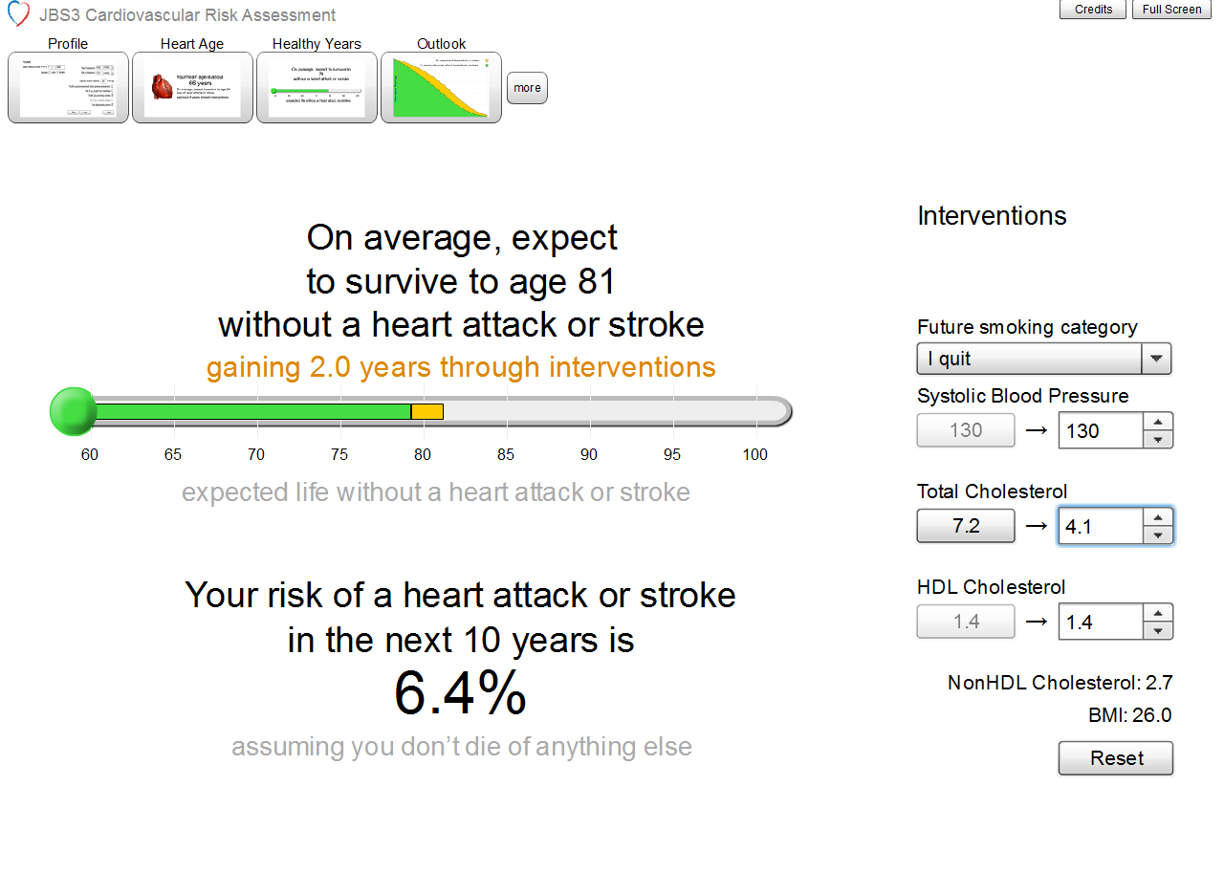

Slide 24
Lipid Targets
What target lipids are we aiming for?

Slide 25
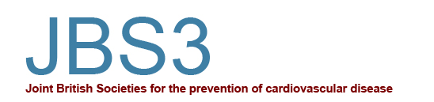
Targets??
Aim for a greater than 40% reduction in non‑HDL cholesterol.
Aim for non-HDL-c of <2.5 mmol/L (broadly equivalent to an LDL-c of <1.8 mmol/l)
But.. NICE eligibility for newer drugs is based on LDL-c!!!
What about diagnosis of FH?

Slide 26
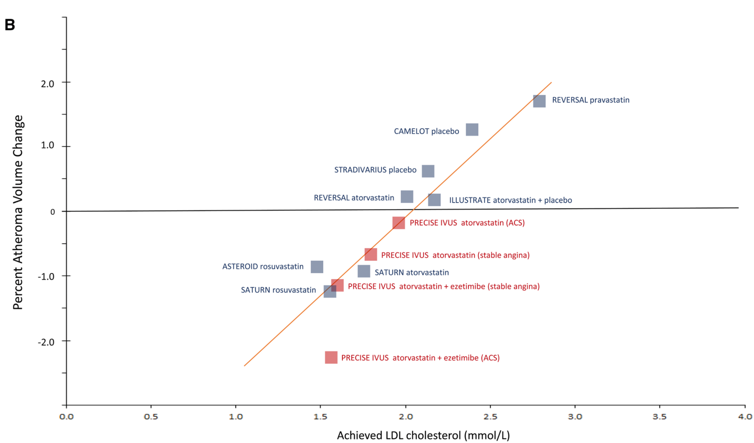
LDL-C and atheroma formation
Eur Heart J. 2017
Notes:
Figure 2 Log-linear association per unit change in low-density lipoprotein cholesterol (LDL-C) and the risk of cardiovascular disease as reported in meta-analyses of Mendelian randomization studies, prospective epidemiologic cohort studies, and randomized trials. The increasingly steeper slope of the log-linear association with increasing length of follow-up time implies that LDL-C has both a causal and a cumulative effect on the risk of cardiovascular disease. The proportional risk reduction (y axis) is calculated as 1−relative risk (as estimated by the odds ratio in Mendelian randomization studies, or the hazard ration in the prospective epidemiologic studies and randomized trials) on the log scale, then exponentiated and converted to a percentage. The included meta-analyses were identified from (i) MEDLINE and EMBASE using the search terms meta-analysis, LDL, and ‘cardiovascular or coronary’; (ii) the reference lists of the identified meta-analyses; (iii) public data from GWAS consortia; and (iv) by discussion with members of the EAS Consensus Panel. We included the most updated meta-analyses available, giving preference to meta-analyses that used individual participant data. Trial acronyms: AF/TexCAPS, Air Force/Texas Coronary Atherosclerosis Prevention Study; ALERT, Assessment of LEscol in Renal Transplantation; ALLHAT-LLT, Antihypertensive and Lipid-Lowering Treatment to Prevent Heart Attack Trial Lipid Lowering Trial; ALLIANCE, Aggressive Lipid-Lowering Initiation Abates New Cardiac Events; ASPEN, Atorvastatin Study for Prevention of Coronary Heart Disease Endpoints in non-insulin-dependent diabetes mellitus; ASCOT LLA, Anglo Scandinavian Cardiac Outcomes Trial Lipid Lowering Arm; AURORA, A Study to Evaluate the Use of Rosuvastatin in Subjects on Regular Hemodialysis: An Assessment of Survival and Cardiovascular Events; CARE, Cholesterol and Recurrent Events; CARDS, Collaborative Atorvastatin Diabetes Study; CHGN, Community Health Global Network; 4D Deutsche Diabetes Dialyse Studies; ERFC, Emerging Risk Factors Collaboration; GISSI, Gruppo Italiano per lo Studio della Sopravvivenza nell'Infarto Miocardico; HOPE, Heart Outcomes Prevention Evaluation Study; HPS, Heart Protection Study; IDEAL, Incremental Decrease in End Points Through Aggressive Lipid Lowering; IMPROVE-IT, Examining Outcomes in Subjects With Acute Coronary Syndrome: Vytorin (Ezetimibe/Simvastatin) vs Simvastatin; JUPITER, Justification for the Use of Statins in Primary Prevention: An Intervention Trial Evaluating Rosuvastatin trial; LIPID,, Long-Term Intervention with Pravastatin in Ischemic Disease; LIPS, Lescol Intervention Prevention Study; MEGA, Management of Elevated Cholesterol in the Primary Prevention Group of Adult Japanese; POST-CABG, Post Coronary Artery Bypass Graft; PROSPER, Pravastatin in elderly individuals at risk of vascular disease; PROVE-IT, Pravastatin or Atorvastatin Evaluation and Infection Therapy; SHARP, Study of Heart and Renal Protection; TNT, Treating to New Targets; WOSCOPS, West of Scotland Coronary Prevention Study.

Slide 27
Content
CV Risk and lipid lowering
Lipid lowering therapies
Pathways for lipid management

Slide 28
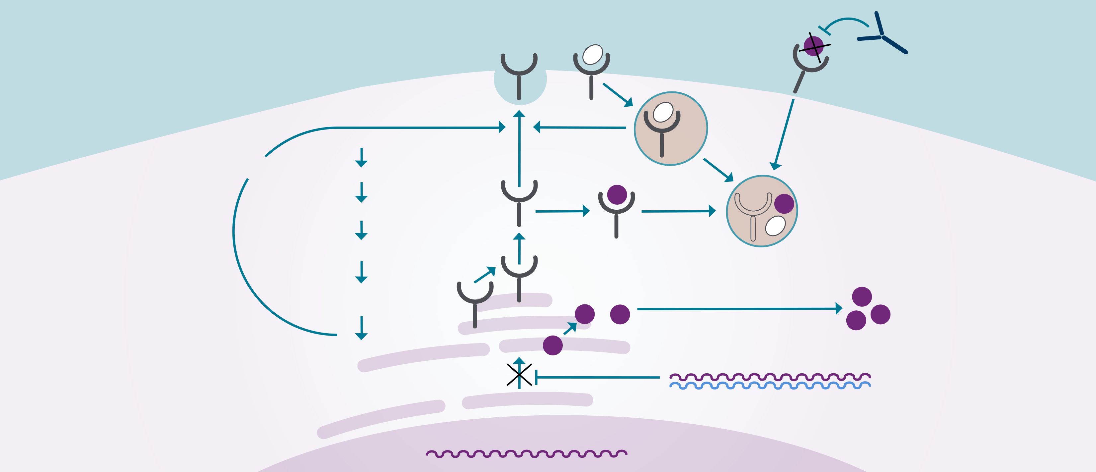

THERAPEUTIC APPROACHES TO REDUCING LDL-C VIA THE LDL RECEPTOR small molecules, monoclonal antibodies, siRNA
Small molecules Intracellularly and extracellularly located
Antibodies
Extracellularly located
Ezetimibe²
Intestinal cholesterol absorption
LDL
LDLR
Anti-PCSK9 monoclonal antibodies
Transiently block PCSK9 binding to LDLR extracellularly
NPC1L1
Citrate
Bempedoic acid³
ACL
Acetyl-CoA
LDLR
synthesis
Lysosomal
degradation
HMG-CoA
PCSK9
synthesis
Statins
HMG-CoA
reductase
PCSK9
Adapted from Nordestgaard BG et al. Nat Rev Cardiol 2018.¹
Cholesterol depletion
Intracellular cholesterol depletion increases LDLR synthesis via transcription
siRNA
PCSK9 synthesis inhibitors
Long-term inhibition of PCSK9 synthesis and all intracellular and extracellular PCSK9 functions
Cholesterol
Gene silencing
Intracellularly
(and extracellularly) located
PCSK9 mRNA
Nucleus
ACL – ATP-citrase lyase; CoA – coenzyme A; HMG – 3-hydroxy-3-methylglutaryl; LDL – low-density lipoprotein; LDL-C – low-density lipoprotein cholesterol; LDLR – low-density lipoprotein receptor; mRNA – messenger ribonucleic acid; NPC1L1 – Niemann Pick C1-like 1 protein; PCSK9 – proprotein convertase subtilisin/kexin type 9; siRNA – small interfering ribonucleic acid
References: 1. Nordestgaard BG et al. Nat Rev Cardiol 2018;15(5):261-272. 2. Landmesser U et al. Eur Heart J 2018;39(14):1131-1143. 3. Agarwala A and Goldberg AC. Future Cardiol 2020;16(5):361-371.

Slide 29
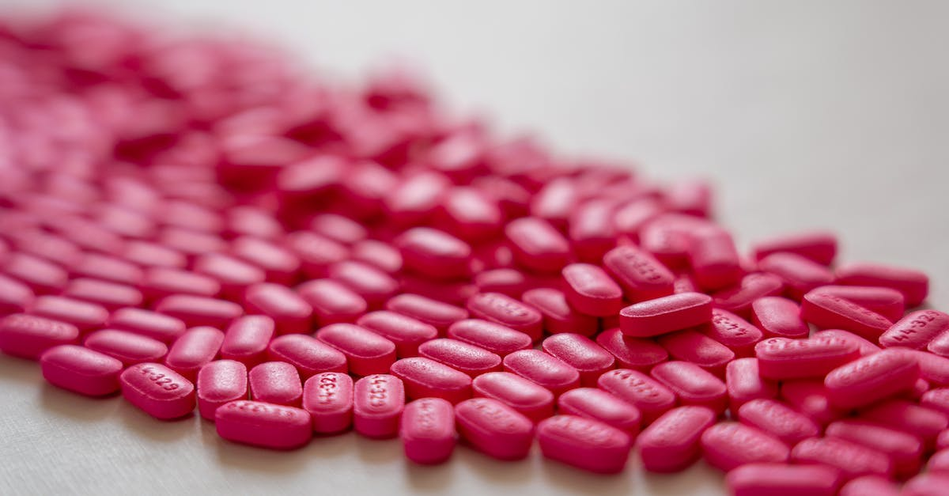
Lipid Lowering Therapies
Well established:
Statins
Ezetemibe
Newish:
PCSK9 mabs
New:
Bempedoic Acid
Inclisiran

Slide 30
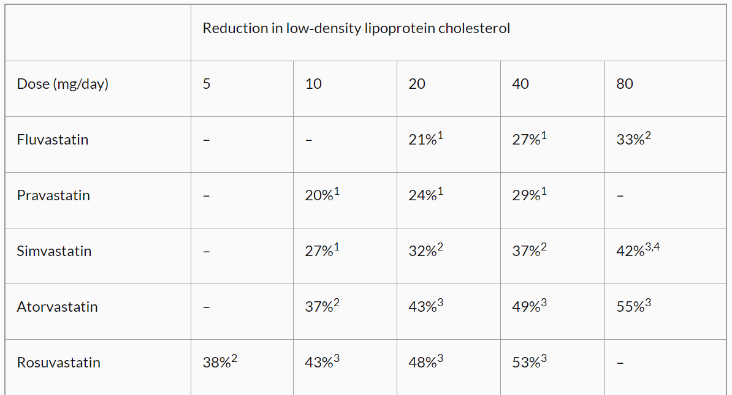
Statins

Slide 31
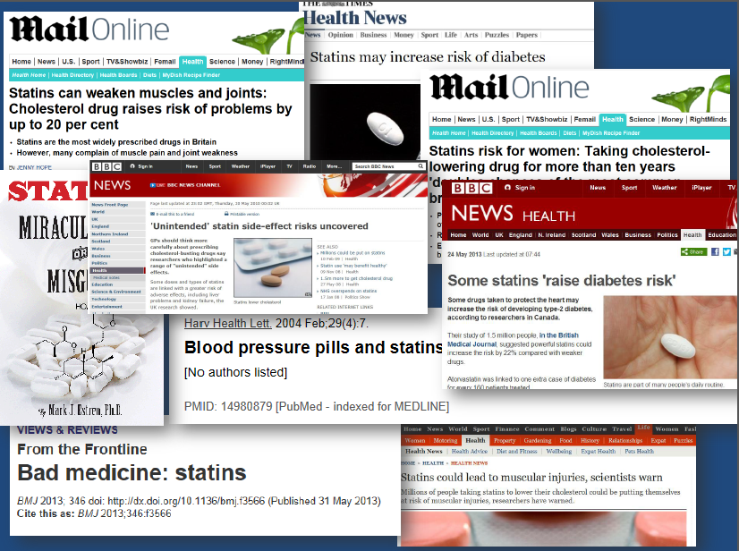
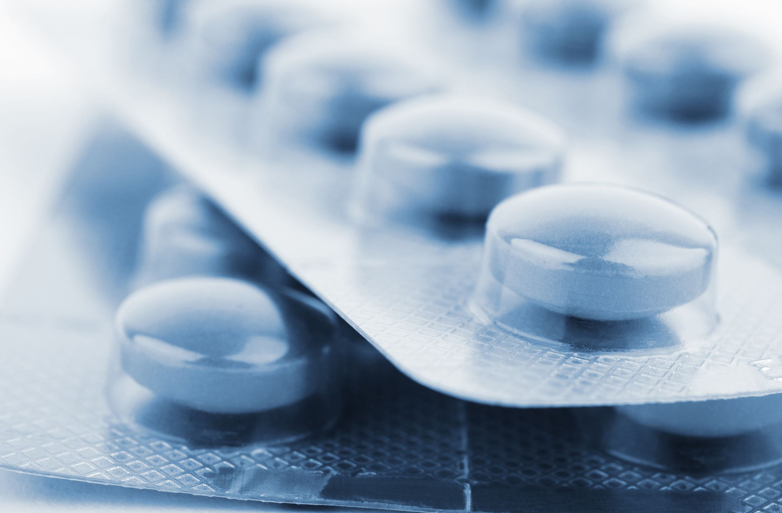

Slide 32
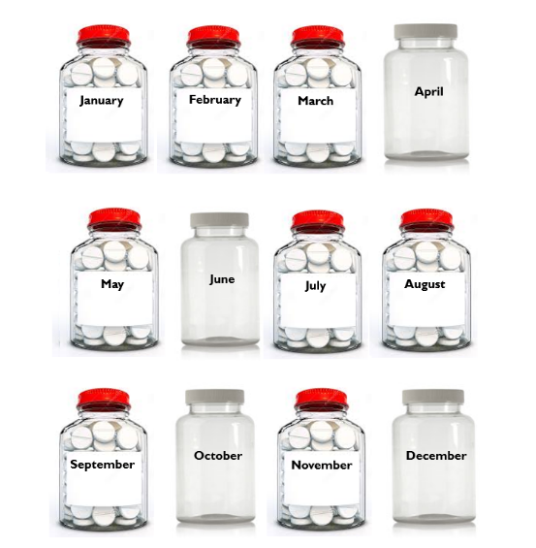

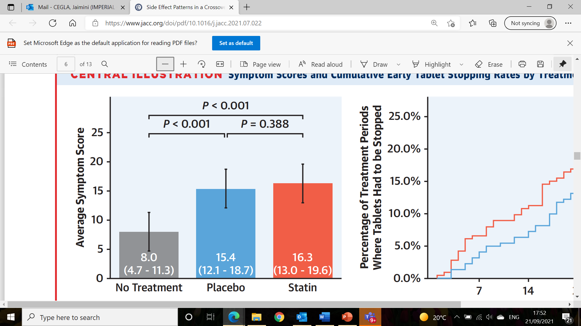
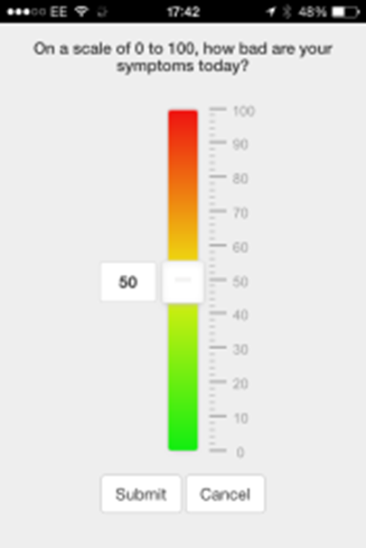
SAMSON
Placebo
Self-assessment toolkit trial
for people who have stopped statins due to adverse symptoms
Symptoms scores recorded daily on a smartphone app and at end of trial participant’s given their individual results to allow them to make a more informed decision about future treatment
Placebo
Placebo
4 months
nothing
4 months
placebo
4 months
statin
Placebo
They note their symptoms daily on an app
<10 secs
J Howard et al. J Am Coll Cardiol 2021; 78:1210-1222.

Slide 33
What to do if muscle ache
Take good history
Measure CK (myalgia v myopathy)
Myalgia and symptoms intolerable: Statin break
Do symptoms go away? If YES, try lower dose of same statin (i.e. rechallenge)
If CK high (>10 ULN i.e. myalgia), stop statin immediately. Monitor CK. Usually reintroduce statin lower dose as well and carefully monitor

Slide 34

Statin Intolerance Pathway
Person at high CVD risk reports potential intolerance to recommended high intensity statin treatment
Consider other potential side effects for statins
• Be aware of Statin Reluctance and Nocebo Effect
• See ‘Person Centred Care’ box at page 2
NO
New onset or worsening of muscle symptoms since starting statins? (pain, tenderness or weakness)
NO
YES
*Symmetrical pain and/or weakness in large proximal muscle groups, worsened by exercise
Muscular symptoms not related to statins
Symptoms typical for Statin Related Muscle toxicity (SRM)*?
YES
**Consider other causes if new onset of muscle symptoms
of > 2 weeks duration in a person previously tolerant of statin
therapy for > 3 months
Non SRM: Consider other causes e.g. PMR, Vit D deficiency.
Check bone profile, Vit D, CRP.
Measure Creatinine Kinase (CK)
Assess severity of symptoms
+/- repeat baseline assessment**
Tolerable symptoms
No clinical concern
CK < 4x ULN
Intolerable symptoms
and/or clinical concern and/or CK > 4x and < 10x ULN
CK > 10x and < 50x ULN
CK > 50x ULN
Improvement within 2 weeks
Resolved within 6 weeks
Patient happy to continue
NO
Stop statin for 4-6 weeks
Document time to symptom onset and time to resolution
YES
Renal function stable/normal eGFR
NO
Stop statin and consider Rhabdomyolysis
Has CK normalised?
Consider Statin induced necrotising autoimmune myopathy (SINAM)
NO
YES
Non-SRM. Consider other causes
Have symptoms resolved?
Seek specialist advice and consider PCSK9i
(NICE TA 393, 394)
Urgently
seek specialist advice and inpatient assessment
NO
YES
Wait for 2 weeks before rechallenge
Has the patient been symptom free for at least 2 weeks?
YES
Reassess and restart with lower dose/alternative statin (see page 2 - ‘Statin-based Approaches’)
Offer low or moderate dose of a higher intensity statin (Atorvastatin 10 or 20 mg OD, or Rosuvastatin 5 or 10mg OD)
Abbreviations
CK = Creatinine Kinase
CRP = C-Reactive Protein
eGFR = Estimated Glomerular Filtration Rate
PMR = Polymyalgia Rheumatica
SINAM = Statin Induced Necrotising Autoimmune Myopathy
SRM = Statin Related Muscle Toxicity
ULN = Upper Limit of Normal Range
Vit D = Vitamin D
No recurrence of muscle symptoms
Titrate at 8 weeks intervals to achieve appropriate targets
Recurrence of muscle symptoms
Short time to onset
Symptoms intolerable
Symptoms tolerable
Treatment goals achieved
Patient happy to continue
NO
Consider further options
(For example co-administering ezetimibe or as monotherapy)
see page 2 - ‘Statin-based Approaches’
IF NOT EFFECTIVE
Please refer to page 2 for more details
NHS Accelerated Access Collaborative » Statin intolerance pathway (england.nhs.uk)

Slide 35
Statins: Liver safety
Small percentage ↑transaminases
Generally in first 3/12 and asx
Reverse with stopping
Risk of liver failure probably not above background risk
Caution in labelling someone as statin intolerant i.e. benefit>risk

Slide 36
Transaminitis with Statins in Clinical Trials: Association with Higher Intensity Statins
 | Statins used | % ↑ ALT X 3
PROVE IT (ACS) | A80 v P40 | 3.3 v 1.1
A to Z (ACS) | S80 v S20 | 0.9 v 0.4
TNT (Stable CHD) | A80 v A10 | 1.2 v 0.2
IDEAL (Stable CHD) | A80 v S20-40 | 1 v 0.1%
SPARCL (Stroke) | A80 v P | 2.2 v 0.5
Armitage. Lancet 2007; 370: 1781–90

Slide 37
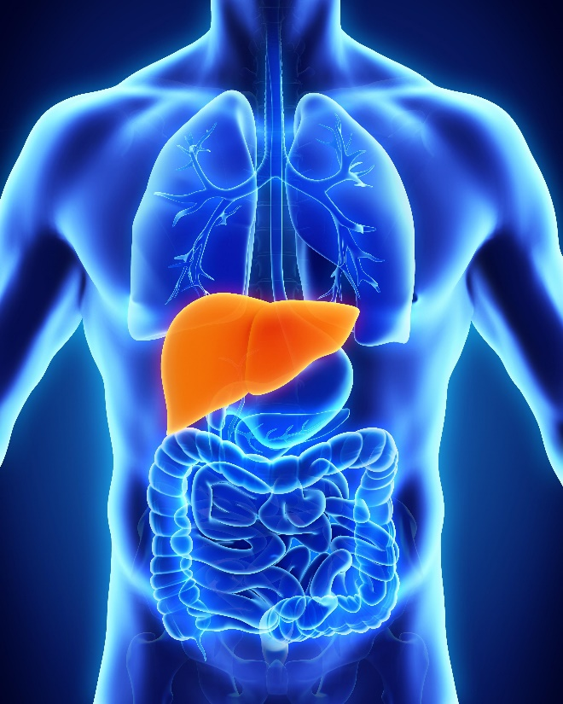
Statins and Baseline Liver Abnormalities
Histopathological study show that long-term statin treatment improves liver histology with regression of steatosis over time without significant changes in liver tests
Kargiotis et al. World J Gastroenterol 2015;
Dongiovanni P et al. J Hepatol 2015;
Nascimbeni et al. BMJ Open Gastroenterol 2016

Slide 38
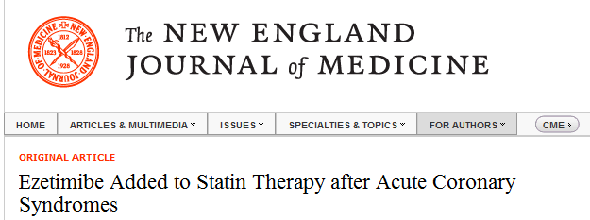
Ezetemibe
Decreases cholesterol absorption in intestine
  Acts via NPC1L1 protein on GI epithelial cells of brush border
  Forces upregulation of LDL-R and recycling of LDL ➔ reduce cholesterol levels (~20%)

Slide 39
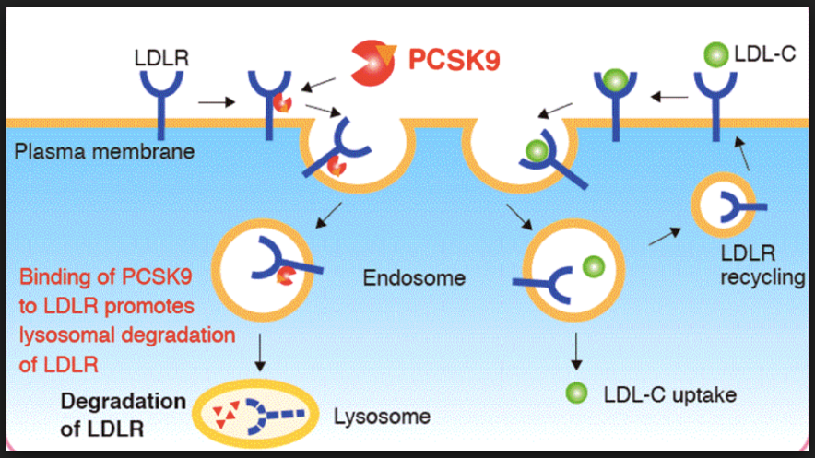
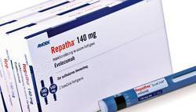
PCSK9 mAbs
Proprotein convertase subtilisin/kexin type 9 (PCSK9)
  Chaperones LDL-R to destruction → ↑ circulating LDL-C
  Loss-of-fxn genetic variants → ↑ LDL-R → ↓ LDL-C & ↓ risk of MI
Evolocumab/Alirocumab
  Fully human anti-PCSK9 mAb
  ~60% ↓ LDL-C
  Safe & well-tolerated in Ph 2 & 3 studies
  Subcut injection every 2 wks
Notes:
Evolocumab is a fully human monoclonal antibody targeting proprotein convertase subtilisin/kexin type 9 (PCSK9), which lowers circulating LDL-C by >60%⁷. In patients with cardiovascular disease and additional risk factors

Slide 40
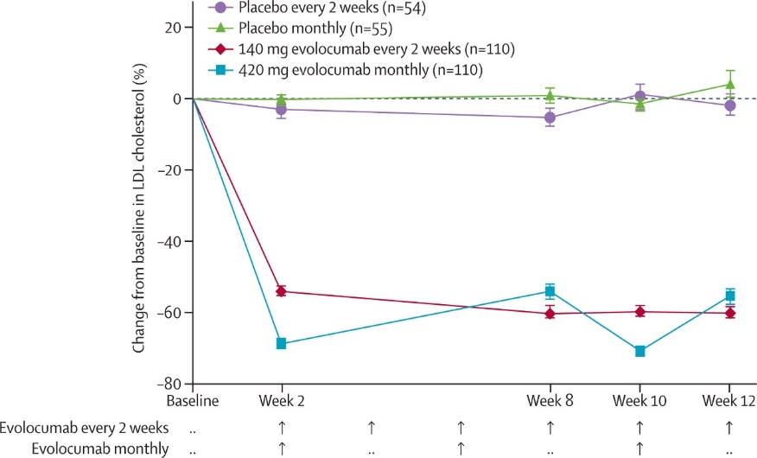
PCSK9 mAbs and LDL-c lowering
Raal et al, Lancet. 2015

Slide 41
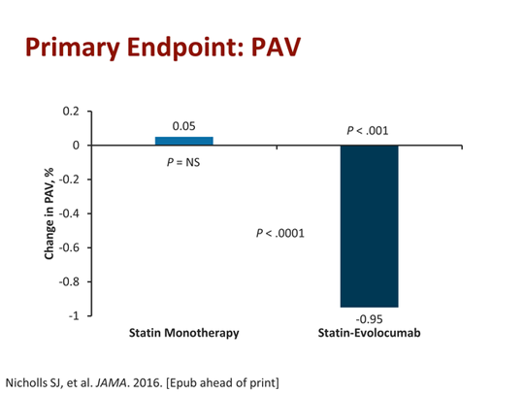
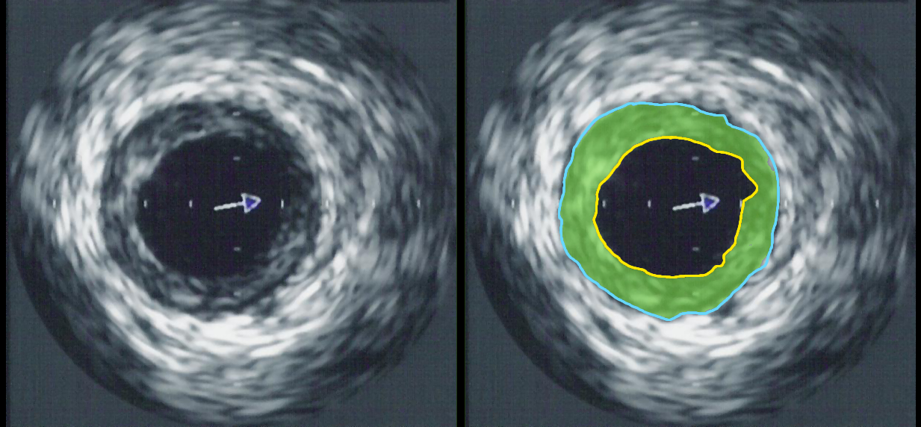
PCSK9 mAbs and effect on the coronaries
Yellow = lumen
Blue = external elastic membrane
Green = atheroma
Nicholls et al, JAMA, 2016
Notes:
Evolocumab reduces coronary atheroma volume in patients with coronary artery disease, as determined by intravascular ultrasound¹³.
Key PointsQuestion Does treatment with a PCSK9 inhibitor modify coronary atherosclerosis disease progression?
Findings In this clinical trial in which 968 patients with coronary disease were treated with the PCSK9 inhibitor evolocumab or placebo monthly for 76 weeks and underwent serial intravascular ultrasound determination of coronary atheroma volume, lower low-density lipoprotein cholesterol levels were observed in the evolocumab group (36.6 vs 93.0 mg/dL), which also was associated with a reduction in percent atheroma volume for evolocumab (−0.95%) but not placebo (+0.05%) and a greater percentage of patients demonstrating plaque regression (64.3% vs 47.3%).
Meaning Addition of the PCSK9 inhibitor evolocumab to statin therapy produced greater low-density lipoprotein cholesterol lowering and atheroma regression.
Abstract
Importance Reducing levels of low-density lipoprotein cholesterol (LDL-C) with intensive statin therapy reduces progression of coronary atherosclerosis in proportion to achieved LDL-C levels. Proprotein convertase subtilisin kexin type 9 (PCSK9) inhibitors produce incremental LDL-C lowering in statin-treated patients; however, the effects of these drugs on coronary atherosclerosis have not been evaluated.
Objective To determine the effects of PCSK9 inhibition with evolocumab on progression of coronary atherosclerosis in statin-treated patients.
Design, Setting, and Participants The GLAGOV multicenter, double-blind, placebo-controlled, randomized clinical trial (enrollment May 3, 2013, to January 12, 2015) conducted at 197 academic and community hospitals in North America, Europe, South America, Asia, Australia, and South Africa and enrolling 968 patients presenting for coronary angiography.
Interventions Participants with angiographic coronary disease were randomized to receive monthly evolocumab (420 mg) (n = 484) or placebo (n = 484) via subcutaneous injection for 76 weeks, in addition to statins.
Main Outcomes and Measures The primary efficacy measure was the nominal change in percent atheroma volume (PAV) from baseline to week 78, measured by serial intravascular ultrasonography (IVUS) imaging. Secondary efficacy measures were nominal change in normalized total atheroma volume (TAV) and percentage of patients demonstrating plaque regression. Safety and tolerability were also evaluated.
Results Among the 968 treated patients (mean age, 59.8 years [SD, 9.2]; 269 [27.8%] women; mean LDL-C level, 92.5 mg/dL [SD, 27.2]), 846 had evaluable imaging at follow-up. Compared with placebo, the evolocumab group achieved lower mean, time-weighted LDL-C levels (93.0 vs 36.6 mg/dL; difference, −56.5 mg/dL [95% CI, −59.7 to −53.4]; P < .001). The primary efficacy parameter, PAV, increased 0.05% with placebo and decreased 0.95% with evolocumab (difference, −1.0% [95% CI, −1.8% to −0.64%]; P < .001). The secondary efficacy parameter, normalized TAV, decreased 0.9 mm³ with placebo and 5.8 mm³ with evolocumab (difference, −4.9 mm³ [95% CI, −7.3 to −2.5]; P < .001). Evolocumab induced plaque regression in a greater percentage of patients than placebo (64.3% vs 47.3%; difference, 17.0% [95% CI, 10.4% to 23.6%]; P < .001 for PAV and 61.5% vs 48.9%; difference, 12.5% [95% CI, 5.9% to 19.2%]; P < .001 for TAV).
Conclusions and Relevance Among patients with angiographic coronary disease treated with statins, addition of evolocumab, compared with placebo, resulted in a greater decrease in PAV after 76 weeks of treatment. Further studies are needed to assess the effects of PCSK9 inhibition on clinical outcomes.

Slide 42

PCSK9 mAbs and CV Outcome data
Sabatine et al, NEJM. 2017
Notes:
Evolocumab positively impacted a composite cardiovascular outcome, and reduced rates of stroke and transient ischaemic attack (TIA)¹⁴. However, the effect of Evolocumab in patients with carotid artery stenosis has not been investigated.
Background
Evolocumab is a monoclonal antibody that inhibits proprotein convertase subtilisin–kexin type 9 (PCSK9) and lowers low-density lipoprotein (LDL) cholesterol levels by approximately 60%. Whether it prevents cardiovascular events is uncertain.
Methods
We conducted a randomized, double-blind, placebo-controlled trial involving 27,564 patients with atherosclerotic cardiovascular disease and LDL cholesterol levels of 70 mg per deciliter (1.8 mmol per liter) or higher who were receiving statin therapy. Patients were randomly assigned to receive evolocumab (either 140 mg every 2 weeks or 420 mg monthly) or matching placebo as subcutaneous injections. The primary efficacy end point was the composite of cardiovascular death, myocardial infarction, stroke, hospitalization for unstable angina, or coronary revascularization. The key secondary efficacy end point was the composite of cardiovascular death, myocardial infarction, or stroke. The median duration of follow-up was 2.2 years.
Results
At 48 weeks, the least-squares mean percentage reduction in LDL cholesterol levels with evolocumab, as compared with placebo, was 59%, from a median baseline value of 92 mg per deciliter (2.4 mmol per liter) to 30 mg per deciliter (0.78 mmol per liter) (P<0.001). Relative to placebo, evolocumab treatment significantly reduced the risk of the primary end point (1344 patients [9.8%] vs. 1563 patients [11.3%]; hazard ratio, 0.85; 95% confidence interval [CI], 0.79 to 0.92; P<0.001) and the key secondary end point (816 [5.9%] vs. 1013 [7.4%]; hazard ratio, 0.80; 95% CI, 0.73 to 0.88; P<0.001). The results were consistent across key subgroups, including the subgroup of patients in the lowest quartile for baseline LDL cholesterol levels (median, 74 mg per deciliter [1.9 mmol per liter]). There was no significant difference between the study groups with regard to adverse events (including new-onset diabetes and neurocognitive events), with the exception of injection-site reactions, which were more common with evolocumab (2.1% vs. 1.6%).
Conclusions
In our trial, inhibition of PCSK9 with evolocumab on a background of statin therapy lowered LDL cholesterol levels to a median of 30 mg per deciliter (0.78 mmol per liter) and reduced the risk of cardiovascular events. These findings show that patients with atherosclerotic cardiovascular disease benefit from lowering of LDL cholesterol levels below current targets. (Funded by Amgen; FOURIER ClinicalTrials.gov number, NCT01764633.)

Slide 43
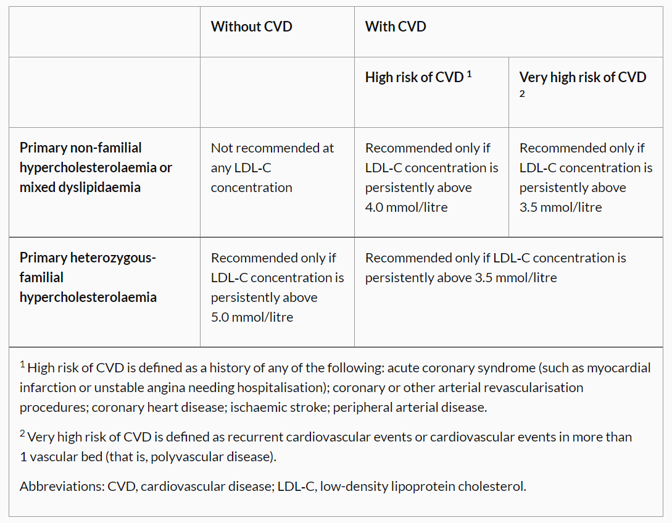
PCSK9 mAbs and NICE
NICE TA394

Slide 44

Case 2
Case 2
62 year old female
Q Risk 14%
DM and BP
Atorva 20mg CK 1300
Rosuva 10mg ow myalgia
Total cholesterol 6.4 mmol/L
HDL-c 1.4 mmol/L
LDL-c 4.4 mmol/l
TG 1.4 mmol/l
Non-HDL-c 5.0 mmol/l

Slide 45
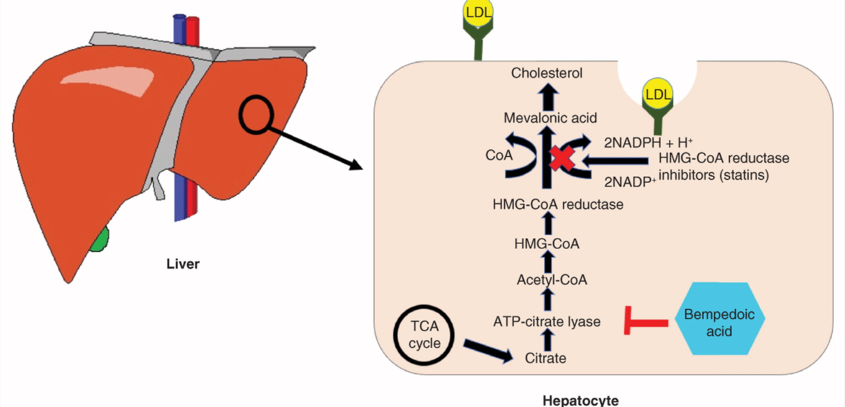
Bempedoic Acid
a
b
Notes:
Bempedoic acid (BA) is a once‐daily, oral, first‐in‐class ATP–citrate lyase inhibitor. ATP–citrate lyase is a cytosolic enzyme integral to the cholesterol synthesis pathway that acts upstream of statin reductase.¹² This mechanism of action is distinct from other lipid‐lowering therapies, including statins (which target statin reductase) and ezetimibe (an inhibitor of intestinal cholesterol absorption). By inhibiting ATP–citrate lyase, BA suppresses cholesterol synthesis,¹² thereby triggering upregulation of low‐density lipoprotein receptor expression in the liver, resulting in increased clearance of low‐density lipoprotein particles and lowering of LDL‐C.¹ Both phase 2 and phase 3 clinical trials showed that BA as monotherapy or when added to background lipid‐lowering therapy significantly lowered LDL‐C as well as other relevant lipids and biomarkers.¹³
https://www.nejm.org/doi/full/10.1056/NEJMoa1803917

Slide 46
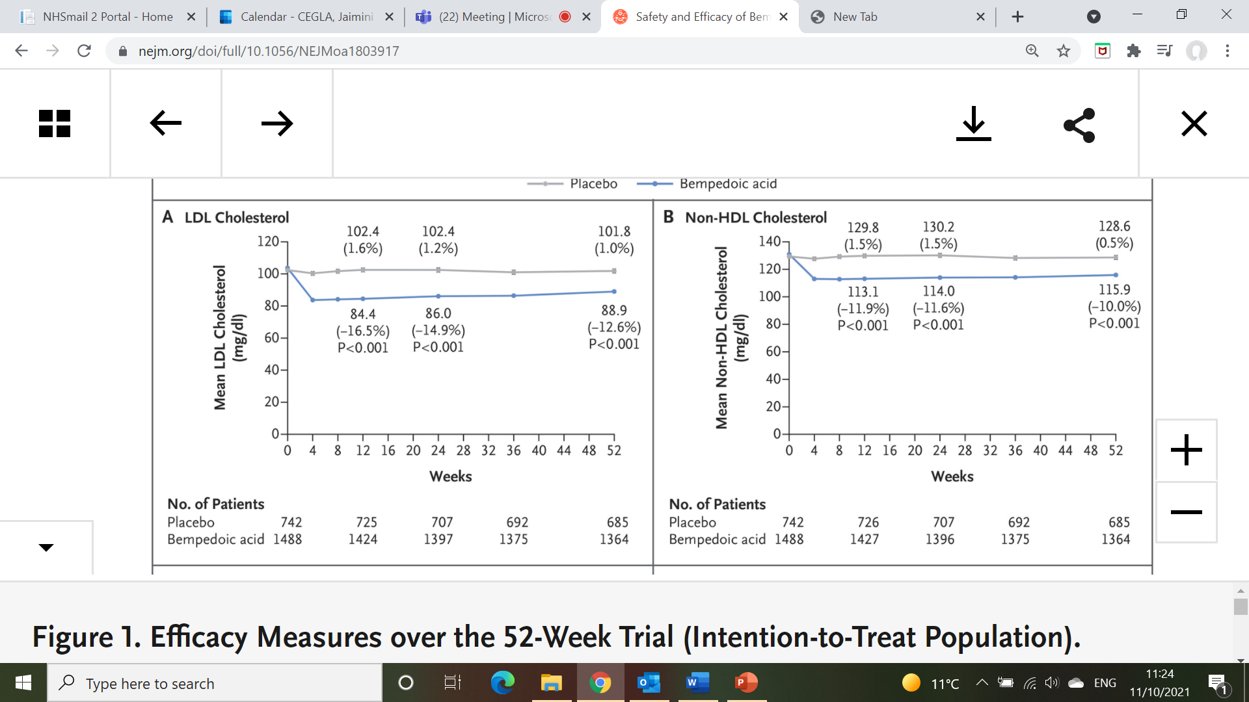
Bempedoic Acid and LDL-c lowering
a
b
Ray et al, NEJM. 2019
Notes:
Bempedoic acid (BA) is a once‐daily, oral, first‐in‐class ATP–citrate lyase inhibitor. ATP–citrate lyase is a cytosolic enzyme integral to the cholesterol synthesis pathway that acts upstream of statin reductase.¹² This mechanism of action is distinct from other lipid‐lowering therapies, including statins (which target statin reductase) and ezetimibe (an inhibitor of intestinal cholesterol absorption). By inhibiting ATP–citrate lyase, BA suppresses cholesterol synthesis,¹² thereby triggering upregulation of low‐density lipoprotein receptor expression in the liver, resulting in increased clearance of low‐density lipoprotein particles and lowering of LDL‐C.¹ Both phase 2 and phase 3 clinical trials showed that BA as monotherapy or when added to background lipid‐lowering therapy significantly lowered LDL‐C as well as other relevant lipids and biomarkers.¹³
https://www.nejm.org/doi/full/10.1056/NEJMoa1803917

Slide 47
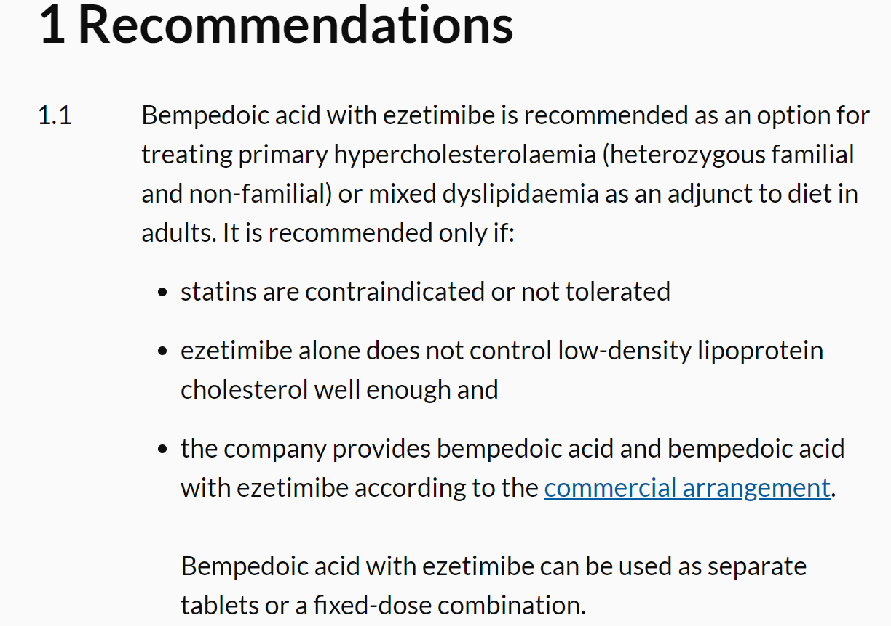
Bempedoic Acid and NICE
NICE TA694

Slide 48
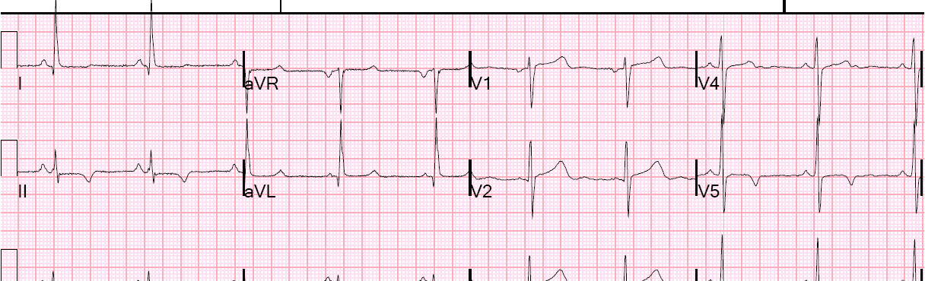

Case 3
Case 3
67 year old male
NSTEMI 2018 3x stents
DM
Atorva 80mg and ezetemibe 10mg
Total cholesterol 4.2 mmol/L
HDL-c 1.1 mmol/L
LDL-c 2.7 mmol/l
TG 0.9 mmol/l
Non-HDL-c 3.1 mmol/l

Slide 49
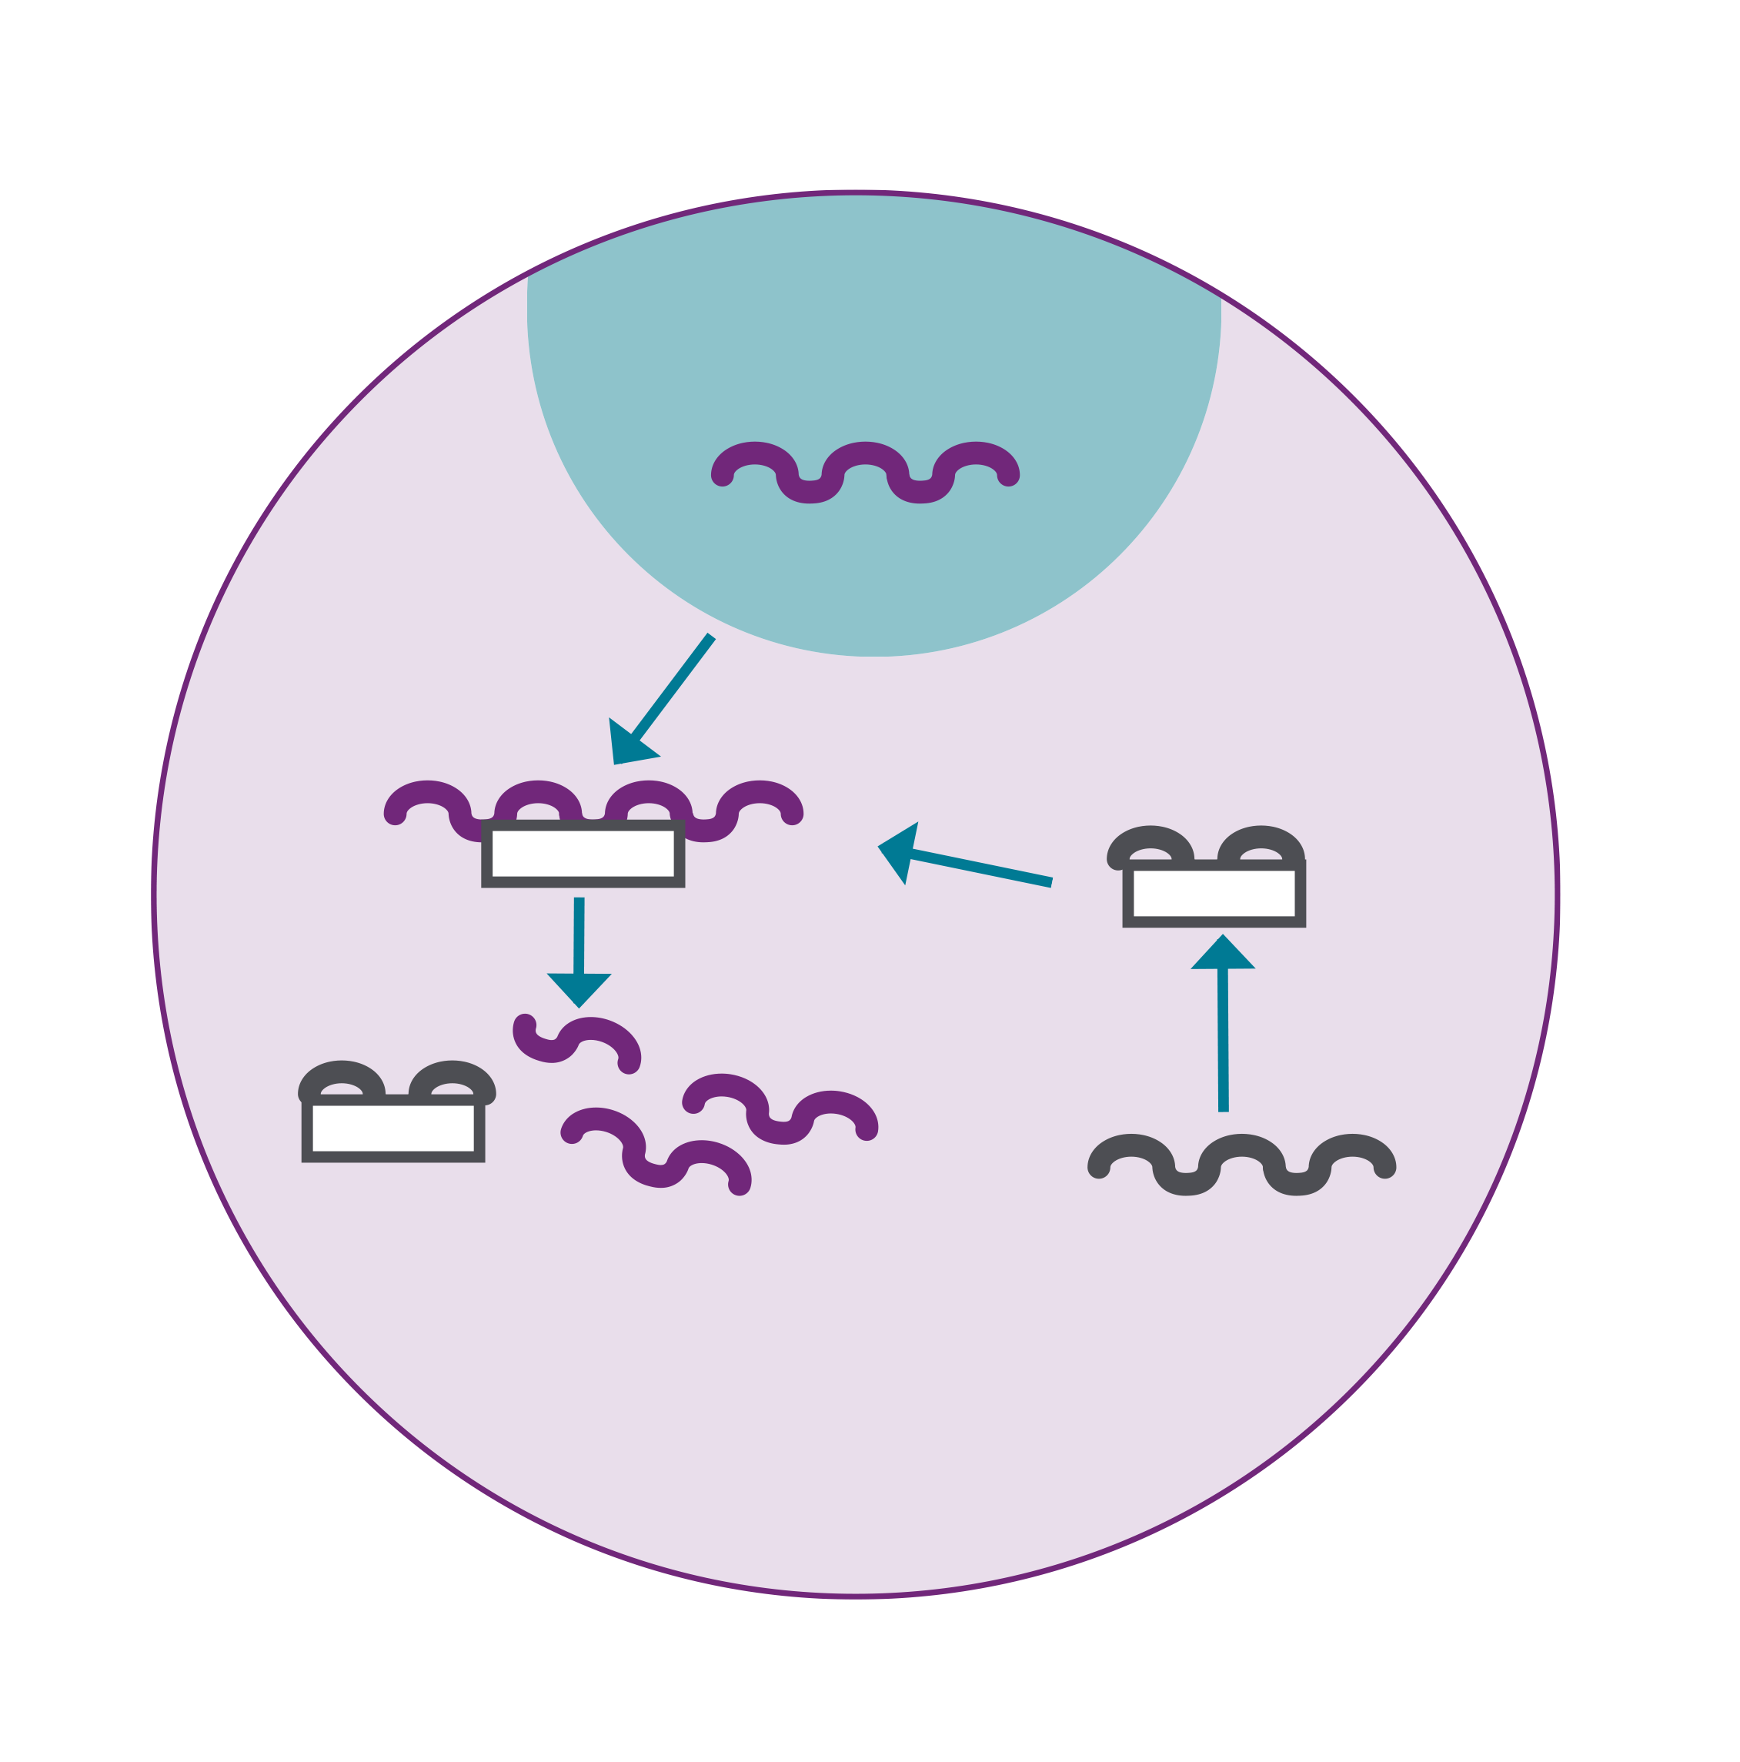
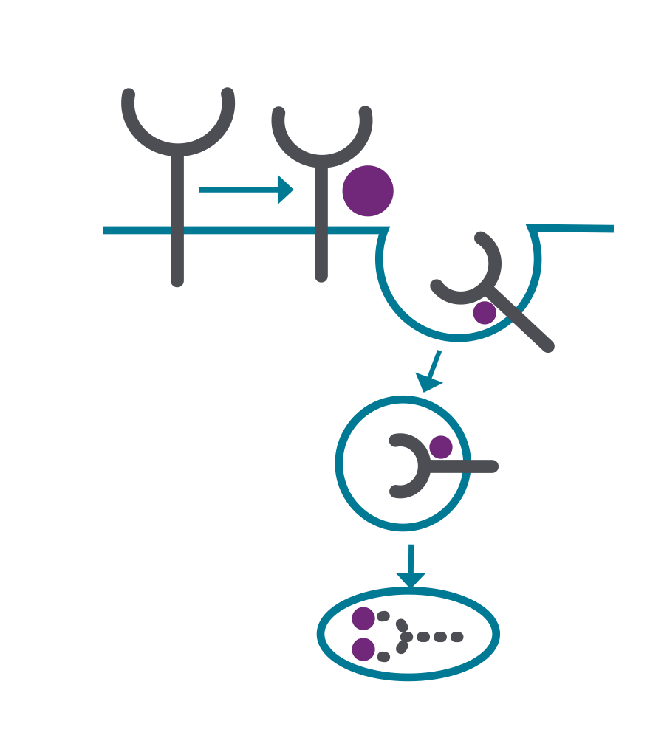
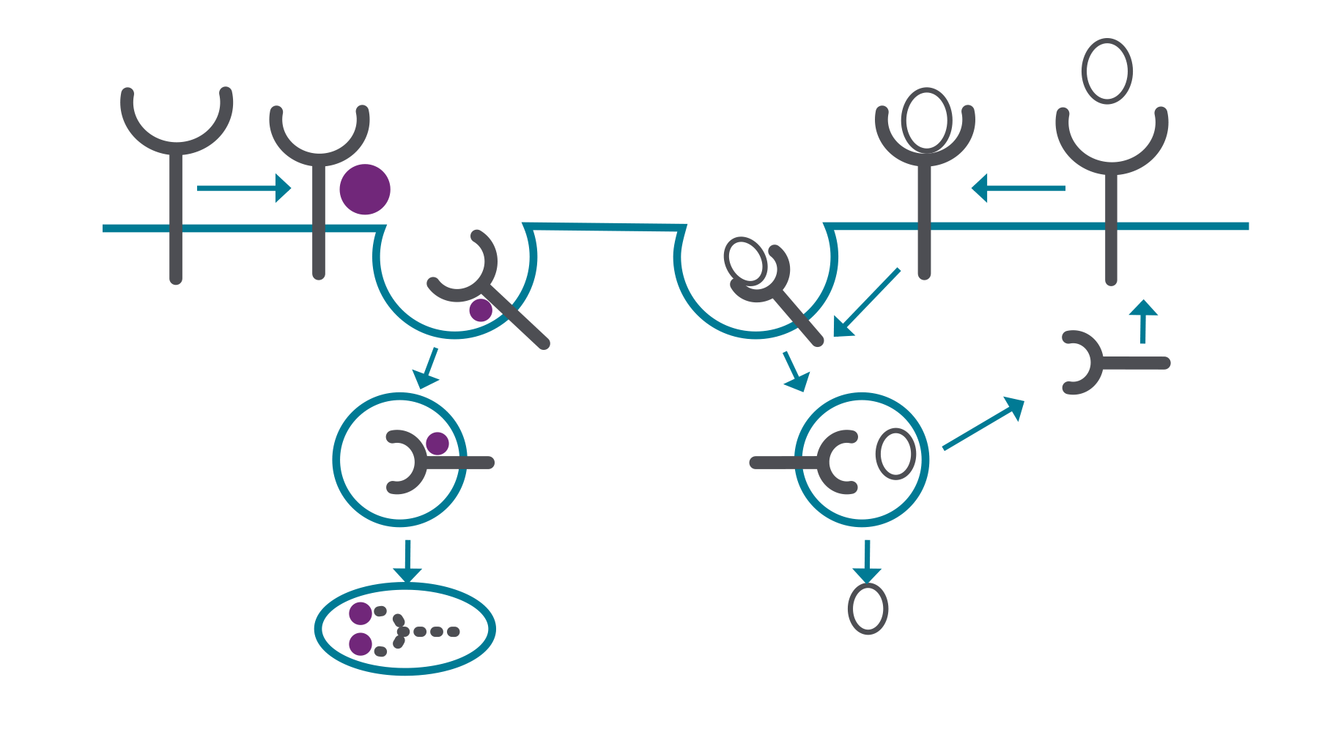
Inclisiran
LDL-C
PCSK9 mRNA
PCSK9
siRNA
RISC COMPLEX CLEAVES PCSK9
siRNA
LOADED INTO RISC COMPLEX
a
b
LDL RECEPTOR
RECYCLING
PCSK9 mRNA DEGRADATION
siRNA
(INCLISIRAN)
Adapted from Kosmas CE et al. Diseases 2018.⁴
LYSOSOMAL DEGRADATION
LDL-C INCORPORATION INTO THE CELL
LDL – low-density lipoprotein; LDL-C – low-density lipoprotein cholesterol; mRNA – messenger ribonucleic acid; PCSK9 – proprotein convertase subtilisin/kexin type 9; RISC – RNA-induced silencing complex; RNAi – ribonucleic acid interference; siRNA – small interfering ribonucleic acid
References: 1. Leqvio® Summary of Product Characteristics. 2. Stoekenbroek RM et al. Future Cardiol 2018;14(6):433-442. 3. Klinovski M et al. CADTH Issues in Emerging Health Technologies, 2019. Canadian Agency for Drugs and Technologies in Health. 4. Kosmas CE et al. Diseases 2018;6(3):63.
Notes:
Bempedoic acid (BA) is a once‐daily, oral, first‐in‐class ATP–citrate lyase inhibitor. ATP–citrate lyase is a cytosolic enzyme integral to the cholesterol synthesis pathway that acts upstream of statin reductase.¹² This mechanism of action is distinct from other lipid‐lowering therapies, including statins (which target statin reductase) and ezetimibe (an inhibitor of intestinal cholesterol absorption). By inhibiting ATP–citrate lyase, BA suppresses cholesterol synthesis,¹² thereby triggering upregulation of low‐density lipoprotein receptor expression in the liver, resulting in increased clearance of low‐density lipoprotein particles and lowering of LDL‐C.¹ Both phase 2 and phase 3 clinical trials showed that BA as monotherapy or when added to background lipid‐lowering therapy significantly lowered LDL‐C as well as other relevant lipids and biomarkers.¹³
https://www.nejm.org/doi/full/10.1056/NEJMoa1803917

Slide 50

Inclisiran and LDL-c lowering
2
MAINTENANCE
HCP-administered
Subcutaneous injection
No refrigeration required
Fixed dose
DOSES
a
b
A YEAR
^{†1}
† After an initial dose, inclisiran is administered again at 3 months, followed by every 6 months.¹
* In patients with ASCVD or risk equivalents (including type 2 diabetes, FH, or a 10-year risk of a cardiovascular event of ≥20% as assessed by the Framingham Risk Score for Cardiovascular Disease or equivalent).²
ASCVD – atherosclerotic cardiovascular disease; FH – familial hypercholesterolaemia; HCP – healthcare professional; LDL-C – low-density lipoprotein cholesterol
References: 1. Leqvio® Summary of Product Characteristics. 2. Ray KK et al. N Engl J Med 2020;382(16):1507‐1519. 3. Stoekenbroek RM et al. Future Cardiol 2018;14(6):433-442. 4. Klinovski M et al. CADTH Issues in Emerging Health Technologies, 2019. Canadian Agency for Drugs and Technologies in Health.
Notes:
Bempedoic acid (BA) is a once‐daily, oral, first‐in‐class ATP–citrate lyase inhibitor. ATP–citrate lyase is a cytosolic enzyme integral to the cholesterol synthesis pathway that acts upstream of statin reductase.¹² This mechanism of action is distinct from other lipid‐lowering therapies, including statins (which target statin reductase) and ezetimibe (an inhibitor of intestinal cholesterol absorption). By inhibiting ATP–citrate lyase, BA suppresses cholesterol synthesis,¹² thereby triggering upregulation of low‐density lipoprotein receptor expression in the liver, resulting in increased clearance of low‐density lipoprotein particles and lowering of LDL‐C.¹ Both phase 2 and phase 3 clinical trials showed that BA as monotherapy or when added to background lipid‐lowering therapy significantly lowered LDL‐C as well as other relevant lipids and biomarkers.¹³
https://www.nejm.org/doi/full/10.1056/NEJMoa1803917

Slide 51


Inclisiran and LDL-c lowering
In patients with ASCVD (or risk equivalents) on a maximally tolerated statin, inclisiran:^{1,2}
20
0
PLACEBO*
TIME-ADJUSTED
(MONTHS 3–18)
MONTH 17
-20
49
%
50
%
-40
a
b
Percentage change from baseline
INCLISIRAN*
-60
-80
-100
Adapted from Ray KK et al. N Engl J Med 2020.¹
0
3
5
9
11
15
17
18
Months
No. of Patients
Placebo 807 797 785 774 773 764 739 749
Inclisiran 810 790 796 778 773 768 724 742
At Month 17, inclisiran delivered placebo-corrected LDL-C reductions of 50%, as compared with baseline (95% CI: −53.1 to −46.6; P<0.0001) in ORION-11, with respective time-adjusted LDL-C reductions of 49% (95% CI: −51.6 to −46.8; P<0.0001) from baseline between Months 3 and 18 relative to placebo.^{1,2}
* Reductions were achieved on top of a maximally tolerated statin and/or other lipid-lowering therapies.¹
ASCVD – atherosclerotic cardiovascular disease; CI – confidence interval; LDL-C – low-density lipoprotein cholesterol
References: 1. Ray KK et al. N Engl J Med 2020;382(16):1507‐1519. 2. Leqvio® Summary of Product Characteristics.
Notes:
Bempedoic acid (BA) is a once‐daily, oral, first‐in‐class ATP–citrate lyase inhibitor. ATP–citrate lyase is a cytosolic enzyme integral to the cholesterol synthesis pathway that acts upstream of statin reductase.¹² This mechanism of action is distinct from other lipid‐lowering therapies, including statins (which target statin reductase) and ezetimibe (an inhibitor of intestinal cholesterol absorption). By inhibiting ATP–citrate lyase, BA suppresses cholesterol synthesis,¹² thereby triggering upregulation of low‐density lipoprotein receptor expression in the liver, resulting in increased clearance of low‐density lipoprotein particles and lowering of LDL‐C.¹ Both phase 2 and phase 3 clinical trials showed that BA as monotherapy or when added to background lipid‐lowering therapy significantly lowered LDL‐C as well as other relevant lipids and biomarkers.¹³
https://www.nejm.org/doi/full/10.1056/NEJMoa1803917

Slide 52
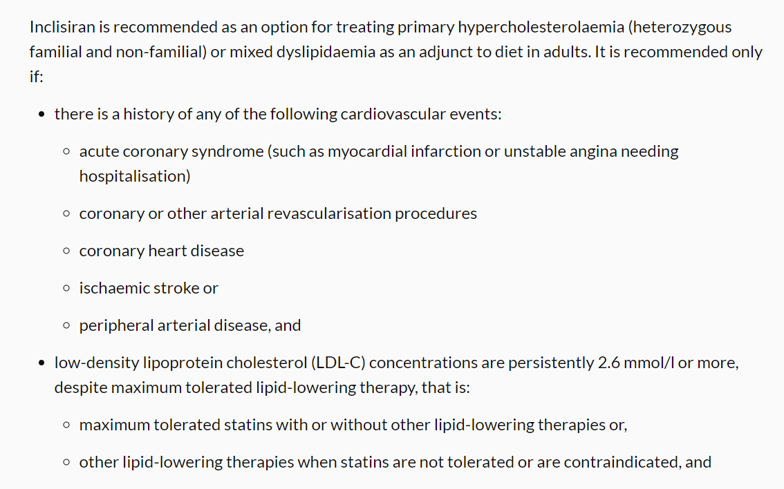
Inclisiran and NICE
NICE TA733

Slide 53
Inclisiran
Patients referred to secondary care for further lipid management
~90 patients
Dec 2021
Seen and assessed in Lipid clinic:
Baseline bloods taken, treatment options explored including suitability for inclisiran treatment
Once approved, patients booked for initial inclisiran dose administered by Lipid CNS
Review at 2 month follow up with repeat blood tests
Subsequent doses to be given by General Practice
Padam et al, Open Heart 2022

Slide 54
Baseline characteristics
 | FH n = 30 | Non-FH n = 50 | Total n = 80
Sex n (%)
Male Female | 18 (60) 12 (40) | 34 (68) 16 (32) | 52 (65) 28 (35)
Age, mean (SD, range) | 61.7 (± 12.6, 34-83) | 65.3 (± 8.5, 51-83) | 64 (± 10.3, 34-83)
Ethnicity n (%)
Asian Black Mixed Other White | 8 (26.7) 2 (6.7) 1 (3.3) 3 (10) 16 (53.3) | 10 (20) - 2 (4) 9 (18) 29 (58) | 18 (22.5) 2 (2.5) 3 (3.8) 12 (15) 45 (56.3)
Atherosclerotic disease n (%)
Coronary artery disease CABG MI PCI Subclinical cor. disease Cerebrovascular disease Stroke TIA Subclinical carotid disease Peripheral arterial disease | 23 (76.7) 2 (6.7) 8 (26.7) 2 (6.7) 11 (36.7) 4 (13.3) 1 (3.3) 1 (3.3) 2 (6.7) 1 (3.3) | 44 (88) 7 (34) 12 (24) 13 (26) 17 (34) 10 (20) 1 (2) 3 (6) 6 (12) 3 (6) | 67 (83.8) 9 (11.3) 20 (25) 15 (18.8) 28 (35) 14 (17.5) 2 (2.5) 4 (5) 8 (10) 4 (5)
Cardiovascular risk factors n (%)
Hypertension Diabetes mellitus Smoking history | 7 (23.3) 3 (10) 3 (10) | 25 (50) 16 (32) 9 (18) | 32 (40) 19 (23.8) 12 (15)
Lipid profile, mmol/L, mean (SD)
Total cholesterol LDL-c Triglycerides ª HDL-c | 5.5 (± 1.3) 3.5 (± 1.2) 1.4 (1.0 - 1.4) 1.4 (± 0.3) | 5.9 (± 1.4) 3.6 (±1.1) 1.7 (1.3 - 2.9) 1.3 (± 0.4) | 5.8 (± 1.4) 3.5 (± 1.2) 1.6 (1.2 - 2.3) 1.3 (± 0.4)
Lipid Lowering treatment ^{b} n (%)
Atorvastatin alone Rosuvastatin alone Ezetimibe alone Statin and Ezetimibe Colesevelam alone Bempedoic acid Bempedoic acid and Ezetimibe Triple combinative therapy ^{c} No Lipid lowering treatment | 5 (16.7) 1 (3.3) 3 (10) 14 (46.7) 1 (3.3) - - 6 (20) - | 4 (8) 1 (2) 10 (20) 6 (12) 1 (2) 1 (2) 1 (2) 7 (14) 19 (38) | 9 (11.3) 2 (2.5) 13 (16.3) 20 (25) 2 (2.5) 1 (1.3) 1 (1.3) 13 (16.3) 19 (23.8)
Padam et al,
Open Heart 2022

Slide 55
Inclisiran
**
LDL-c mmol/L
LDL-c mmol/L
Baseline
Post Inclisiran
Baseline
Post Inclisiran
C
D
*
**
**
**
**
**
Padam et al, Open Heart 2022

Slide 56
Inclisiran
Padam et al, Open Heart 2022

Slide 57
Content
CV Risk and lipid lowering
Lipid lowering therapies
Pathways for lipid management

Slide 58
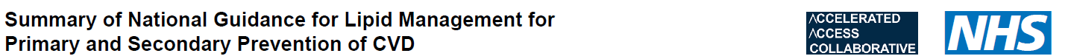
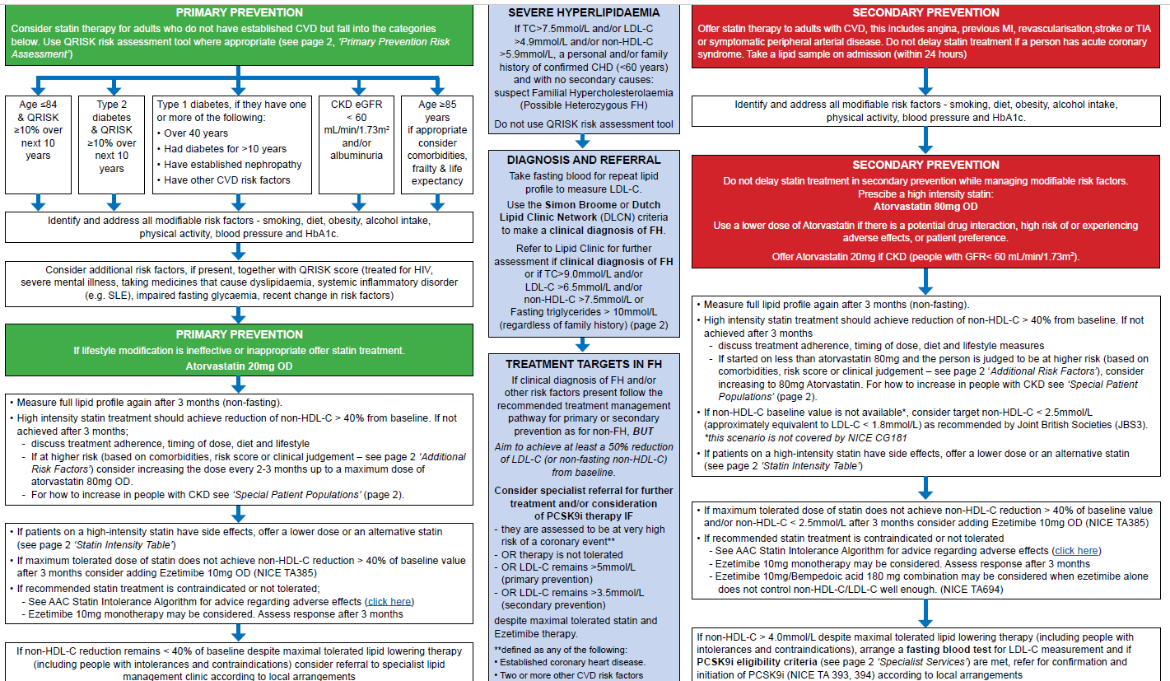

Slide 59
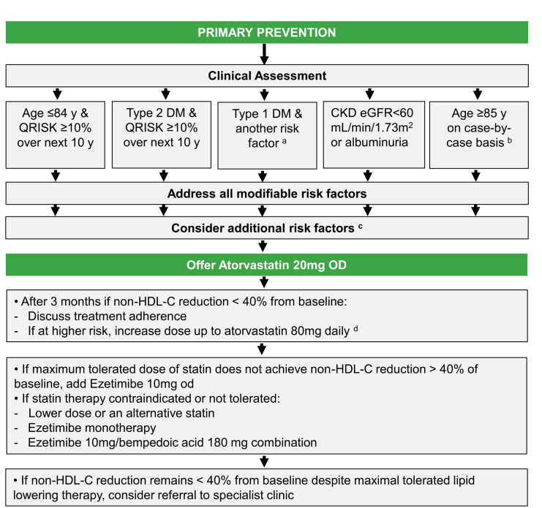
AAC/ NHS England

Slide 60
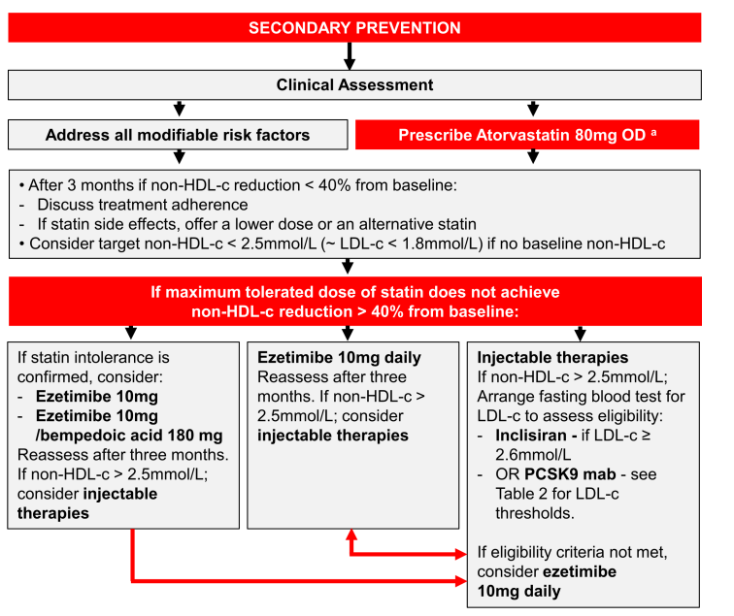
AAC/ NHS England

Slide 61

NWL ICS Update
Keval Modi, Medicines Management Lead Hillingdon, NWL ICS

Slide 62
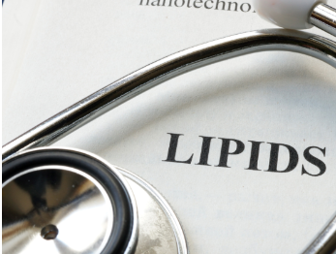
Lipid Resources
NWL ICS Lipid Webpage
Includes document library with links to
National and local guidance on lipid management
Lipid Management Implementation Support Pack
Inclisiran initiation and funding guidance - updated
Familial Hypercholesterolaemia guidance
Other Lipid Conditions
How to access UCLP searches in EMIS & SystmOne
If you require further information or wish to share your experience of lipid management, please contact: Cardiovascular@imperialcollegehealthpartners.com

Slide 63

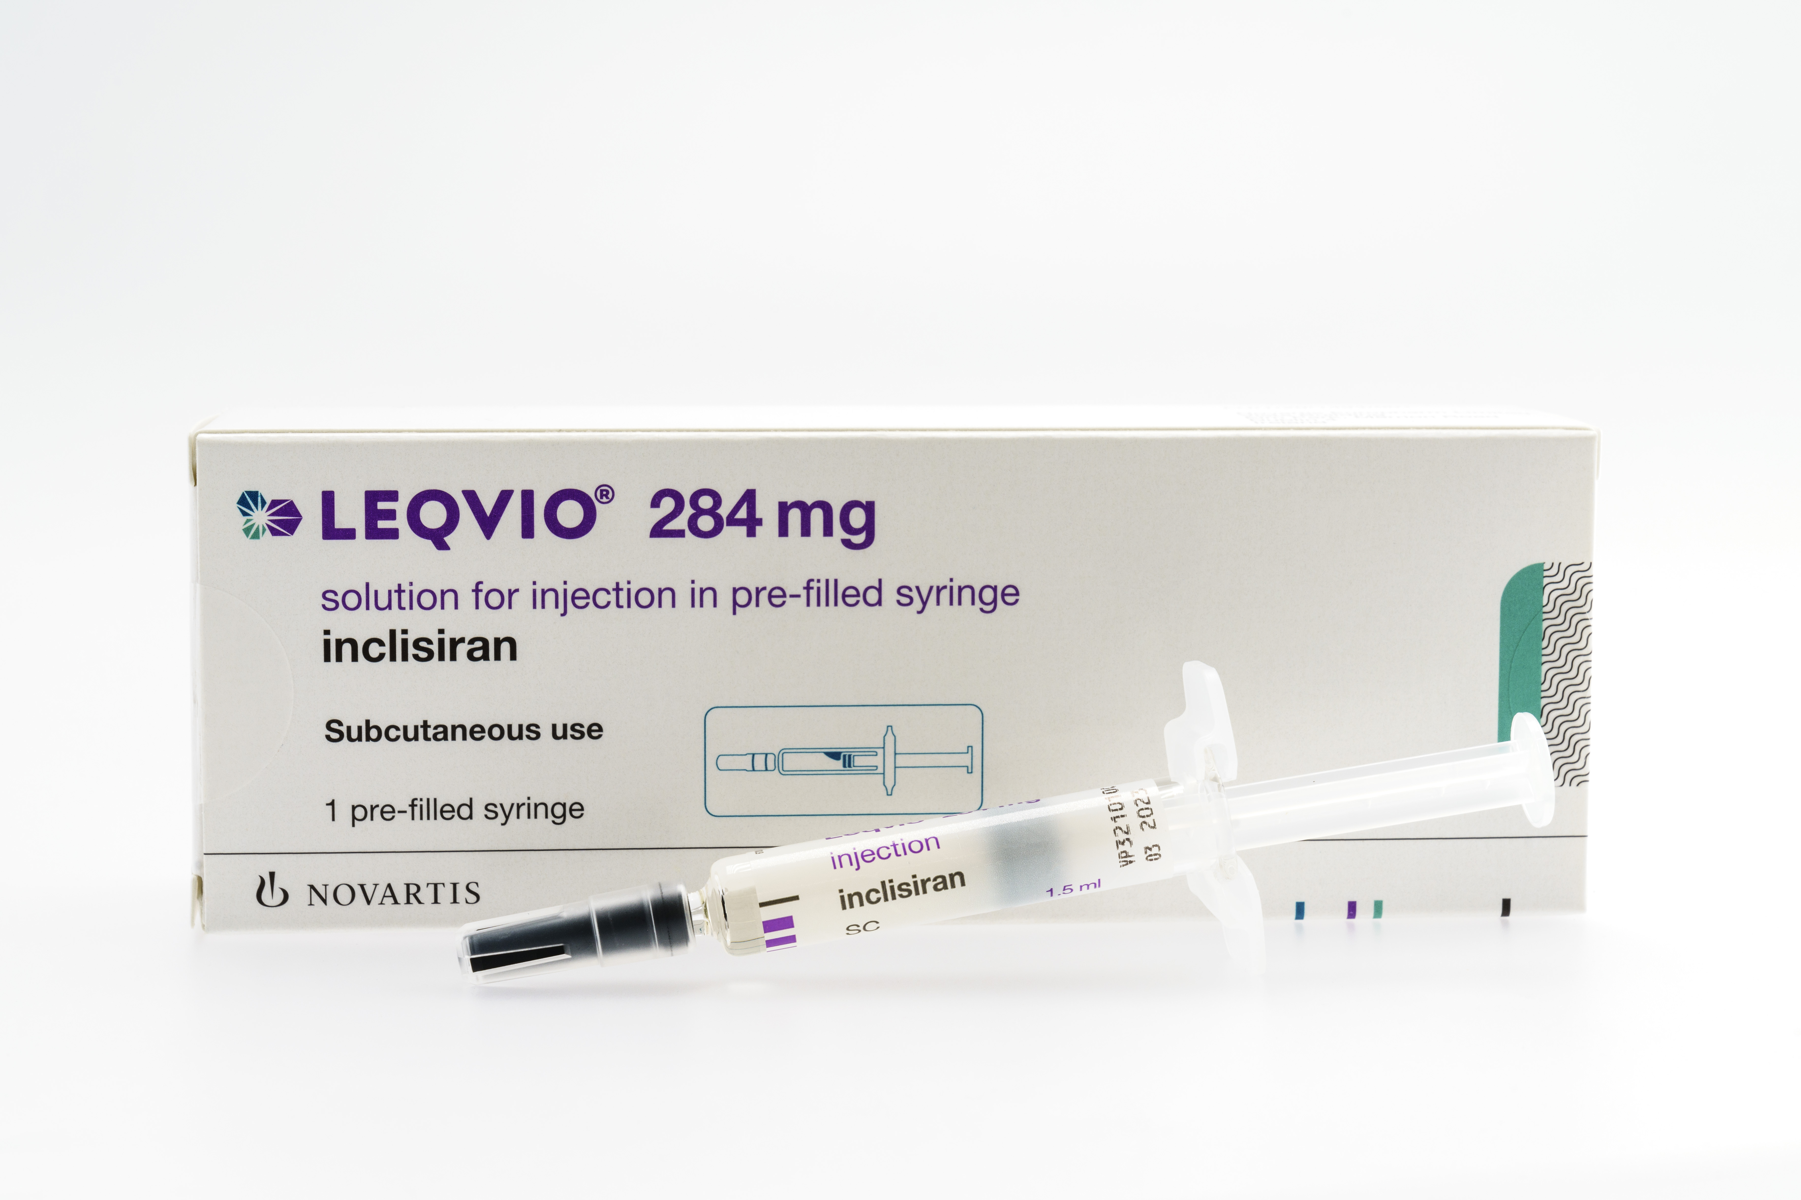
Inclisiran Reimbursement Update
Updated FAQs on inclisiran ordering and reimbursement
Submit FP34PD* document + FP10 for each Inclisiran Injection to receive
Inclisiran Cost (£45) plus £5 PA item fee
*Do not use FP34PD High Volume Appendix Form for vaccines
Full details can be found in the summary information on the funding and supply of inclisiran (Leqvio®)
Contact NWL Medicines Management Team
nhs.nwl.medicinesmanagement@nhs.net if any queries

Slide 64
Panel Q&A

Slide 65
CVD Champions 2023/24
Zahra Mahir, Pharmacist, Hammersmith and Fulham
Zahra.mahir@nhs.net
Dr Perviz Asaria, Consultant Cardiologist, Harrow
p.asaria@imperial.ac.uk
Joanne Peh, Pharmacist, Hounslow
joanne.peh@nhs.net
Dr Venothan Suri, GP, Hillingdon
v.suri@nhs.net
Rokaih Noori, Pharmacist, Kensington and Chelsea (West London)
rokaih.noori@nhs.net
6
Dr Amisha Mehta, GP, Westminster
amisha.mehta@nhs.net
7
Dr Riham Rabee, GP, Brent
riham.rabee@nhs.net
Notes:
Zahra is a practising independent prescribing pharmacist, currently working as a senior medicines optimisation pharmacist with Central London Community Healthcare NHS trust under the North Hammersmith and Fulham PCN.
Dr Perviz Asaria is a Consultant Cardiologist with additional training in public health, currently working at the Imperial College School of Public Health.
Joanne is currently the Head of Hounslow PCN Pharmacy services and has recently been the Hounslow PCNs’ social prescriber manager. Joanne has a strong clinical background in intensive care (ICU), neurosciences (pain management), renal and cardiovascular medicine.
Dr Venothan Suri is a GP at Glendale Medical Centre in Hillingdon (Hayes and Harlington PCN) and is Hillingdon LMC Chair. With an interest in medical education, Dr Suri has been an Imperial medical student facilitator.
Rokaih is currently the lead pharmacist for West Hill Health PCN and senior pharmacist in West London GP Federation, managing and developing a team of pharmacists and pharmacy technicians across west London.
Amisha has worked in several of the Westminster practices as well as working at scale in the GP federation and is currently the Deputy Clinical Lead for the HCL eHub service.
Riham is currently a GP Partner, splitting her time working between Willesden Green Surgery, St Mary’s Hospital as an ENT GP Fellow, and teaching medical students at Imperial College Medical school.

Slide 66
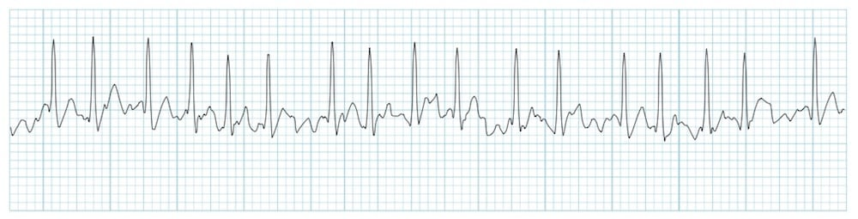

Next Education Session
AF Case Finding Webinar
14/09/2023 1pm to 2pm
Speakers: Dr Sadia Khan, Dr Shazia Siddiqi, Zainab Khanbhai and ICHP AF InHIP Team.
Presenting AF in NWL, Case Finding, Case Study and InHIP engagement with PCNs.
Our speakers will be available for a
15-minute Q&A, please bring along any questions or case studies for our panel.
To register for the event please click here

