Slide 1
Atrial Fibrillation
Case Finding, and Healthcare Inequalities
Thursday 14th September 2023
13:00 – 14:00

Slide 2

Agenda: Atrial Fibrillation: Effective case-finding and highlighting healthcare inequalities in NWL
Agenda Item | Speaker | Time
Welcome & Update on AF in NWL | Dr Shazia Siddiqi and Dr Sadia Khan, Primary Care and Secondary Care Co-Chairs, NWL AF Working Group | 10mins
AF Case Finding | Zainab Khanbhai, Senior Cardiothoracic Surgical Pharmacist, Royal Brompton Hospital | 15 mins
AF Healthcare Inequalities | Tom Clutterbuck, Innovation Advisor, Imperial College Health Partners | 15 mins
Q&A | Lead by Dr Shazia Siddiqi and Dr Sadia Khan | 15 mins
Feedback and Close | Chanelle Corena, Senior Innovation Manager, Imperial College Health Partners | 5 mins
Housekeeping:
      Please remain on mute and with camera off unless speaking
      Questions? Enter into the chat, or, during our Q&A section at 13:45 use ‘raise hand’ function
      Please note we will be recording this meeting

Slide 3
Atrial Fibrillation in NWL
Dr Shazia Siddiqi and Dr Sadia Khan

Slide 4
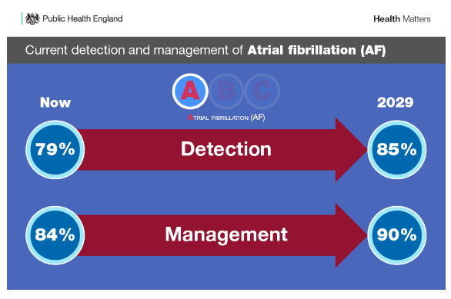
Notes:
https://www.gov.uk/government/publications/health-matters-preventing-cardiovascular-disease/health-matters-preventing-cardiovascular-disease

Slide 5
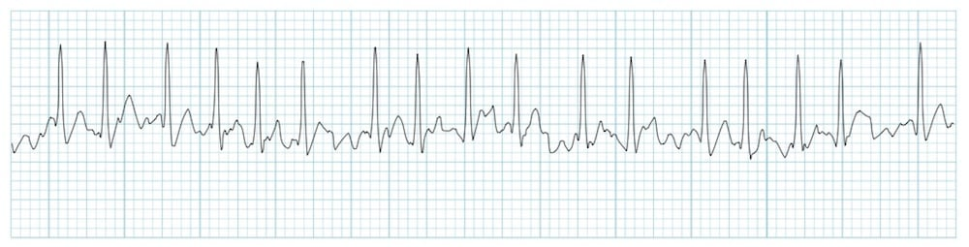

NWL CVD AF Plan
Improve detection of atrial fibrillation and ensure appropriate stroke risk reduction through anticoagulation
Detect 85% of expected prevalence

Slide 6
QOF – Atrial Fibrillation
Indicator | Points | Achievement thresholds
AF001 The contractor establishes and maintains a register of patients with atrial fibrillation. | 5 | —
AF006 The percentage of patients with atrial fibrillation in whom stroke risk has been assessed using the CHA2DS2-VASc score risk stratification scoring system in the preceding 12 months (excluding those patients with a previous CHADS2 or CHA2DS2-VASc score of 2 or more) | 12 | 40–90%
*AF008. Percentage of patients on the QOF Atrial Fibrillation register and with a CHA2DS2- VASc score of 2 or more, who were prescribed a direct-acting oral anticoagulant (DOAC), or, where a DOAC was declined or clinically unsuitable, a Vitamin K antagonist | 12 | 70-95%
*Please note AF008 has recently replaced AF007, in the 23/24 QOF Indicators.
Notes:
https://www.england.nhs.uk/wp-content/uploads/2023/03/PRN00289-quality-and-outcomes-framework-guidance-for-2023-24.pdf

Slide 7
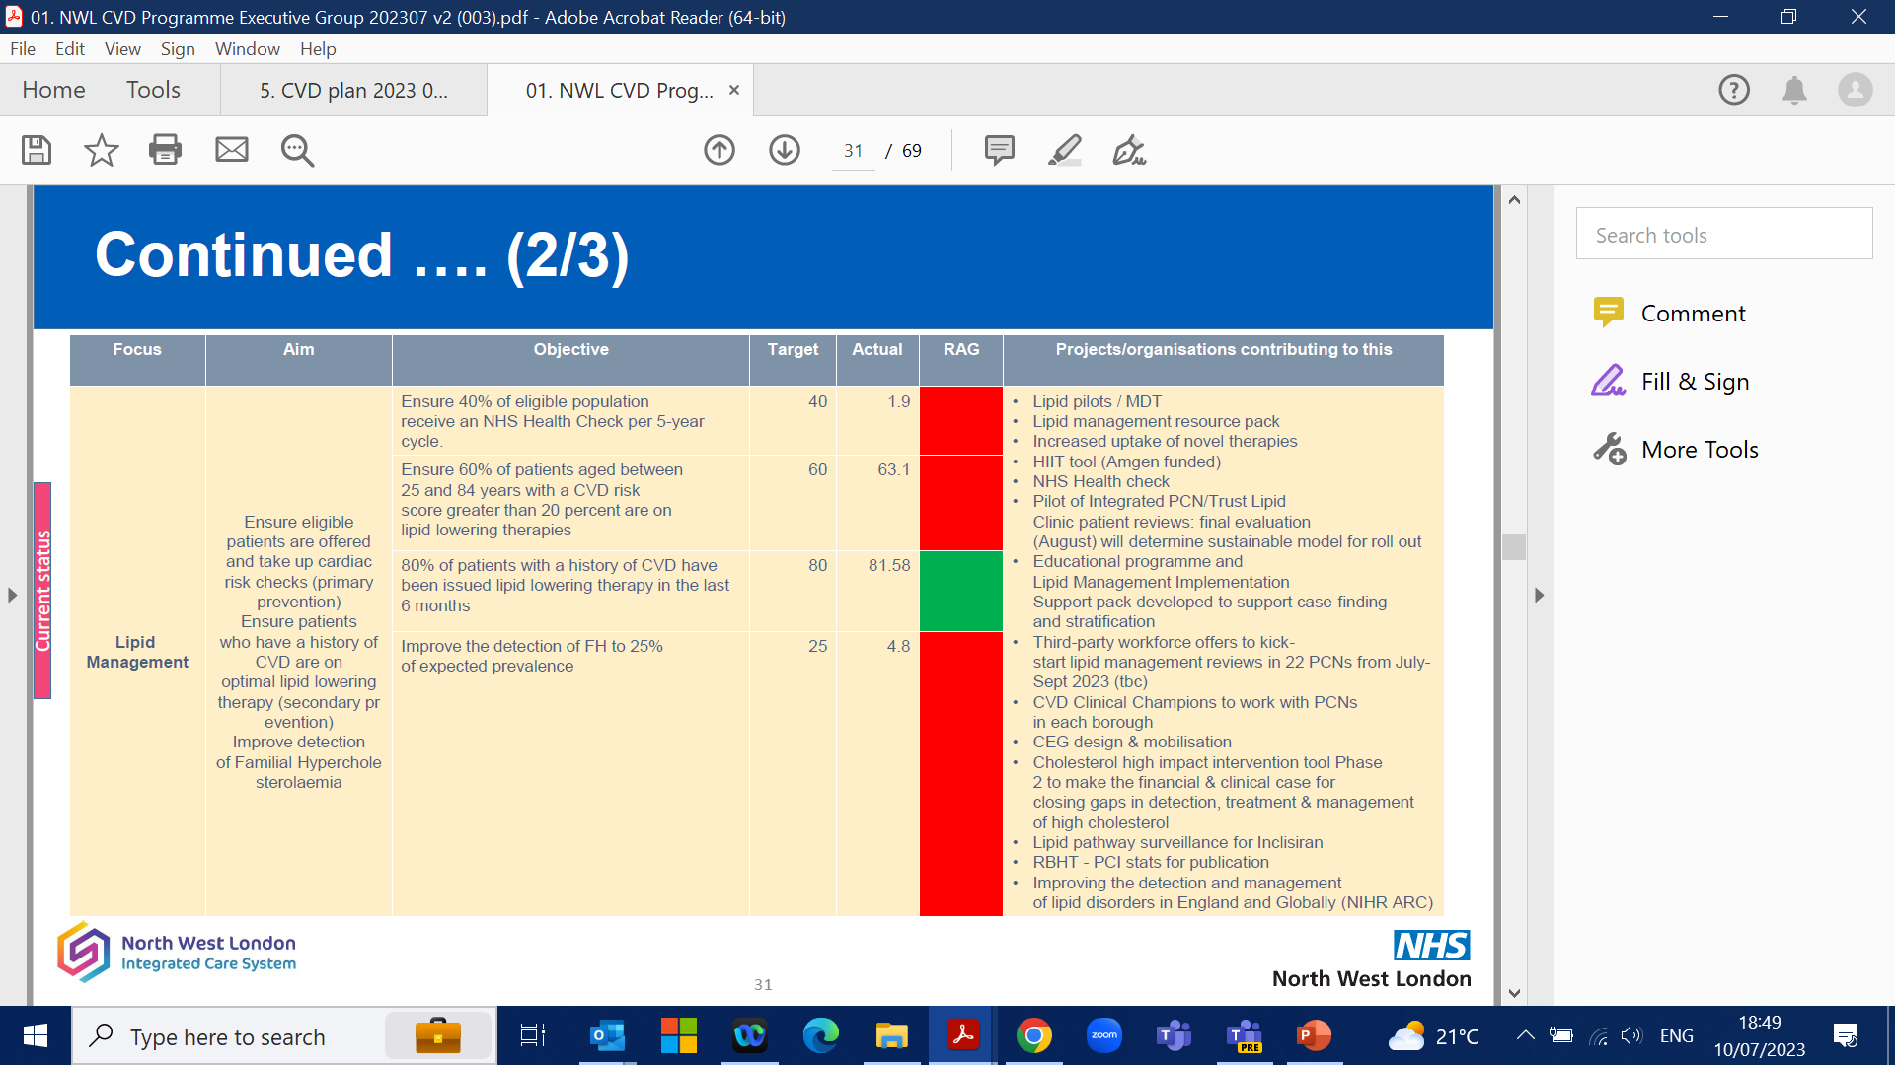
How is NWL performing?
Atrial Fibrillation | Aim | Objective | Target | Actual (Jan-23)
Lipid Management | Improve detection of atrial fibrillation and ensure appropriate stroke risk reduction through anticoagulation | Detect 85% of expected prevalence | 85% (1.4%)* | 65% (1.1% actual vs 1.7% estimated)
 |  | Ensure 90% of patients with AF to have a CHADVASC assessment in the last 12 months (QOF AF006) | 90% | 84.27%
 |  | Ensure 90% of those with a score of >=2, to be on anticoagulation, or, where a DOAC was declined or clinically unsuitable, a Vitamin K antagonist (QOF AF008) | 90% | 86.76%
*Target and actual are expressed as quarterly increases. Target of 40% over 5 years equates to a 2% increase per quarter.

Slide 8
Initiating medication
For patients commencing treatment for AF: subject to the criteria specified in the relevant NICE technology appraisal guidance:
  Clinicians should use edoxaban where this is clinically appropriate.
If edoxaban is deemed not clinically appropriate for the specific patient, then consider rivaroxaban, then apixaban or dabigatran, and this should be clearly documented in patients’ notes

Slide 9
Reviewing medication
Existing patients already established on an alternative DOAC for AF, should continue on their current DOAC (provided they are not experiencing adverse events of concern and provided their current DOAC is not contraindicated)

Slide 10
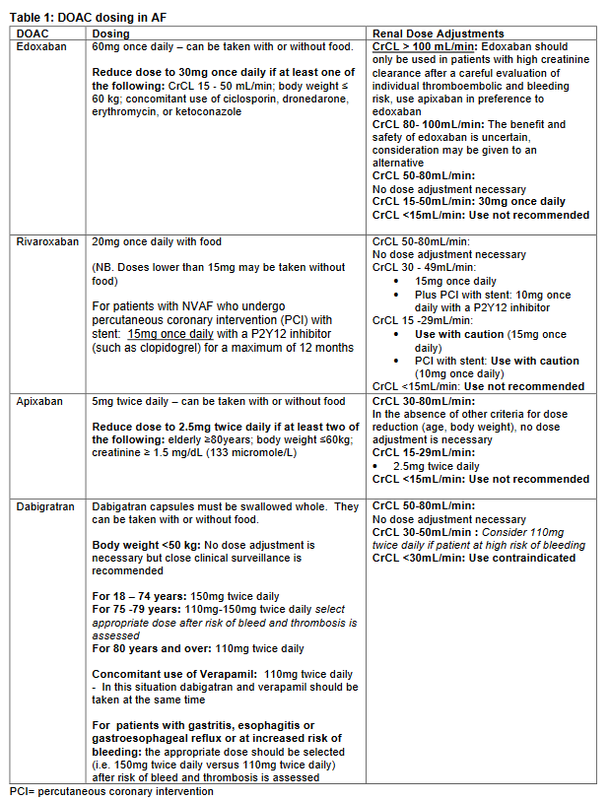
DOAC Dosing
1
2

Slide 11
DOAC Dosing
3
4

Slide 12
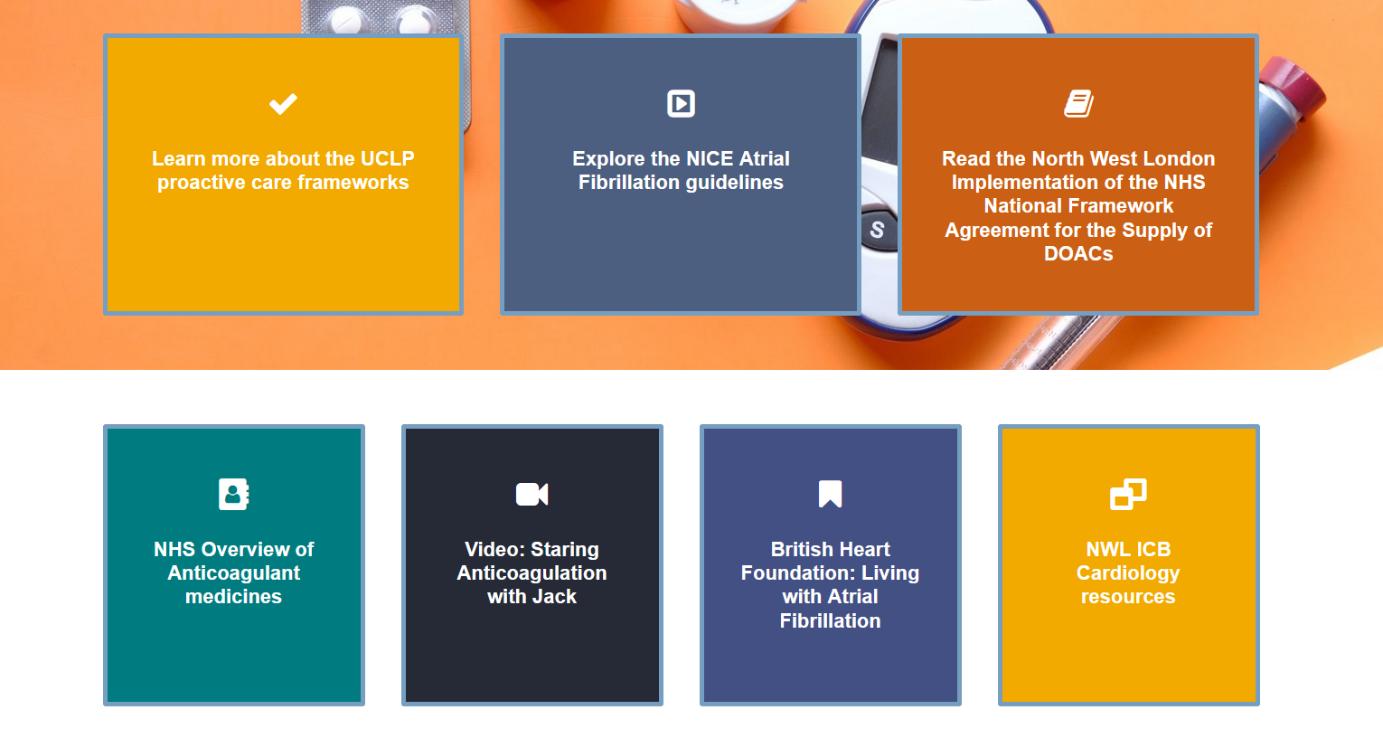
Resources
Please click here or visit imperialcollegehealthpartners.com
/resource/atrial-fibrillation/ where we have collated clinical and patient resources for staff to access across NWL.
We have also linked the ICB Cardiology webpage, where future resources will be updated.

Slide 13
AF Case Finding
Zainab Khanbhai
Capture AF Lead, Senior Pharmacist – Cardiothoracics
Royal Brompton and Harefield Hospitals

Slide 14
Background
Atrial Fibrillation (AF) is the most common heart rhythm abnormality
There are approximately 890,000 people who are living with diagnosed AF in England (1.6% general population)
Prevalence increases with age from 0.7% in people aged 55-59 years to 18% in those older than 85
AF is the leading cause of embolic stroke
Notes:
National cardiovascular intelligence network’ (NCVIN) with public health England have produced the AF prevalence estimates
474,000 patients undiagnosed
AF affects over 1 million people in the UK
Prevalence is likely to be an underestimation as screening events have shown higher prevelance in the general population – AFA screening event in Glasgow recently showed a prevelance of 3%.
Patients with heart failure 30-40% have AF
Previous MI 20% have AF
Over 65 years 7% have AF

Slide 15
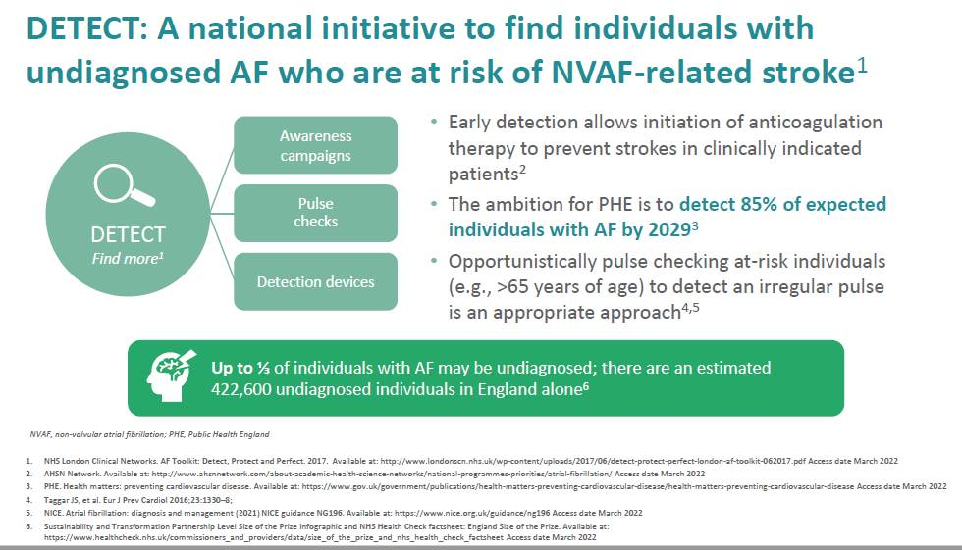

Slide 16
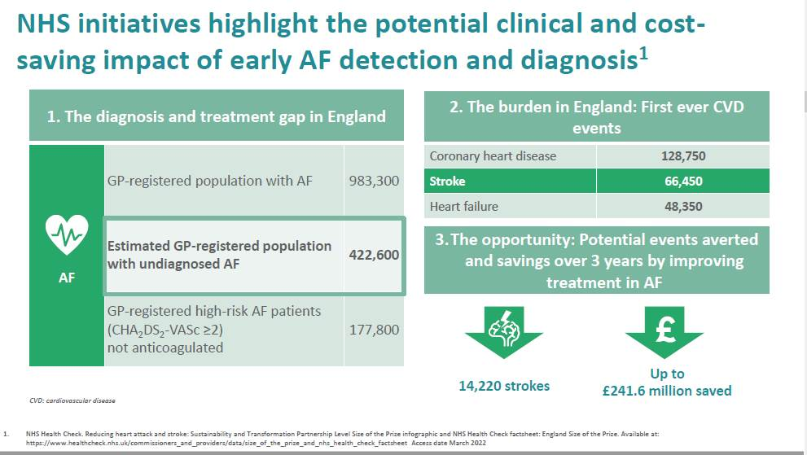

Slide 17
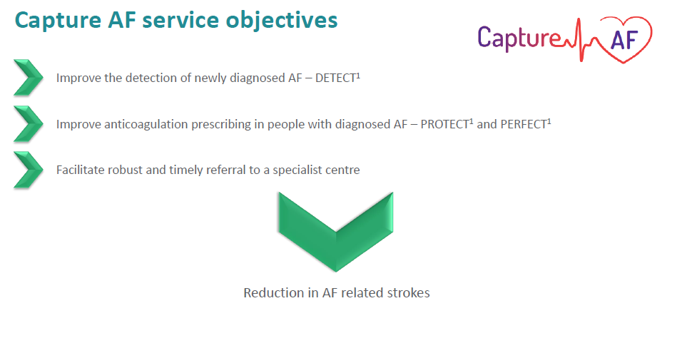
Capture AF Service Objectives

Slide 18
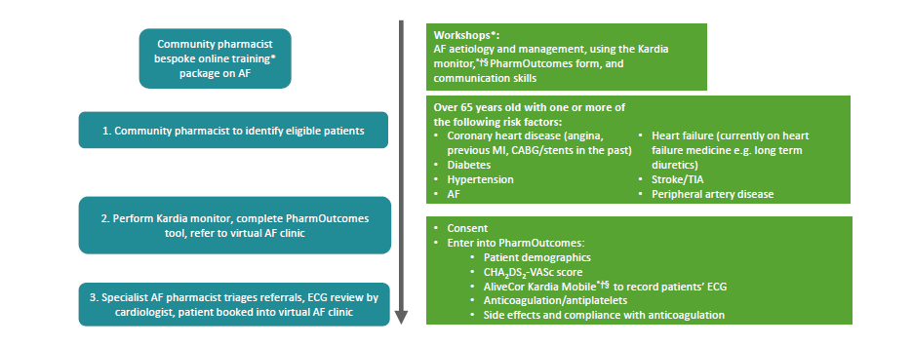
Capture AF Model

Slide 19
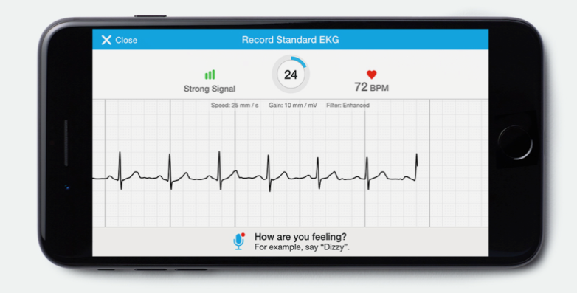
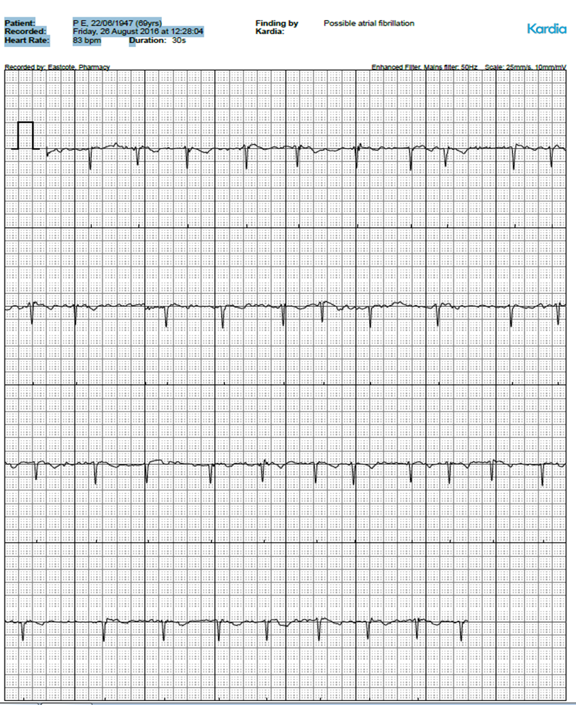

Kardia Monitor
Linked to smartphone via app
ECG trace in 30s
ECG analysis provided immediately
Portable
Cheap
Easy to use
PDF of ECG trace which can be emailed directly
Long battery life
Notes:
Pocket sized ECG recorder used with a mobile device app
It detects possible atrial fibrillation and can be used by people with intermittent palpitations to help determine the cause of their symptoms.
Can be used in any setting in place of an ECG recording and during normal daily activities
The monitor has 2 metal plates which contain electrodes
Two studies reported sensitivity higher than 85% and specificity higher than 90% for the AliveCor Heart Monitor and the AliveECG app, in detecting atrial fibrillation.
Two further studies of a clinician's ability to interpret AliveCor HeartMonitor readings reported sensitivity and specificity rates higher than 90%.
A user preference survey reported that most users preferred the AliveCorHeart Monitor to traditional transtelephonic monitors
Accredited by NICE and a full review is available in MIB232 www.nice.org.uk/guidance/mib232 and DG35 https://www.nice.org.uk/guidance/dg35
Either attached directly to the mobile device or must be within 30cm of it
Once reading taken, it is sent wirelessly via a patented high frequency sound transmission to the mobile device
Can be viewed using the Kardia app

Slide 20
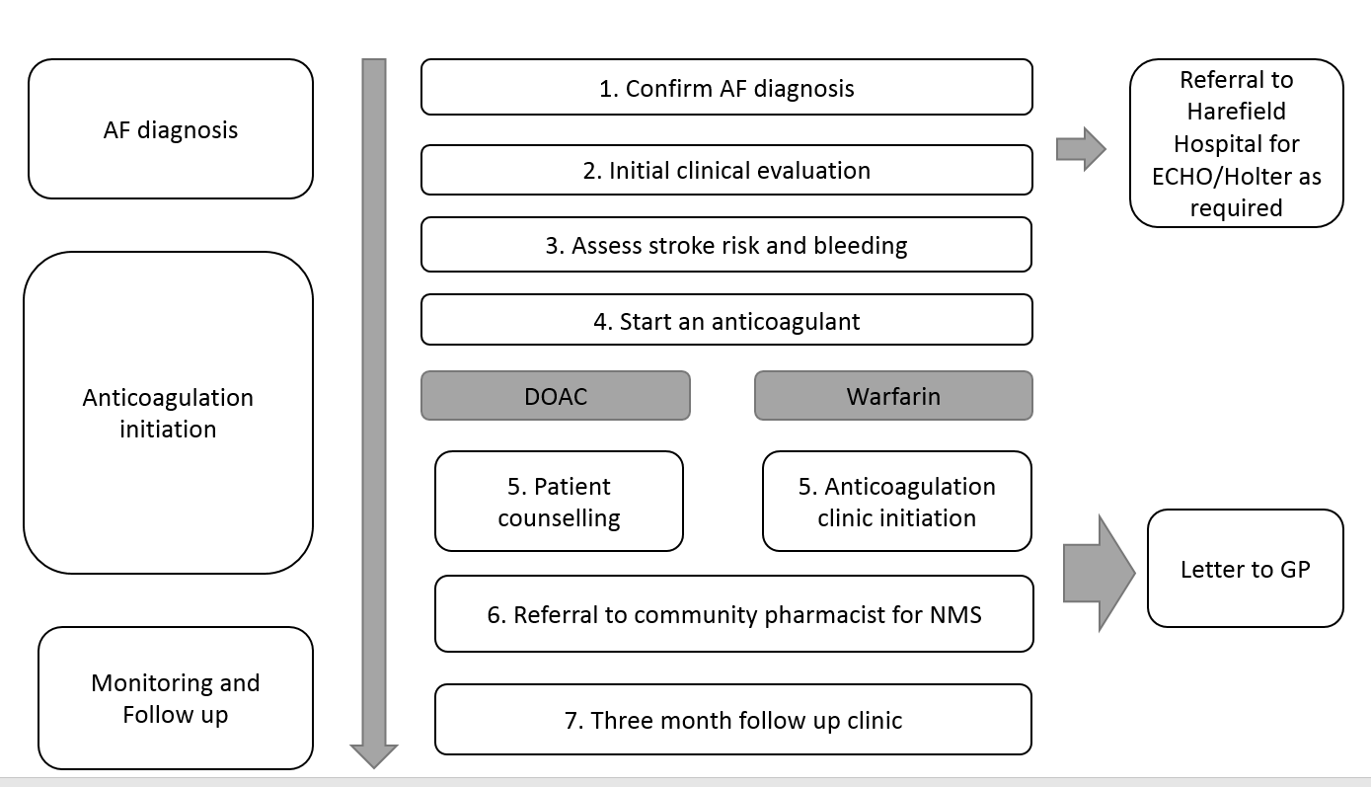
AF management pathway

Slide 21
Impact of Capture AF -Detection
Number of new AF
56
65 years plus with one risk factor for AF
Number of strokes saved
2 per annum¹
^{1 life saved}
Medical: £37,482
Medical and social care cost: £47,454
Year 1 Savings made from strokes prevented
Notes:
1) Granger CB, Alexander JH, McMurray JJV. et al. Apixaban versus warfarin in patients with atrial fibrillation. N Engl J Med 2011;365:981-92
2) Xu X-M et al. The economic burden of stroke care in England, Wales and Northern Ireland: Using a national stroke register to estimate and report patient-level health economic outcomes in stroke. Eur Stroke J 2018;3:82-91

Slide 22
Capture AF – Protection
Known AF not on an anticoagulant
Antiplatelet and anticoagulant review
Optimisation of anticoagulant
Dose adjustment: - 5
Warfarin to DOAC: – 14
23
13
Medical: £32,284,
Medical and Social Care: £53,829
2.4 1
strokes saved per annum life saved
Notes:
23 patients – save 1 stroke per year
10 patients – save 0.4 stroke per year
If optimise all 53 patients, potential to save additional 2 strokes per annum (1+0.4+0.4+0.4=2.2 strokes).
Zainab needs to decide numbers to include. 1st and 2nd group are essentially treatment naive, last group (optimised patients) will depend on what being optimised from….
Once agreed on number of strokes saved, multiply by year 1 figures from Xu paper (hidden slide 2) medical cost only - £13,452 or medical and social - £22,429

Slide 23
Sustainability plan
Perform Kardia monitor,
complete PharmOutcomes tool
Patient enters community pharmacy.
Age>65 with more than 1 risk factor
Possiblenew AF
Known AF
Referred to primary care arrhythmia team
Not on anticoagulant
On anticoagulant/antiplatelet
Optimisation to anticoagulation
Tachycardia
bradycardia
better symptom control
Initial assessment and investigations
Confirm with 12 lead ECG
Bloods: U+E’s FBC, lipids, TFTs
ECHO when heart rate controlled
Refer to NWL AF Pathway
Referred to primary care arrhythmia team
ECG inconclusive
Specialist support
ANTICOAGULATE
Assess stroke risk and bleeding
Refer to UCLP AF Framework
Review need for antiplatelets
Assess stroke risk and bleeding
Refer to UCLP AF Framework
Review TTR if on warfarin, renal function, adherence, side effects
Refer to UCLP AF Framework
Other arrhythmia
AF confirmed
Better symptom control HR>110bpm
Specialist support
Secondary care arrythmia team to support primary care arrhythmia team on appropriate management pathway
ANTICOAGULATE
Assess stroke risk and bleeding
Refer to NWL AF Pathway
Primary care arrhythmia team updates relevant practice.
Hands care back to GP
Community pharmacist
Primary Care Arrhythmia Team
Secondary Care Arrhythmia Team
Priority One (not on anticoagulant)
Priority Two (anticoagulant/antiplatelet review)
Priority Three (Optimisation of anticoagulation)

Slide 24
Insights from InHIP: an inequalities focus on AF in NWL
ICHP InHIP Project Team

Slide 25




Project at a glance
ICHP has been working on behalf of North West London ICS to deliver InHIP. We have focused on tackling health inequalities for those in North West London with Cardiovascular disease, specifically Atrial Fibrillation.
We have taken a Clinical Effectiveness approach, aiming to support local teams with data analysis, clinical and patient engagement to identify existing inequalities and inform interventions.
Our clinical area / specific healthcare inequality
Atrial fibrillation (AF) access, experience and/or outcomes
Our Core20PLUS population
Populations living in NWL areas with higher deprivation measured by IMD score
Our InHIP team
Data analyst
Patient and public involvement and engagement (PPIE)
Project management
Our NICE-approved innovation
Use of Direct Oral Anti-Coagulants (DOACs) to prevent AF-related strokes
Question for reflection - based on the insights presented today, is there one action you can take to improve treatment of AF in your practice?

Slide 26
Data Insights – Prevalence of Atrial Fibrillation in NWL
Key points
The percentage of patients with AF in NWL who are undiagnosed is estimated to be at 27%. Expected prevalence is calculated from a study based in Sweden¹. It should be noted that this study accounts for age & gender, but not ethnicity.
The percentage of the total estimated AF population who are undiagnosed is at roughly 50% for patients of non-White ethnicity. By contrast, only 5% of White patients with AF are estimated to be undiagnosed.
When stratified by age, a lot of the differences between ethnic groups can be seen in the over 60 group. According to the expected prevalence figures, all patients over 60 who have undiagnosed AF are non-White.
.
Further insights
As expected, the diagnosed and expected prevalence increases with age. However, patients aged between 20 and 60 have a much higher estimated likelihood of being undiagnosed with AF (over 50% compared to ~5% for the over 80s).
Both diagnosed and expected prevalence is higher in men than women. However, the estimated percentage of patients with AF who are undiagnosed is at 35% for men and only 13% for women.
According to the expected prevalence figures, all patients aged under 60 with undiagnosed AF are men. Over 60% of men under 60 are estimated to be undiagnosed
¹ Norberg et al. Estimating the prevalence of atrial fibrillation in a general population using validated electronic health data. Clin Epidemiol. 2013: 5: 475-481
26
Notes:
Norberg et al. Estimating the prevalence of atrial fibrillation in a general population using validated electronic health data. Clin Epidemiol. 2013: 5: 475-481

Slide 27
Data Insights – Direct Oral Anti-Coagulation Prescriptions
Key points
Of the total known AF population (35,165 patients):
  63% have had a DOAC prescription in the last 6 months, 7% have had a Warfarin prescription in the last 6 months
  8% have had a DOAC/Warfarin prescription that is over 6 months old
  21% have had no history of DOAC/Warfarin prescription
67% of White patients have had a DOAC prescription in the last 6 months, compared to 57% of non-White patients.
Levels of DOAC prescription appear to increase with IMD deprivation decile, indicating that those in the least deprived areas are more likely to be prescribed DOACs.
Further insights
Rates of DOAC prescription increase substantially with age. Patients aged under 60 may also be more likely to discontinue treatment.
Rates of Warfarin prescription appear to be high (14%) for those patients aged 40-59 who are female or non-White.
Non-White patients aged under 60 have a higher rate of Warfarin prescription than their White counterparts. Additionally, non-White patients aged over 60 are more likely to have no history of DOAC/Warfarin prescriptions.
Men under 60 seem to be more likely to discontinue treatment, with 13% having their most recent DOAC/Warfarin prescription over 6 months ago.
27
Notes:
Norberg et al. Estimating the prevalence of atrial fibrillation in a general population using validated electronic health data. Clin Epidemiol. 2013: 5: 475-481

Slide 28
We spoke to clinicians in NWL's most deprived areas about the challenges and opportunities in improving treatment of AF
The goal of these interviews was to understand the factors driving the trend observed that patients living in more deprived areas are less likely to be prescribed DOACs for treatment of AF.
We specifically sought out clinicians based in PCNs with higher deprivation (measured by IMD score).
28
Notes:
9 Clinical Interviews conducted / 6 PCNs
PCN
Borough
Inclusive Health
West London
NeoHealth
West London
Harness South
Brent
Kilburn Partnership
Brent
North H&F Primary Care Network
Hammersmith & Fulham
Regents Health
Central London

Slide 29





Clinician challenges with AF treatment
Transient, dynamic patient population – with patients that don’t access healthcare regularly or communicate with their healthcare provider
Missed diagnoses and/or limited early detection
Capacity challenges – which lead to time constraints in appointments, challenges in building rapport and trust with patient and inability to follow up or check in with patient
Lack of clinician education around AF
Delay in responses for cardiology opinion
“We have a transient population that turns over quickly […] you may have contacted 20% of the people and it looks like you haven't done anything because of that constant shift”
“Prioritising AF as an issue and incentivising it with payment can be the only way some of the clinicians pay attention in my PCN because they are so tight on time and they have other initiatives that they want to run”

Slide 30





Patient challenges with AF treatment
(Based on clinician views)
Language barriers and cultural norms – influencing preferences and ability to understand treatment options, especially when reliant on family members
Varying levels of trust in the NHS and big pharma
Habit and aversion to change in medication / routine
“There are a number of patients that just won’t take medication […] and COVID-19 made that worse, because there is a big mistrust of big pharma and the government”
‘one patient who we could not get onto a DOAC […] for eight, 7-8 years because his social event was [the warfarin clinic …] having his INR measured and sitting in the cafe and having a cup of tea”
Lack of health education – poor understanding of the benefits / risks of treatment can lead to cynicism and reticence
Lack of consistency in GP/healthcare provider (e.g. with locum model) – may see someone different every time, have to repeat their ‘story’, feel rushed into treatment or lack trust in clinical opinion

Slide 31





Enablers to increase prescriptions of DOACs
(Based on clinician’s recommendations and previous experiences/initiatives)
Patient (and clinical) education and awareness campaign – a public health campaign similar to those that have been done in diabetes to improve understanding and clarify the importance in stroke prevention | Community support – from nurses to key community members (such as religious leaders) to be trained and supported to promote AF checks (etc) in the community
More time for clinicians to personalise approach – so clinicians can call patients individually, follow-up and have more in-depth conversations to explain benefits of DOACs (the ease/convenience vs warfarin) and build trust | Regular reviews of AF patients (by clinical pharmacist if possible) – to ensure all AF patients (where appropriate) are offered DOACs, or encouraged to switch from warfarin. Also, make it best practice for GPs to check heart rate and offer DOACs to any newly-diagnosed AF patients.
Translation and awareness-raising of translation services if they exist – to encourage patients to approach their GP and encourage autonomy so patients are not reliant on family members
“I'm going to just remind everyone to check people's pulses when they're doing their blood pressures. So then, hopefully we'll catch a few more.”
“[The patient] needed that really slowed down conversation and we booked that in with the elderly care team. We had to book an interpreter, so all those things take time”
“I think having a target which is achievable, realistic and meaningful drives doctors.”

Slide 32

Next steps
We want to thank everyone who has contributed to this work. We are now continuing the project by supporting PCNs covering the most deprived areas of NWL with DOAC optimisation, and ensuring the insights generated are shared with the ICS to inform future projects.
Question for discussion:
  Based on the insights presented today, is there one action you can take to improve treatment of AF in your practice?
Questions for local reflection and action:
  Does your PCN have dedicated resource to monitor and review AF patients?
  Are there any local organisations or community members who could be approached to reach underrepresented groups in your area?
  Are the resources you share with patients accessible for diverse communities?

Slide 33
Panel Q&A

Slide 34
CVD Champions 2023/24
Zahra Mahir, Pharmacist, Hammersmith and Fulham
Zahra.mahir@nhs.net
Dr Perviz Asaria, Consultant Cardiologist, Harrow
p.asaria@imperial.ac.uk
Joanne Peh, Pharmacist, Hounslow
joanne.peh@nhs.net
Dr Venothan Suri, GP, Hillingdon
v.suri@nhs.net
Rokaih Noori, Pharmacist, Kensington and Chelsea (West London)
rokaih.noori@nhs.net
6
Dr Amisha Mehta, GP, Westminster
amisha.mehta@nhs.net
7
Dr Riham Rabee, GP, Brent
riham.rabee@nhs.net
Notes:
Zahra is a practising independent prescribing pharmacist, currently working as a senior medicines optimisation pharmacist with Central London Community Healthcare NHS trust under the North Hammersmith and Fulham PCN.
Dr Perviz Asaria is a Consultant Cardiologist with additional training in public health, currently working at the Imperial College School of Public Health.
Joanne is currently the Head of Hounslow PCN Pharmacy services and has recently been the Hounslow PCNs’ social prescriber manager. Joanne has a strong clinical background in intensive care (ICU), neurosciences (pain management), renal and cardiovascular medicine.
Dr Venothan Suri is a GP at Glendale Medical Centre in Hillingdon (Hayes and Harlington PCN) and is Hillingdon LMC Chair. With an interest in medical education, Dr Suri has been an Imperial medical student facilitator.
Rokaih is currently the lead pharmacist for West Hill Health PCN and senior pharmacist in West London GP Federation, managing and developing a team of pharmacists and pharmacy technicians across west London.
Amisha has worked in several of the Westminster practices as well as working at scale in the GP federation and is currently the Deputy Clinical Lead for the HCL eHub service.
Riham is currently a GP Partner, splitting her time working between Willesden Green Surgery, St Mary’s Hospital as an ENT GP Fellow, and teaching medical students at Imperial College Medical school.

Slide 35

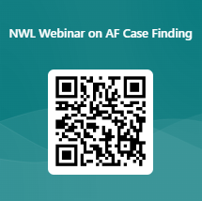
To get involved in ICHP’s CVD education series
Give us feedback on what topics you think we should cover in this format by answering our survey.
For further information and/or to get involved with the ICHP CVD education series please contact:
chanelle.corena@imperialcollegehealthpartners.com or catherine.caldwell@imperialcollegehealthpartners.com
Notes:
https://forms.office.com/e/0tZ9mkjTF5

