Slide 1
Using linked, integrated ‘big data’
to assess opportunities to improve health outcomes in the frail and sarcopenic
Sara Sekelj
Data Analyst
Notes:
What we do:
We turn the potential of innovation into reality to help solve our partners’ challenges. Imperial College Health Partners (ICHP) exists to accelerate the adoption and spread of innovation amongst our member organisations to transform care and maximise efficiencies for the benefit of patients. We connect a unique network of experts within and outside the NHS who together, through collaboration, are committed to solving the biggest challenges facing the health and healthcare of our population.
As a Partnership, we were designated Academic Health Science Network (AHSN) status in 2013. During our first five year license period we have established a strong and successful AHSN; one that is valued by our members and has connections that span the globe, enabling the latest learning and innovations to benefit our members and populations. We have achieved a lot, and also learned a lot.

Slide 2
Notes:
What we do:
We turn the potential of innovation into reality to help solve our partners’ challenges. Imperial College Health Partners (ICHP) exists to accelerate the adoption and spread of innovation amongst our member organisations to transform care and maximise efficiencies for the benefit of patients. We connect a unique network of experts within and outside the NHS who together, through collaboration, are committed to solving the biggest challenges facing the health and healthcare of our population.
As a Partnership, we were designated Academic Health Science Network (AHSN) status in 2013. During our first five year license period we have established a strong and successful AHSN; one that is valued by our members and has connections that span the globe, enabling the latest learning and innovations to benefit our members and populations. We have achieved a lot, and also learned a lot.

Slide 3
20 50k+ 2m
Partner staff residents
organisations
1 huge opportunity to make a
lasting difference
Together we aspire to create a health system
where what we know is what we do

Slide 4
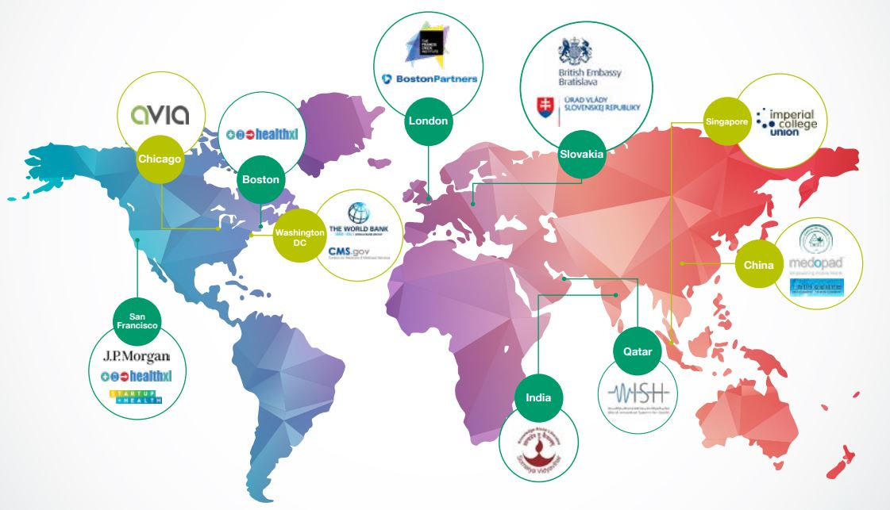
Increasingly global
Notes:
We work closely with a range of international partners to help share learning from North West London, as well as to help introduce international expertise to our members. These strategic relationships also offer vital investment and partnership opportunities for our sector, facilitating the export of many of our members’ innovations, as well as the opportunity to work with cutting edge industries to help improve their current healthcare services.

Slide 5
Working with and learning from the best

Slide 6
Dr Foster Global Frailty Score
Context
Frailty - important determinant of health outcomes and costs in aging populations
Developed from international datasets
Australia, Belgium, Denmark, England, Finland, Italy, Netherlands, Norway, USA
Aims
To explore predictive power of a model
To design an international weighted frailty index
Consists of 7 frailty groups:
Dementia and delirium
Mobility problems
Falls and fractures
Pressure ulcers and weight loss
Incontinence
Dependence and care
Anxiety and depression
Notes:
All analyses in this report are based on the frailty definitions developed within Dr Foster Global Frailty Score

Slide 7
Analysis plan
Along with 7 frailty groups covered in Dr Foster Global Frailty Score, 2 additional groups were included in the analysis:
Weakening (loss of appetite, anorexia)
Muscle weakness (muscle atrophy)
All patients >65
Admissions
In-hospital mortality rate
Frail patients >65
Admissions
30-day readmission
Long LOS >10 days
In-hospital mortality rate
30-day readmission
Long LOS
Notes:
The results are based on the data from five full calendar years, which are 2013 to 2017. 12 months of patient history was included as a lookback period to improve capture of clinical coding.
For example, muscle weakness would be flagged if muscle weakness is coded in current admission or in any previous admissions for a period of 12 months
All results are based on ordinary hospital admissions, including both elective and non-elective activity, but excluding day cases.
The analysis was done on all patients over 65 years of age, and repeated in all patients over 65 years of age considered frail by the Dr Foster Global Frailty Score
Outcome measures that were of interest were as follows: admissions, in hospital mortality rate, 30-day readmission, and long length of stay which was defined as over 10 days.

Slide 8
Associations of frailty and sarcopenia with outcomes of interest
Frailty
Independently predicted LOS where severely frail patients had 65%-89% longer hospital stays than non-frail patients
Sarcopenia
Predictive of in-hospital mortality
Increased postoperative complications after colorectal surgery
Frail patients with mean age of 79 years had longer LOS than non-frail
No association found between sarcopenia and outcomes
Not predictive of 6-month mortality or LOS

Slide 9
Hospital Episode Statistics (HES) data
Largest healthcare real world data in the world
10-year longitudinal dataset updated monthly
High level data published on the NHS Digital website
Processing record level data requires a licence held by health informatics agencies
HES ID numbers enable linked activity analysis over time
Pseudonymised dataset – used by the NHS for performance management and identifying areas amenable to improvement
Notes:
The analysis was done on Hospital Episode Statistics (or HES) data.

Slide 10
% of all admissions in the age group of 65+ year-olds
Notes:
Frailty aggregate is defined as presence of at least one of the seven frailty groups. As we can see from the graph, the frailty aggregate comes to 50%, meaning that 50% of all admissions had at least one of the frailty groups. The leading groups by % of admissions were Falls and Fractures and Dementia and delirium. Is is also seen from the graph that Muscle weakness associated conditions account only for 0.1% of all admissions in this age group.

Slide 11
Differences in outcomes for chosen groups of interest
Increased burden of admissions, readmissions as well as in-hospital mortality and LOS for frail patients compared to all >65 year-olds
Notes:
If we look at trends in outcomes within the three groups: all people over 65 years of age, frail patients and patients with registered muscle weakness, we can observe a trend in all selected outcomes. 42% of patients with muscle weakness have long LOS compared with 24% patients overall. In hospital mortality rate was 10% for patients with muscle weakness compared to 6% for all patients over 65 years of age.

Slide 12
In-hospital mortality rate in the age group of 65+ year-olds
Crude in-hospital mortality rate for patients with muscle weakness is 10.4%
Top 5 along with:
Pressure ulcers and weight loss
Weakening
Incontinence
Dementia and delirium
Notes:
We also compared the outcomes within the frailty groups included in Dr Foster Global Frailty Score and two added groups. Starting from in hospital mortality rate, we can see that muscle weakness group is among top 5 highest groups for in hospital mortality rate. The average mortality rate for any frail group is 8%

Slide 13
30-day readmission rate in the age group of 65+ year-olds
30-day readmission rate comparable within all frailty groups indicating the complexity and interlinkage of frailty associated conditions
Notes:
30 day readmission rate is comparable between all frailty groups. In average 23% of patients over 65 are readmitted within 30 days. The comparability of the frailty groups indicates the need for complex care of frail patients and therefore increased burden on the system

Slide 14
% of admissions with long LOS in the age group of 65+ year-olds
Dependence and care is leading group for % of admissions with long LOS (56.8%)
42.9% of admissions with muscle weakness had long LOS

Slide 15
Proportion of frail patients depending on LOS
Short LOS (0-5 days) has equal proportion of frail and non-frail patients over 65 years of age
86% of patients >65 years of age who stay in hospital over 40 days are frail

Slide 16
Conclusions
Frailty is an important determinant of health outcomes
Poor coding practice on muscle atrophy is not in line with the changing population and increased health needs of elderly
- Functional ability and intrinsic capacity (WHO)
Inclusion of sarcopenia in ICD-10 codes is necessary
The differences in total admissions with muscle weakness (0.1%) and the impact on outcomes that is seen point to the fact that these conditions are developed during patients’ stay
Further analysis would clarify the connection between the long length of stay and development of muscle atrophy
Improved coding practice would enable discussions around the burden of sarcopenia

Slide 17
Next steps…
Determine the relationship between muscle weakness and LOS
Access the Discover database
Target analysis on muscular-related observation/examination READ codes
O/E - muscle atrophy present
O/E - muscle tone hypotonic
O/E - muscle tone atonic
O/E - muscle power reduced
O/E - muscle power absent

Slide 18
Thank you!
ありがとうございました！

Slide 19
Acknowledgements
Collaboration:
Dr Foster worked together with clinicians from Guy’s and St Thomas’ hospital and international clinical leads to define frailty syndromes in secondary care data and test the research hypothesis
Publication:
Manuscript written and submitted for a publication in an academic journal with a title
The Dr Foster Global Frailty Score:
and international risk prediction model for hospitalised older persons derived from administrative datasets

